Slide 1
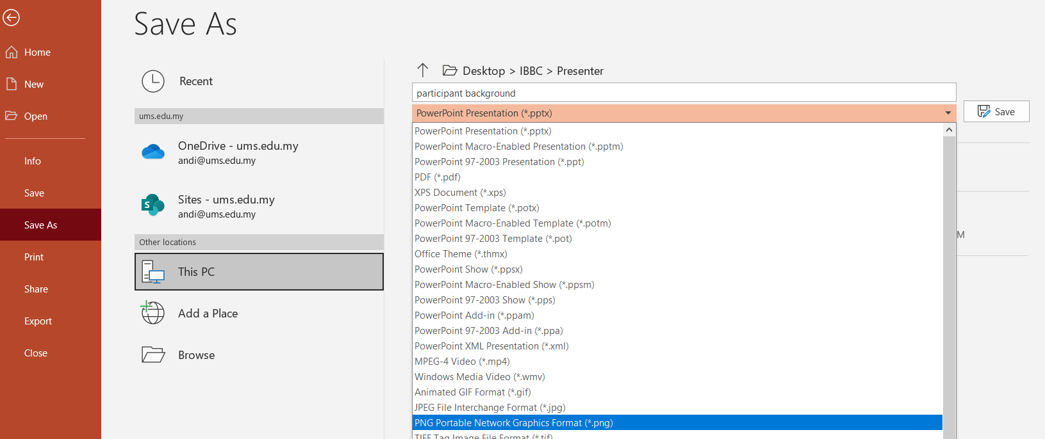
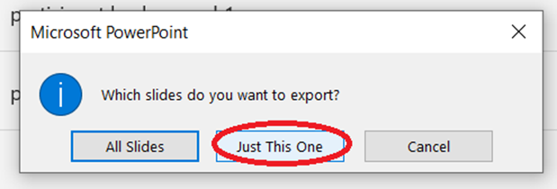
GUIDELINES : How to Save Background File
Please insert your name and affiliation in slide number 3.
Click File → Save as → Save the file as PNG Portable Network Graphics format (*.png)
Please select Just This One

Slide 2
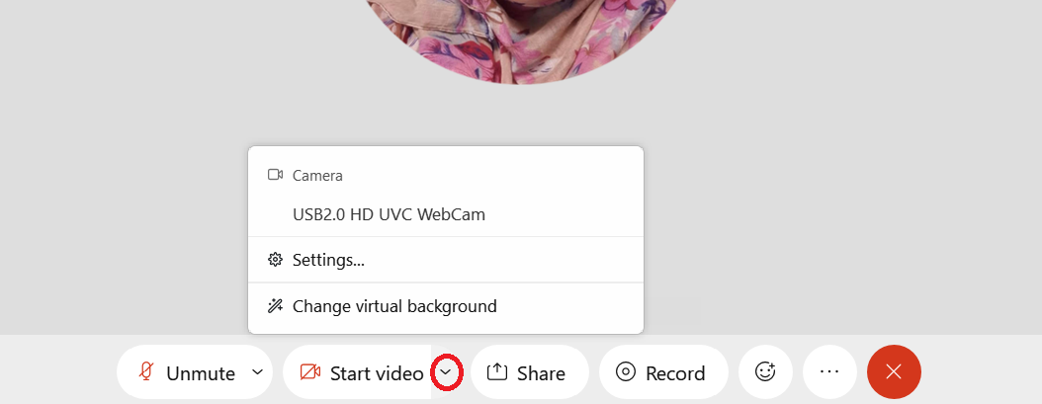
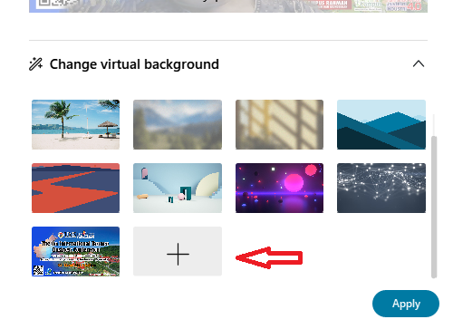
GUIDELINES: How to Change Virtual Background in Webex
Please click this cursor in the panel and select change virtual background.
Scroll down and click + image
Choose the background image and click open
Click Apply

Slide 3

INSERT YOUR NAME
INSERT YOUR AFFILIATION

