Slide 1

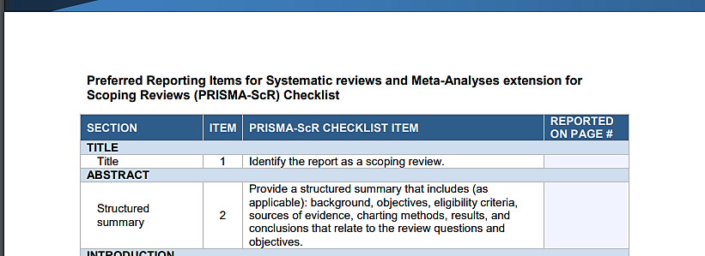
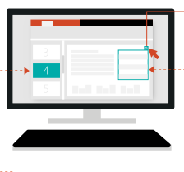
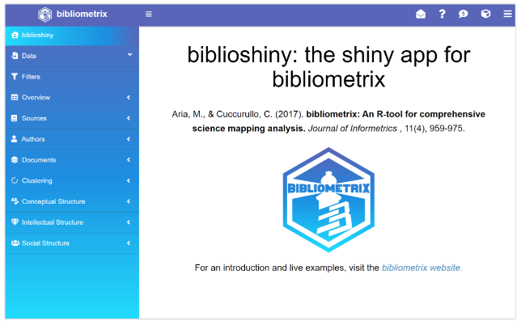
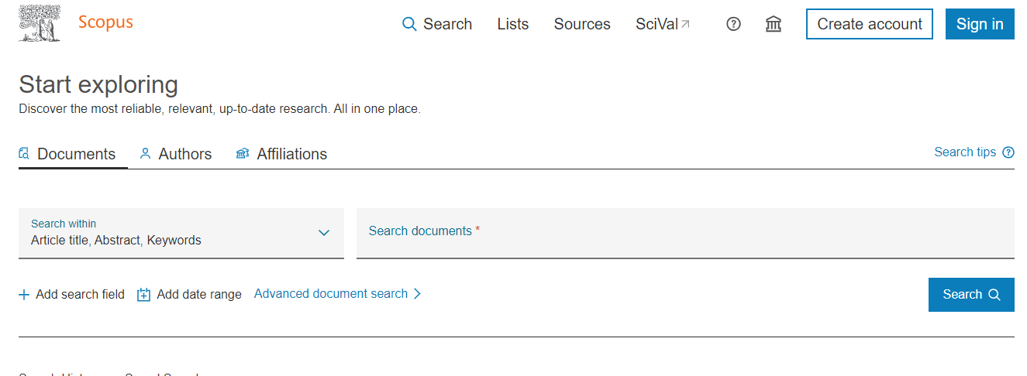
A Guide in The Application of Innovative Tools in Bibliometric
Analysis for Systematic Literature Review in Management and Business Study
Nor Azma binti Rahlin¹*, Faerozh Madli², Suddin bin Lada³ and Syarifah Hanum Ali⁴
¹Faculty of Business, Economics, and Accounting, Universiti Malaysia Sabah, 88400 Kota Kinabalu, Sabah, Malaysia.
Co-responding author email: norazma.rahlin@ums.edu.my *
Background of the study
Objective
The systematic literature utilizing bibliometrics is the most reliable strategy for summarising the growing body of knowledge. Nevertheless, existing studies on bibliometrics frequently differ in design, operational quality, and subjects under study. Each study may have a different approach, adding to the complexity of the indication and conclusion. However, its application in management and business study is still new and needs to be improved in many cases.
This study aims to provided recent user-friendly guide based on integrated tools in the bibliometric analysis required for systematic literature review in management and business study for novices and junior researchers.
Methodology:
The PRISMA scoping reviews and SCOPUS data-based have been utilized for completing a scoping review and data extraction. Bibliometrics R Studio programme and Microsoft Excel were used to analysis characterize the relationships between data information, analytic approaches and summarized results into a typology of literature review. PRISMA writing template utilized for full writing manuscript.
Result:
Result:
Find suitable topic of interest in Scopus data based
Identify research question in PRISMA template
Design literature review procedures/ methodology
Analysing data from SCOPUS data based by exporting to excel and bibliometix R Studio,
Results from SCOPUS data based extraction and biblioshiny summarized into the typology of literature review
Manuscript writing base on PRISMA systematic literature review template.
Conclusion:
This integrated tool is an innovation of bibliometric analysis for literature review, particularly beneficial for a broader application, especially non-coding users, to produce high-quality systematic literature. The results may fuel further study and add to the body of knowledge on the management and business study.
Notes:
A Guide in The Application of Innovative Tools in Bibliometric Analysis for Systematic Literature Review in Management and Business Study
The systematic literature utilizing bibliometrics is the most reliable strategy for summarising the growing body of knowledge. Nevertheless, existing studies on bibliometrics frequently differ in design, operational quality, and subjects under study. However, its application in management and business study is still new and needs to be improved in many cases.
This study aims to provided recent user-friendly guide based on integrated tools in the bibliometric analysis required for novices and junior researchers.
The PRISMA scoping reviews an template writing and SCOPUS data-based, Bibliometrics R Studio programme and Microsoft Excel were used of literature review.
1.Find suitable topic of interest in Scopus data based
2.Identify research question in PRISMA template
3.Design literature review procedures/ methodology
4.Analysing data from SCOPUS data based by exporting to excel and bibliometix R Studio,
5.Results from SCOPUS data based extraction and biblioshiny summarized into the typology of literature review
6. Manuscript writing base on PRISMA systematic literature review template.
This integrated tool is an innovation of bibliometric analysis for literature review, particularly beneficial for a broader application, especially non-coding users, to produce high-quality systematic literature. The results may fuel further study and add to the body of knowledge on the management and business study.

