Slide 1
Case Report: Counterclockwise Mesenteric Whirlpool Sign with Left Artery Pseudoaneurysm in a Case of Left Paravertebral Neuroblastoma
By
Cindy Chin*.Nor Fauziah Muhamad Handar,
Nur Aishah Binti Mohyin, Che Zubaidah Binti Che Daud³

Slide 2
Authors

Slide 3
Cindy Chin.
  Radiology Trainee
  Faculty of Medicine & Health Science, University Malaysia Sabah,Kota Kinabalu,Malaysia
  Radiology Department , University Kebangsaan Malaysia Medical Centre, Cheras,Malaysia
Nor Fauziah Muhamad Handar
  Radiology Trainee
  Radiology Department , University Kebangsaan Malaysia Medical Centre, Cheras,Malaysia
Nur Aishah Binti Mohyin
  Radiologist
  Women & Child Hospital Kuala Lumpur, Malaysia
Che Zubaidah Binti Che Daud
  Paediatric Radiologist
  Women & Child Hospital Kuala Lumpur, Malaysia

Slide 4
Objectives

Slide 5
This case report will explore and raised the awareness of counterclockwise mesenteric whirlpool sign as a normal variant. It should not be mistaken with the clockwise mesenteric whirlpool sign which is closely associated with malrotation or volvulus.
The misinterpretation of this counterclockwise mesenteric whirlpool sign as ‘midgut volvulus’ will result in serious clinical implications
This case is also reported to improve the understanding of renal pseudoaneurysm.
The knowledge on these two conditions are essential in proper management to avoid unnecessary surgery, additional radiographic investigations and life threatening complications.

Slide 6
Abstract

Slide 7
Background:The superior mesenteric vein(SMV) normally lies to the right of superior mesenteric artery(SMA) with its tributaries cross anteriorly to SMA in clockwise direction. Clockwise whirlpool sign is highly specific and sensitive in representing malrotation/volvulus. As opposed to this, counterclockwise rotation of SMV around SMA can be a normal variant. There have been only seven counterclockwise SMV rotation about the SMA with four of it proven to be negative for malrotation or volvulus.22% of the cases were found to be associated with intra-abdominal pathologies with 31% of them was due to left renal mass.Renal pseudoaneurysm is a rare vascular lesion likely due to under-reported asymptomatic cases. It have an estimated incidence of 5%. This arises when the arterial wall injury of the kidney is tamponade by the hematoma and form fibrosis encapsulating the haemorrhage, which resembles an aneurysmal sac.An unstable pseudoaneurysm can rupture and lead to life threatening haemorrhage.
Case Report: A 2 year old girl, presented with fever, left eye bruising and swelling for 4 days. CT Brain and Abdomen noted to have enhancing mass in middle cranial fossa and large left paravertebral mass adjacent to left kidney. Image guided biopsy of the left paravertebral mass was done and proven to be neuroblastoma. Upon reassessment with CT Abdomen after completion of chemotherapy, noted the large left paravertebral mass have reduced in size but there is a pseudoaneurysm involving branches of anterior segment of left renal artery and counterclockwise whirlpool sign of SMV branches .
Conclusion :It is important for radiologists to be aware of this normal CT appearance of mesenteric vessels which can be seen to avoid unnecessary laparotomy and increase load of additional investigations in the present era. Renal psudoaneurysm is also an important post renal biopsy complication that should not be miss to avoid life threatening situation.
Keyword: Counterclockwise whirlpool sign, Pseudoaneurysm of left renal artery, Left paravertebral neuroblastoma.

Slide 8
Clinical Data

Slide 9
A 2 year old girl, born full term, no significant antenatal history, born via vaginal delivery, no complication upon delivery, have normal development milestone, no family history of malignancy.
presented with fever, left eye bruising and swelling for 4 days. Denies of any abdominal pain or swelling , no altered bowel habit. No loss of appetite or loss of weight.
On physical examination, vague mass noted at left lumbar region. Otherwise, no neurological deficit or obvious abdominal distension
CT Brain and Abdomen( 20.2.2019) noted to have enhancing mass in middle cranial fossa and large left paravertebral mass adjacent to left kidney.
Image guided biopsy of the left paravertebral mass was done and proven to be neuroblastoma.
CT Brain, Thorax & Abdomen repeated on 15.4.2019 after completion of chemotherapy,

Slide 10
CT ABDOMEN DATED 15.4.2019
The previously seen large left paravertebral mass have markedly reduced in size currently measures 3.1x3.4x3.4cm(APxWxCC).
Counterclockwise appearance of the superior mesenteric vein branches (SMV),(>270 degree). No abnormal bowel dilatation. D3 of duodenum seen crossing to the left side posterior to the superior mesenteric artery(SMA) and superior mesenteric vein (SMV).
There is also an abnormal well defined enhancing lesion with peripheral hypodensity adjacent to the left renal pelvis measuring 3.2x3.4x3.0cm(APxWxCC).It has similar contrast enhancement with the aorta. Nipple sign seen at anterior aspect of it suggestive of pseudoaneurysm likely arising from the interlobar branches of anterior segment of left renal artery.

Slide 11
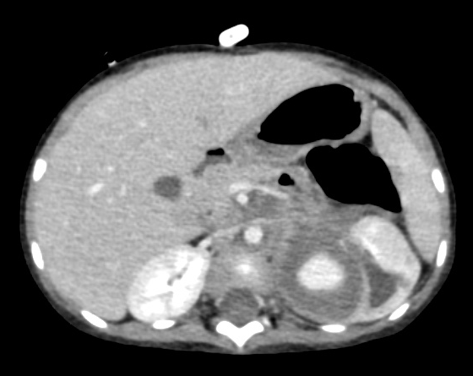
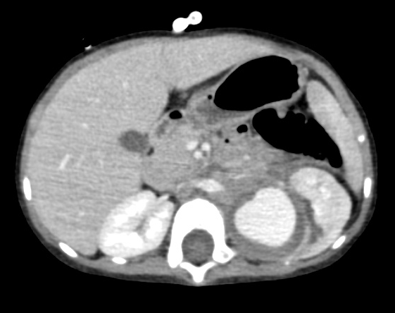
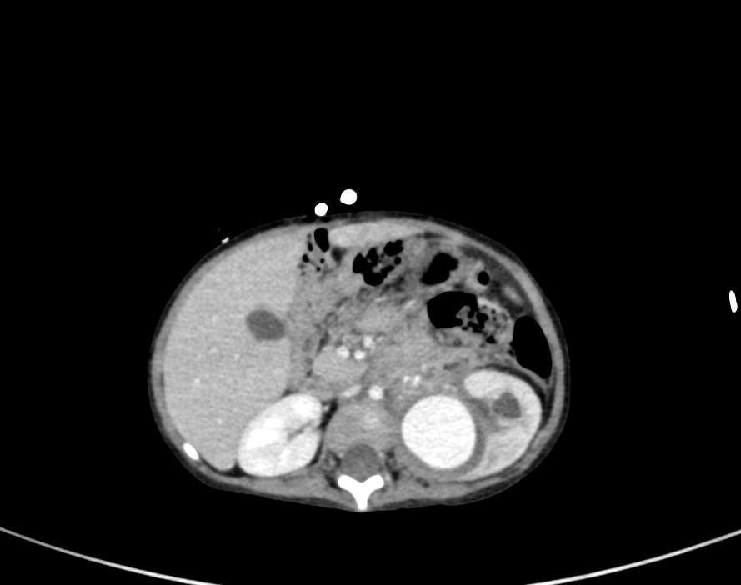
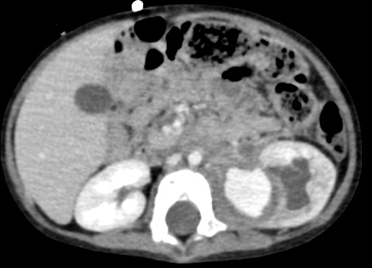
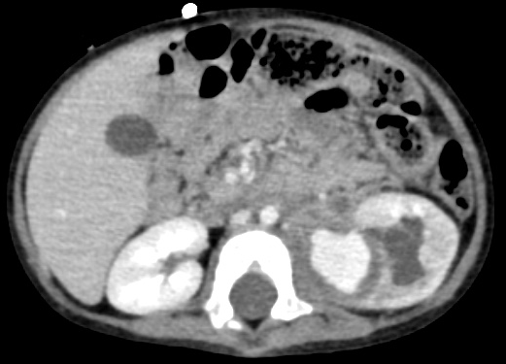

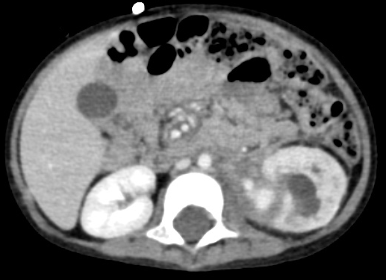
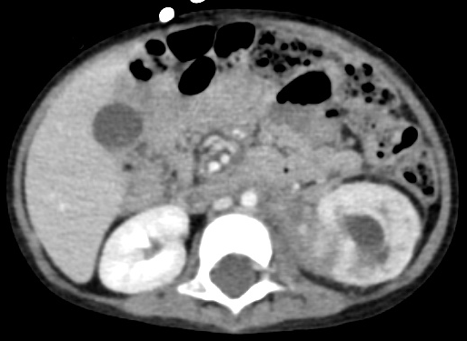
Black Arrow Head: SMV
Arrow: SMA
White Arrow Head:
Pseudoaneurysm

Slide 12
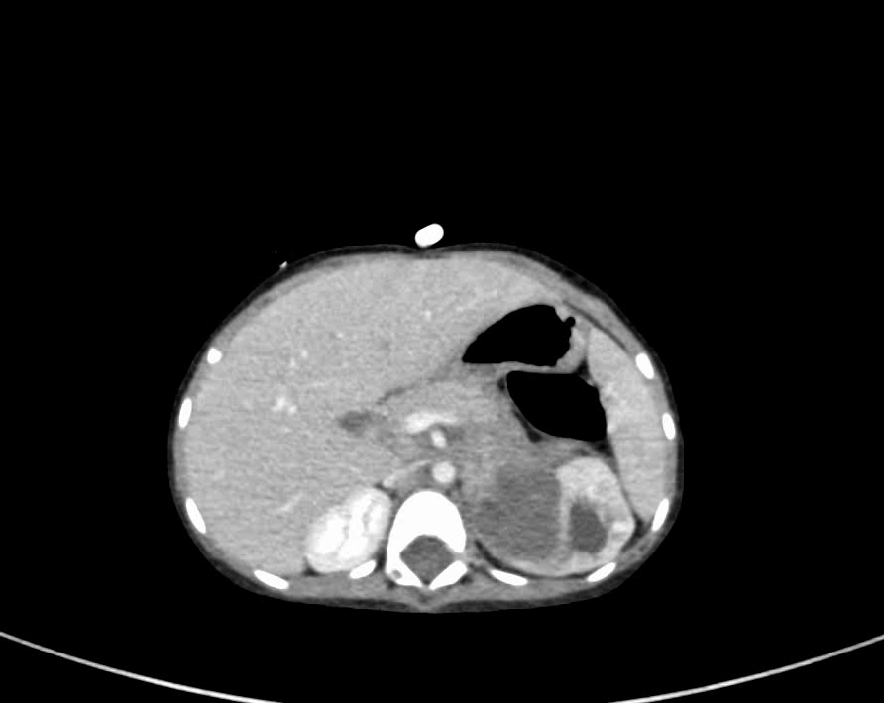

Slide 13
Discussion

Slide 14
In a common anatomic circumstances, the superior mesenteric vein (SMV) lies to the right of superior mesenteric artery (SMA) with its branches course anteriorly to the SMA in a clockwise fashion.
This can be appreciated on consecutive CT images seen from cranial to caudal direction with the SMA as the center axis^{1,2}
Several signs have been used to describe unusual relationships between the SMA and the SMV seen on imaging as well as their association with midgut malrotation and volvulus.
The commonly seen whirlpool sign was first described by Pracros et al as a clockwise wrapping of the SMV and mesentery around the SMA seen by ultrasound in patients with midgut volvulus.
Another less common pattern known as barber-pole or counterclockwise sign was described by Buranasiri et al in 1973. It was discovered as an angiographic sign demonstrated as a counterclockwise twisting of the mesenteric vessels upon themselves in a rare case of malrotation with counterclockwise volvulus.²

Slide 15
According to a study done by Shimanuki et al in 1996,the direction of the twisting mesenteric vessels is significant in their correlation with the presence or absence of volvulus.
In their study, three cases of a counterclockwise whirlpool sign that were thought to be caused by malrotation or volvulus through symptom or fluroscopic study was proven to be negative at surgery. The authors concluded that the counterclockwise pattern of SMA and SMV might be a normal variant.²
It occurs due to a proximal jejunal branch of the SMV which before joining the main SMV, circles in a counterclockwise fashion between SMA and aorta.¹
In K.S. Sodhi et al study , counterclockwise sign was reported to be present in 36% of the patients with no clinico-sonological profile suggestive of malrotation/volvulus.
In their study also, abdominal pathologies were encountered in 22% of the patients which could have possibly increased the degree of counterclockwise rotation.¹
However, counterclockwise rotation of SMV around SMA is a normal and non-specific finding, and can be seen in normal patients.This finding should not be misinterpreted as a partial or incomplete midgut volvulus. ²

Slide 16
Pseudoaneurysm form by cascade of events that occur in response to arterial wall injury.³
It started with the kidney tissue produce enough tamponade force surrounding the site of injury to slow down the bleeding and forms hematoma around the injured site. Subsequently, reactive fibrosis will occurs encapsulating the hemorrhage and form the aneurysmal sac.³
Pseudoaneurysm become life-threatening when there is loss of tamponade effect of the hematoma and connective tissue against the intraluminal hydrostatic pressure. This will cause rupture of the pseudoaneurysm and form perirenal hematoma which subsequently lead to hemorrhagic shock.³
However according to Tin C. Ngo et al study,the incidence of renal pseudoaneurysm following renal biopsy is estimated to be approximately 5%. Thus, they concluded that percutaneous renal biopsy is still a safe procedure with relatively low rate of major hemorrhagic complications.³

Slide 17
Conclusion

Slide 18
Conclusion
In short, just as the clockwise whirlpool sign has been shown to be a sensitive positive sign for midgut volvulus, the counterclockwise whirlpool sign can represent a normal relationship of the mesenteric vessels.
Therefore with a sound knowledge and awareness of the difference between the two whirlpool signs, unnecessary surgery and extra radiological examination can be avoided.

Slide 19
References

Slide 20
Kushaljit S. Sodhi , Anmol Bhatiaa,Akshay K. Saxenaa,Katragadda L.N. Rao, Prema Menon, Niranjan Khandelwal,Anticlockwise swirl of mesenteric vessels: A normal CT appearance,retrospective analysis of 200 pediatric patients, European Journal of Radiology 83 (2014) 710–714
Paul Clark , Lynne Ruess,Counterclockwise barber-pole sign on CT: SMA/SMV variance without midgut malrotation, Pediatr Radiol (2005) 35: 1125–1127, DOI 10.1007/s00247-005-1517-4
Tin C. Ngo, J. Joy Lee and Mark L. Gonzalgo, renal pseudoaneurysm: an overview, Nature Review Urology Vol.7, 619–625 (2010)

Slide 21
Thank you

