Slide 1

Bilateral internuclear Ophthalmoloplegia secondary to cerebellopontine angle tumor.
Dr Yap Jin Yi
Ophthalmology Department
FPSK, UMS.

Slide 2
Introduction
Internuclear ophthalmoplegia (INO) is an ocular movement disorder which is caused by a lesion in the medial longitudinal fasciculus (MLF) and it presents as inability to perform conjugate lateral gaze and ophthalmoplegia.¹
The commonest cause of INO among the young is demyelinating disease while among the elderly is cerebrovascular accident. ^{1,2} Rarely, brain tumor can result in INO as well.

Slide 3
Objectives
We hereby report a case of right cerebellopontine (CP) angle tumor that presented with bilateral INO.

Slide 4
method
Case report

Slide 5
results
A healthy 31-year-old lady presented with two-months history of right sided body weakness associated with blurring of vision and headache. Prior to the current presentation, she had been having right-sided hearing impairment and unsteady gait.
On examination, there was exotropia with adduction deficit bilaterally and horizontal abducting nystagmus on attempted gaze to the contralateral side (figure1). Also, there was right facial palsy with ipsilateral hearing impairment. Other cranial nerves examination was otherwise unremarkable. Her best corrected visual acuity was 6/10 for both eyes with no relative afferent pupillary defect and normal intraocular pressure. Fundus examination revealed pink optic disc with well-defined margin but there was increased cup disc ratio bilaterally. Neurological examination showed reduced power over the right side with hypertonia and hyperreflexia.

Slide 6
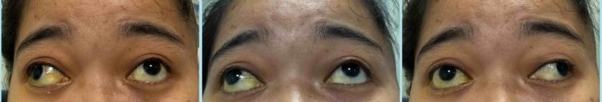
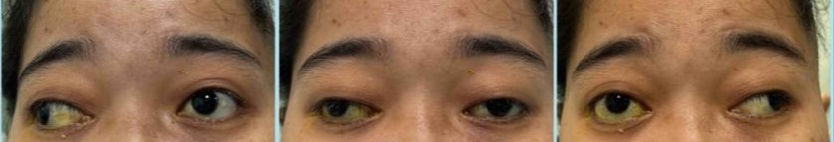
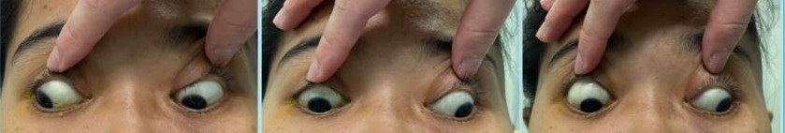

Figure 1: The extraocular muscle movements (exotropia with adduction deficit bilaterally and horizontal abducting nystagmus on attempted gaze to the contralateral side) showed the features of internuclear ophthalmoplegia.

Slide 7
Magnetic resonance imaging (MRI) brain was done, and it showed right CP angle tumor measuring 4.1cmx 5.4cm x 3.7cm with mass effect, hydrocephalus and cerebral edema (figure 2). The scan suggested the diagnosis of a huge right schwannoma at CP angle with severe mass effect to the brainstem and fourth ventricle.

Slide 8
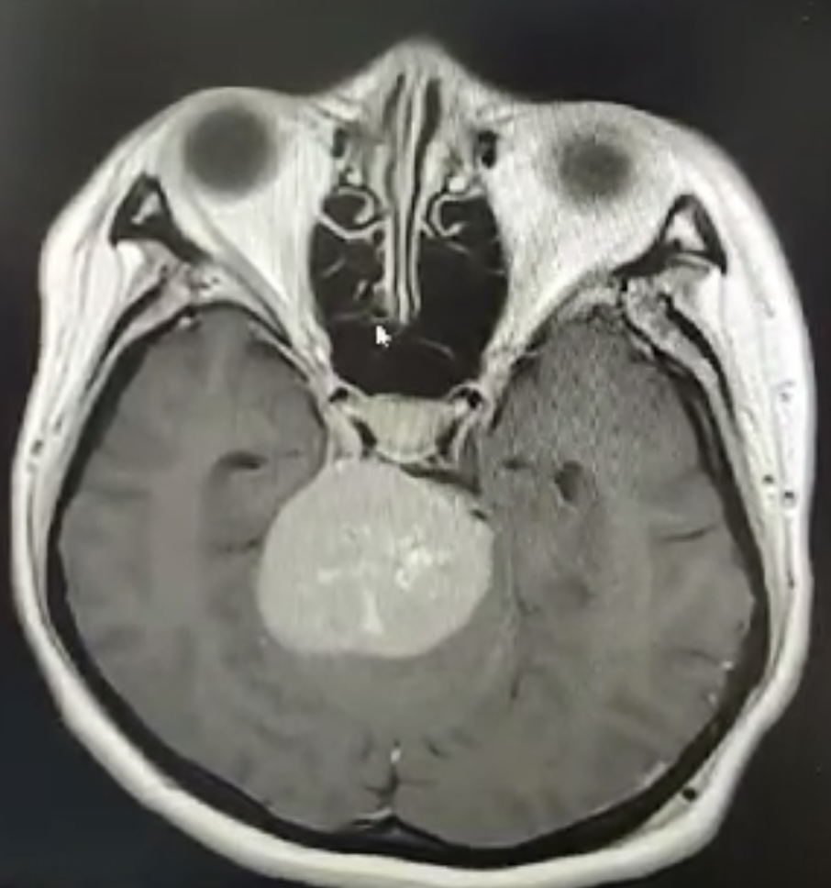
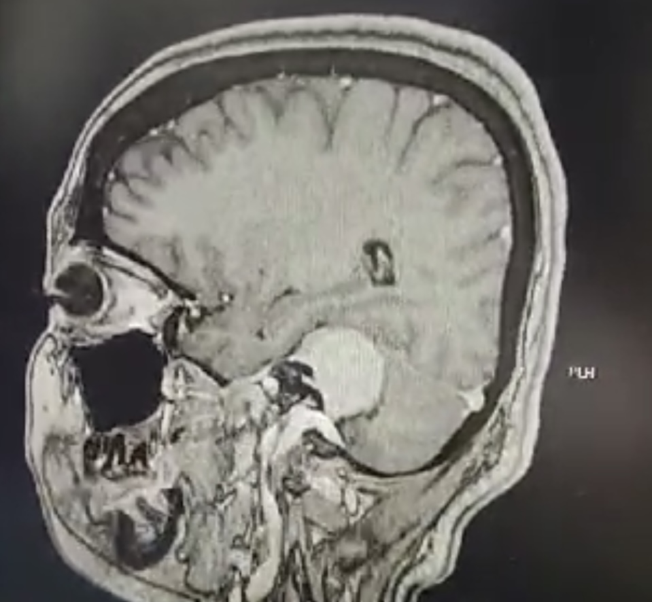
Figure 2: The axial and sagittal view of MRI brain showed right CP angle tumor measuring 4.1cm x 5.4cm x 3.7cm with mass effect, hydrocephalus and cerebral edema.

Slide 9
Discussion
The mechanism of tumour causing INO is explained by a lesion in the MLF that interferes the connection to the third cranial nerve subnuclei that is responsible for conjugate horizontal gaze arising from the final common pathway for horizontal gaze controlled by cranial nerve 6 nuclei. ³
However, the mechanism of INO caused by CP angle is not clearly known. CP angle is a triangular space in the posterior cranial fossa which houses cranial nerves 5, 6, 7 and 8 along with the anterior inferior cerebellar artery and a lesion in the CP angle commonly presented with hearing loss, tinnitus, vertigo, headache, dizziness and gait dysfunction.⁴

Slide 10
Mechanism of CP angle tumor causing INO in this case can be suggested by the extension of the tumor associated with hydrocephalus and cerebral edema as evidence from the CT brain.
Case reports also suggested that important factors in differentiating tumour from demyelinating disease with presentation of INO are young age, signs and symptoms of increased intracranial pressure and widespread brainstem abnormality. ⁵

Slide 11
Conclusion
Although the commonest presentation of bilateral INO among young patient is demyelinating disease, one important differential that need to be considered when a patient presents with INO associated with neurological signs is brain tumour as the treatment plan and prognosis is drastically different.

Slide 12
references
1. Keane JR. Internuclear Ophthalmoplegia: Unusual Causes in 114 of 410 Patients. Arch Neurol. 2005;62(5):714–717.
2. Bolaños I, Lozano D, Cantú C. Internuclear ophthalmoplegia: causes and long-term follow-up in 65 patients. Acta Neurol Scand. 2004 Sep;110(3):161-5.
3. Feroze KB, Wang J. Internuclear Ophthalmoplegia. [Updated 2023 Jun 26]. In: StatPearls [Internet]. Treasure Island (FL): StatPearls Publishing; 2023 Jan-. Available from: https://www.ncbi.nlm.nih.gov/books/NBK441970/
4. Lak AM, Khan YS. Cerebellopontine Angle Cancer. [Updated 2023 Jun 26]. In: StatPearls [Internet]. Treasure Island (FL): StatPearls Publishing; 2023 Jan-. Available from: https://www.ncbi.nlm.nih.gov/books/NBK559116/
5. A C Arnold. (1990). Internuclear ophthalmoplegia from intracranial tumor. J Clin Neuroophthalmol, 10(4):278-86.

