Slide 1

Rare ocular presentation in Miller fisher syndrome
Dr Yap Jin Yi
Ophthalmologist
Ophthalmology Department
FPSK UMS

Slide 2
Introduction
Miller Fisher Syndrome (MFS) is a rare variant of Guillain- Barre’s syndrome which characterized by the classic triad of ophthalmoplegia, ataxia and areflexia. In addition to that, optic neuritis may be a rare presenting feature of anti-GQ1b positive MFS.

Slide 3
Objective
We report a rare case of a young gentleman who presented with bilateral lower limb weakness which associated with bilateral ophthalmoplegia and reduced optic nerve function. His anti-GQ1b antibody was found to be positive.

Slide 4
Method
Case report

Slide 5
Results
A 24-year-old gentleman presented with bilateral lower limb weakness for 6 days which preceded with one-week history of influenza-like illness. It was associated with sudden, painless reduced vision over bilateral eye and diplopia.

Slide 6
On examination, his vision was 6/60 both eyes, relative afferent pupillary defects were equivocal and there were reduced red saturation, color vision and light saturation in both eyes. His bilateral extra-ocular muscle movements were restricted at medial, lateral, and superior gazes (figure 1). Bilateral anterior segment examinations were normal. Fundus examination showed bilateral optic disc swelling (figure 2).
His Humphrey visual field showed generalized visual field defects in both eyes.
Neurological examination showed marked bilateral upper and lower extremities weakness and absent of upper and lower deep tendon reflexes and Babinski’s reflexes

Slide 7
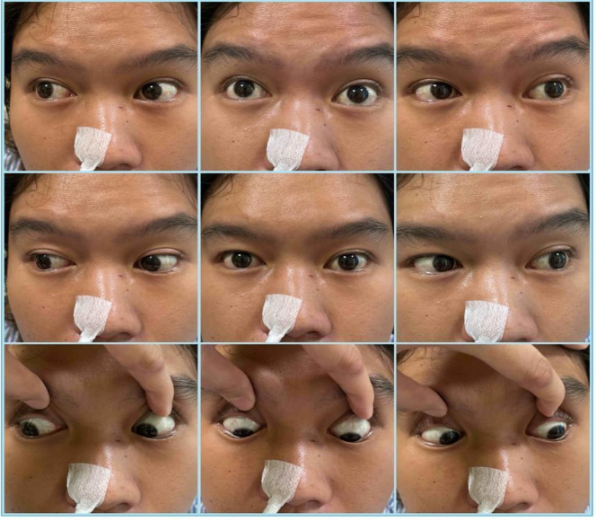

Figure 1 showed restricted EOM over medial, lateral and superior gaze bilaterally.

Slide 8
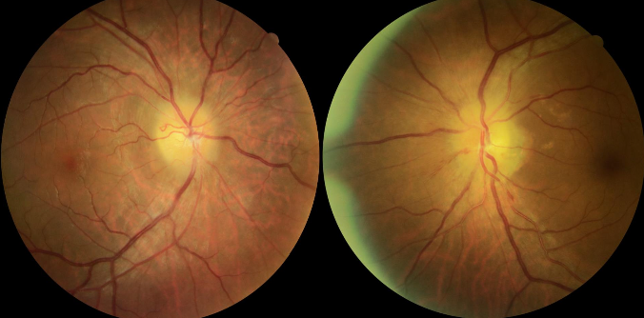
Figure 2: Bilateral optic swelling.

Slide 9
Lumbar puncture was done, and cerebrospinal fluid analysis showed albumin-cytological dissociation. His blood was sent for anti-GQ1b antibodies and found to be positive.

Slide 10
Discussions
The worldwide incidence of MFS is approximately 1 to 2 in 1,000,000.¹ It is thought to result from an aberrant autoimmune response to a preceding infection through molecular mimicry which drive the inflammatory response against the peripheral nerve.¹
Clinical hallmarks of MFS consist of triad presentations of acute ophthalmoplegia, areflexia and ataxia.¹ Diagnosis of MFS is usually by lumbar puncture and serology study. Lumbar puncture will show albuminocytologic dissociation in the cerebrospinal fluid whereby serology study will find antibodies against the GQ1b ganglioside.¹ Anti-GQ1b is a specific serological finding in MFS which found to be present in 90% of the patients.¹

Slide 11
Optic neuritis is a rare presentation in MFS and only 5 cases were reported in the literature.^{2,3,5} It is found to be associated with anti-GQ1B positivity from the reported cases.^{2,3,5} This could be due to IgM mediated inflammatory demyelination of optic nerve as optic nerve consists of high concentrations of GQ1b.⁴
MFS is usually self-limiting. However, it can be treated with supportive care and immunotherapy to encourage faster resolution of symptoms.¹ The mean recovery time range between 8-12 weeks with good prognosis.¹

Slide 12
Conclusion
Optic neuritis is an uncommon presentation of MFS which may make the diagnostic workup more challenging. It should be recognized as part of MFS especially in patients with presence of anti-GQ1b.

Slide 13
References
RochaCabreroF,MorrisonEH.MillerFisherSyndrome.[Updated2023Jun 26]. In: StatPearls [Internet]. Treasure Island (FL): StatPearls Publishing; 2023 Jan
OuhabiH,BourazzaA,RouimiA,BoutalebN,MosseddaqR.Névriteoptique bilatérale et atteinte ponto-mésencéphalique à l'IRM au cours d'un syndrome de Miller-Fisher [Bilateral optic neuritis and ponto-mesencephalic involvement shown by MRI in Miller-Fisher syndrome]. Rev Neurol (Paris). 1998;154(11):780-782.
Chan JW. Optic neuritis in anti-GQ1b positive recurrent Miller Fisher syndrome. Br J Ophthalmol. 2003 Sep;87(9):1185-6. doi: 10.1136/bjo.87.9.1185. PMID: 12928295; PMCID: PMC1771865.
Yoshino H, Maeda Y, King M, et al. Sulfated glucuronyl glycolipids and gangliosides in the optic nerve of humans. Neurology. 1993;43(2):408-411. doi:10.1212/wnl.43.2.408
YepishinIV,AllisonRZ,KaminskasDA,ZagorskiNM,LiowKK.MillerFisher Syndrome: A Case Report Highlighting Heterogeneity of Clinical Features and Focused Differential Diagnosis. Hawaii J Med Public Health. 2016 Jul;75(7):196-9. PMID: 27437164; PMCID: PMC4950094.

