Slide 1

WORKFORCE PLANNING
Precedes recruitment and selection
01
03
Integral part of strategic planning process
Skills required and positions to be filled
02
Dr. Jakaria Dasan

Slide 2



Forecasting Personnel Needs (Labor Demands)
Trend analysis is a study of a firm’s past employment needs (variations) over a period of years to predict future needs.
Ratio analysis – is a forecasting technique for determining future staff needs by using historical ratios between, for example, sales volume (causal factor) and number of employees needed.
3. Scatter plot is a graphical method used to help identify the relationship between two variables.
Dr. Jakaria Dasan
Notes:
To answer the question “How many people with what skills will we need?,” managers have to consider different factors:
A firm’s future staffing needs reflect demand for its products or services, adjusted for changes the firm plans to make in its strategic goals, and for changes in its turnover rate and productivity. Forecasting workforce demand therefore starts with estimating what the demand will be for your products or services.
Longer term managers will follow industry publications and economic forecasts closely, to try to get a sense for future demand. Such future predictions won’t be precise, but should help you address the potential changes in demand.
The basic process for forecasting personnel needs is to forecast revenues first. Then estimate the size of the staff required to support this sales volume.
However, managers must also consider other factors. These include projected turnover, decisions to upgrade (or downgrade) products or services, productivity changes, financial resources, and decisions to enter or leave businesses.
The basic tools for projecting personnel needs include trend analysis, ratio analysis, the scatter plot, and managerial judgment.
Trend analysis – Is a study of a firm’s past employment needs over a period of years to predict future needs.
Ratio analysis – Is a forecasting technique for determining future staff needs by using ratios between, for example, sales volume and number of employees needed.
3. Scatter plot – Is a graphical method used to help identify the relationship between two variables.
4. Managerial judgment – Few historical trends, ratios, or relationships will continue unchanged into the future so managerial judgment is needed to adjust the forecast.

Slide 3
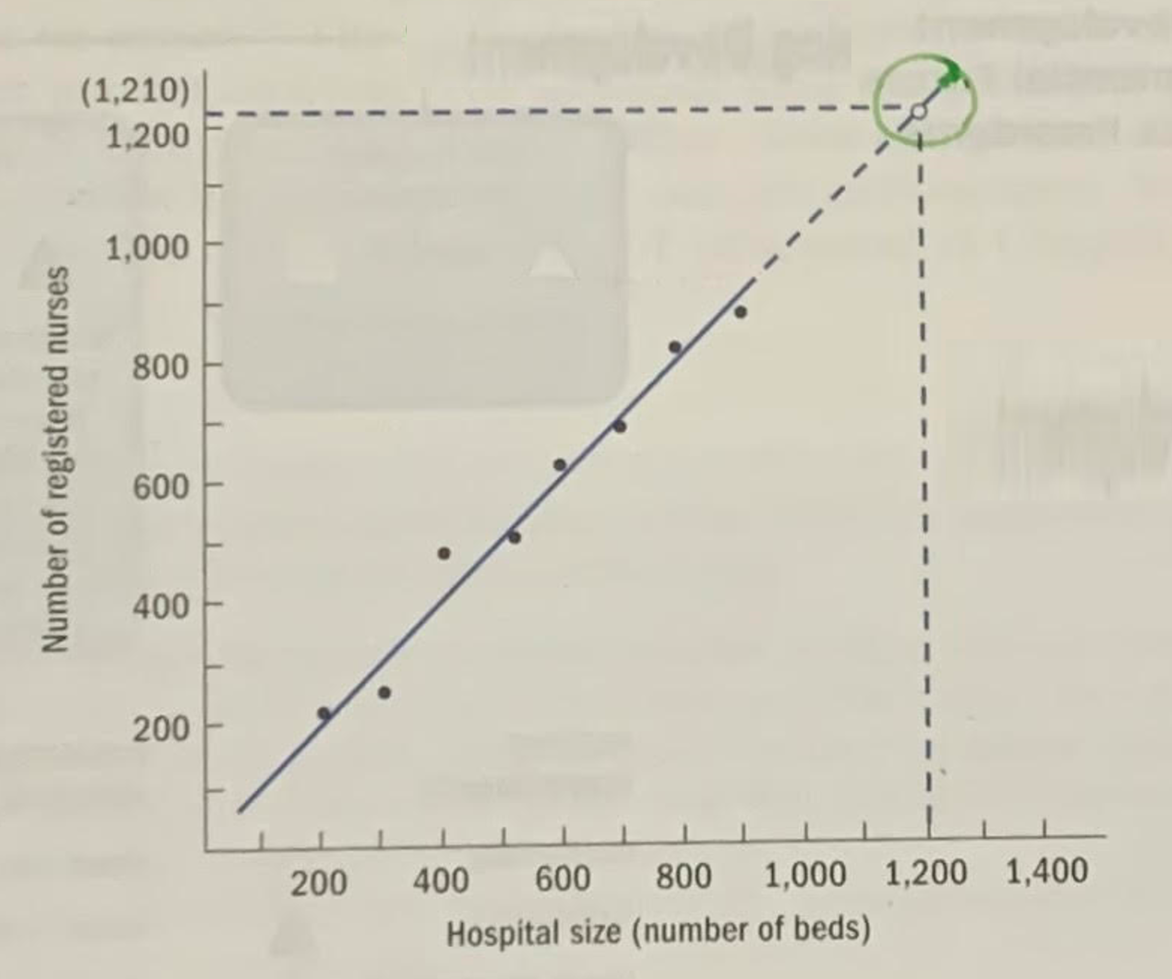
THE SCATTER PLOT
By carefully draw in a line to minimize the distances between the line and each one of the plotted points, you will be able to estimate the number of nurses needed for each hospital size
Graphically show how two variables are related?
Dr. Jakaria Dasan

Slide 4

WORKFORCE PLANNING
- Managerial Judgment -
Few historical trends, ratios, or relationships will continue unchanged into the future so managerial judgment is needed to adjust the forecast.
Why?
To upgrade the quality or enter a new market.
Technological and administrative changes.
Financial resources available
Dr. Jakaria Dasan

