Slide 1




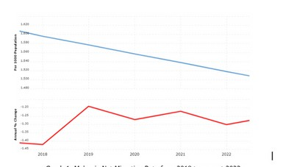
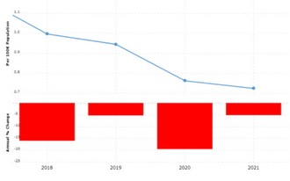





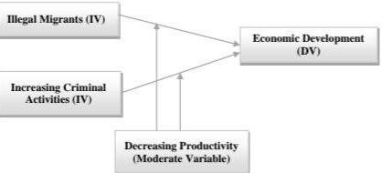





MIGRATION ISSUES: AN OVERVIEW
IN MALAYSIA
ADZLEE BIN JONIS, CHEONG JIA QI
INTRODUCTION
Migration means the movement of people or things from one place to another. People may move within their own country (Internal Migration) or across borders (International Migration).
ANALYSIS AND DISCUSSION
Comparison of Migration and Criminality Migration is one of the main factors
influence crime rates
Factor of Influence Into Criminal Rate Socioeconomic Challenges
Lack of Legal Status Exploitation byCriminal Networks Psychosocial Factors
Malaysia Net Migration Rate
that
Internal Migration: Movement within country's borders.
International Migration: Movement across international borders.
a
From towns to countryside, urban to rural areas, or between regions
Divided into immigration and emigration (movement out of a country).
from 2018 - 2023
Malaysia Crime Rate and Statistic
Discrimination Against Immigrants :
Unfair treatment based on ethnicity results in limited opportunities, lower wages, and negative impacts on both immigrants and their children.
In conclusion, there might be correlations or associations
between migration rates and crime rates in circumstances, whichis direct and universally relationship between the two is challenging.
specific coherent
LITERATURE REVIEW
Various categories of migration, including irregular migration in Malaysia, highlight the complexity of the issue.
ILLEGAL IMMIGRANT CATEGORY :
Unauthorized Entry and Employment; Authorized Entry but Unauthorized Employment;
Authorized Entry & Employment but Permits Invalid Refugees
Children of Undocumented Migrants
IMPACT OF ILLEGAL IMMIGRANT :
Crime and Migration
Public Perception and Statistics Health and Disease Impact
Economic Imbalance and Social Tension Productivity and GDP
Security Concerns and Border Management
RELATED ISSUES (RESEARCHER OPPINION) :
(Wickramasekara ,2012)
Immigrants are forced to abandon treatment or use unreliable means self- medication due to lack of insurance and medical support
(Fakhzan, 2011)
The increase in crime committed by immigrants this will result in prejudice against the hiring of local residents.
(McKenzie, 2009)
Employers will use foreign labor because the cost used is lower
RECOMMENDATION
Role of the Government Fortifying the Labor Market
Robust Awareness and Education Initiatives Employment Assistance Programme Screening and Vaccination Programs
LIMITATION AND FUTURE STUDY
LIMITATION
Limited Access Accurate & up-to-date Data
Reluctance of Migrants to Share Information
Language Barriers in Reporting Time Constraints
CONCLUSION
In short, foreign workers in Malaysia can cause problems like more crime and job issues. Malaysia has rules to manage this, but sometimes people use fake documents, making the problems worse.
FUTURE STUDY
Enhancing Data Collection and Sharing Fostering Trust and Openness Standardizing Language
Longer Time Report
To fix this, Malaysia needs to enforce rules, make the job market stronger, and teach people about it. The main goal is to create good rules that help the country and deal with these issues.

