Slide 1

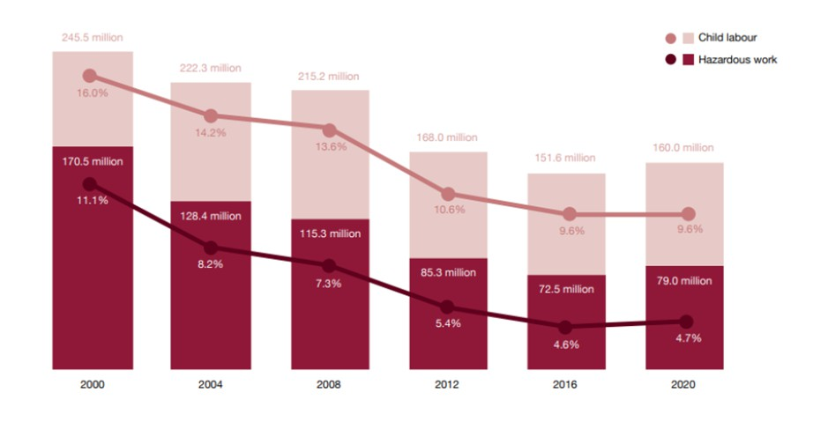
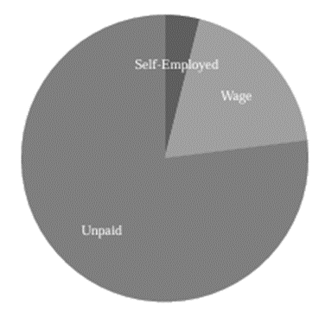

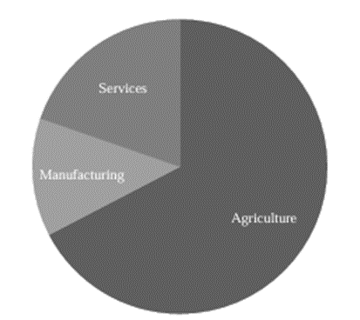






CHILD LABOR'S IMPACT ON SOUTH ASIAN ECONOMIES
Prepared by: Jeffrey Ivan Shafiq Dalmacio, Cheong Jia Qi
INTRODUCTION
Child labor, a pervasive issue across South Asia, exacts a profound toll on the region's economic growth and development. While the numbers tell a stark story, the faces behind the statistics represent a generation robbed of its potential. This infographic unveils the intricate web of consequences, illustrating how child labor, like a silent undercurrent, erodes the foundations of South Asian economies.
AIM FOR THIS STUDY LITERATURE REVIEW
Understanding the relationship between children's employment and economic growth, considering various factors influencing this dynamic.
ECONOMIC CONSEQUENCES OF CHILD LABOUR
Impact on human capital development
Emphasize the specific challenges faced by South Asian countries
Impact on productivity and efficiency
To influence laws that protect children's rights and advance economic development in order to bring about good change.
Poverty and economic conditions
FACTORS INFLUENCING CHILD LABOUR
Legislative and policy frameworks
ANALYSIS
Effects on education and skill development
SOCIAL IMPLICATIONS OF CHILD LABOUR
Psychological and emotional well-being
Health and safety concerns
Figure 2: Pay Status of Working Children
Figure 1: Percentage and number of children aged 5-17 years in child labour and hazardous work
Since 2016, global efforts against child labour have plateaued.
6.5 million more engaged in perilous labour.
The percentage of child labour remains unchanged globally.
Recent surveys reveal 30 million children employed,
17 million in child labour, and 50 million not enrolled in school.
Majority (74%) of working children in data- accessible countries engage in unpaid economic activities.
Child labour often entails unpaid work, commonly
in family settings, highlighting the need for fair treatment and protection of children's rights.
Figure 3: Distributions of Working Children by Sector
Highest child employment rates in agriculture across South Asian countries (46% to 94%).
Figure 3 shows diverse distribution - 25% in service sector, 13% in manufacturing.
Juvenile labour tied to industrialization, influenced by Karl Marx's idea of machinery replacing muscle power, prioritizing child and women labor.
DISCUSSION
EFFICIENCY AND PRODUCTIVITY
HUMAN CAPITAL DEVELOPMENT
HEALTH AND WELL-BEING
Short-term Gains: Child labour may boost household income and survival initially.
Long-term Price: Deprives
children of education and skill development, lowering human capital and perpetuating poverty.
Long-term Impediment: Child labour hinders human capital development, limiting long-term growth and societal progress.
Missed Opportunities: Working
children miss out on education and skill development, impeding workforce efficiency and future economic contributions.
Physical and Emotional Impact: Child labour exposes children to health hazards, impacting physical and emotional well- being.
Economic Consequences:
Detrimental health effects lead to long-term negative impacts on human capital, productivity, and healthcare expenses.
ENHANCE PUBLIC INVESTMENT
LIMITATIONS
The lack of comprehensive and reliable data, particularly in rural and informal sectors, hinders accurate research on child labor in South Asia, where underreporting and absence of official records pose significant challenges
Increase public investment in education in South Asian countries, aiming for at least 3% of GDP, to ensure inclusive and accessible basic education for all children and reduce the risk of child labor.
R E C O M M E N D A T I O N
CONCERNTRATE ON RURAL AREA
FUTURE STUDY
Should prioritize enhanced data collection through longitudinal studies, surveys, and collaboration with international
organizations.
CONCLUSION
Study emphasizes the need for better data on child labor in South Asia. Future research should focus on reliable methods like surveys and technology integration to inform policies effectively.
REFERENCES
Prioritize efforts to address child labor in rural areas, especially in agriculture, recognizing the higher prevalence and vulnerability of children in these settings.
POVERTY REDUCTION
Implement broad-based economic growth and development strategies to alleviate poverty, as poverty is a significant driver of child labor. Eliminate school fees to enhance educational opportunities and reduce the need for children to work.
MAINSTREAMING STRATEGY
Barkoukis, V., Koidou, E., & Tsorbatzoudis, H. (2010). Effects of a motivational climate intervention on state anxiety, self-efficacy, and skill development in physical education. European Journal of Sport Science, 10(3), 167–177.
Basu, K., & Van, P. H. (2005). The Economics of Child Labor. American Economic Review, 95(5), 1495-1524
Doroudiani, S., & Omidian, H. (2010). Environmental, health and safety concerns of decorative mouldings made of expanded polystyrene in buildings. Building and Environment, 45(3), 647–654.
Gunn, S., Jordans, M., Awan, A., Hofman, M., 2015. Development of an instrument for the psychosocial assessment of child workers. ILO.
Iivonen, S., Sääkslahti, A., & Nissinen, K. (2011). The development of fundamental motor skills of four‐ to five‐year‐ old preschool children and the effects of a preschool physical education curriculum. Early Child Development and Care, 181(3), 335–343.
International Labour Organization. 2018. “National Child Labour Legislation, Policy and Programme Review.” Ilo.org. International Labour Organization. 2020.
ILO to consider sweeping universal ban on worst forms of child labour. (1999, May 25). Www.ilo.org. https://www.ilo.org/global/about-the-ilo/newsroom/news/WCMS_007930/lang--en/index.htm
International Labour Organization. 2020. “What Is Child Labour (IPEC).” Ilo.org. International Labour Organization. 2020.
Lambert, S. F., Nylund-Gibson, K., Copeland-Linder, N., & Ialongo, N. S. (2019). Patterns of Adolescent Peer Socialization: Ethnicity and Depressive Symptoms. Journal of Public Health, 41(1), 18-25.
Maheshwari, M., & Singh, M. (2008). Factors affecting Child Labour in India. RePEc: Research Papers in Economics. 11. McGrath, S., & Powell, L. (2016). Skills for sustainable development: Transforming vocational education and training
beyond 2015. International Journal of Educational Development, 50, 12–19.
12. Redd, T. K., Read-Brown, S., Choi, D., Yackel, T. R., Tu, D. C., & Chiang, M. F. (2014). Electronic health record impact on productivity and efficiency in an academic pediatric ophthalmology practice. Journal of American Association for Pediatric Ophthalmology and Strabismus, 18(6), 584–589.
13. Singh. (2001). Child labour in India: Some reflections. The Indian Journal of Labour 14. Economics, 40 (4): 819-828.
15. Zavyalova, E. K., & Kosheleva, S. V. (2010). Gender stereotyping and its impact on human capital development in contemporary Russia. Human Resource Development International, 13(3), 341–349.
Integrates child labor concerns into various policies, plans, budgets, and development initiatives, encompassing social welfare, employment rights, child rights, and labor market information systems.

