Slide 1
ACTIVITIES PART 1
Excel in Excel : Chart & Visualisation
by
Sharifah Milda Amirul (Ph.D)
Accounting Lecturer, UMS

Slide 2
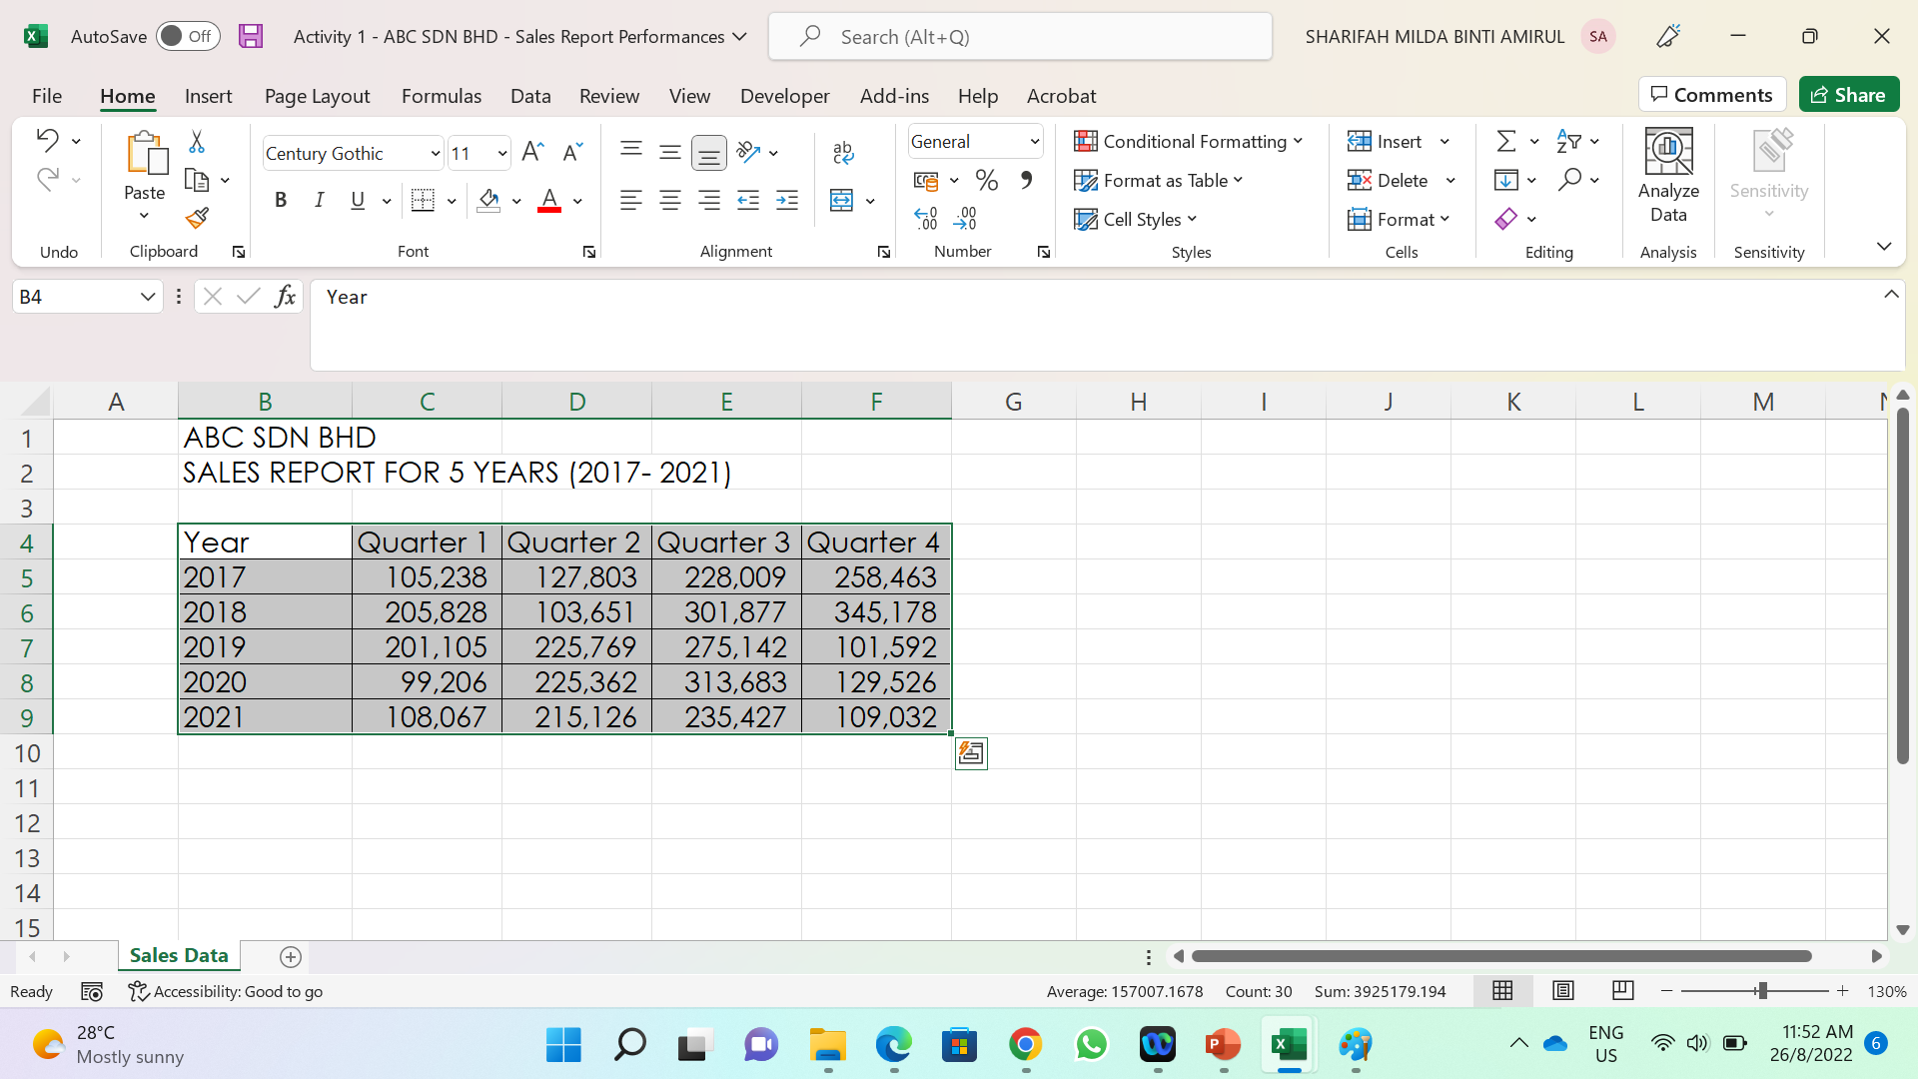
1. Sales Performance Analysis: Visualizing Through Data Point
To visualize the Sales Performances of ABC Sdn. Bhd. for the past 5 years, follows the following steps:
Load the ABC Sdn Bhd Sales Report File.
Select the cell from B4 to F9 – click cell B9, press shift and hold it, then click on the cell F9 (the cell ranges from B4 to B9 is now selected). Refer to Figure 1.1
Figure 1.1

Slide 3
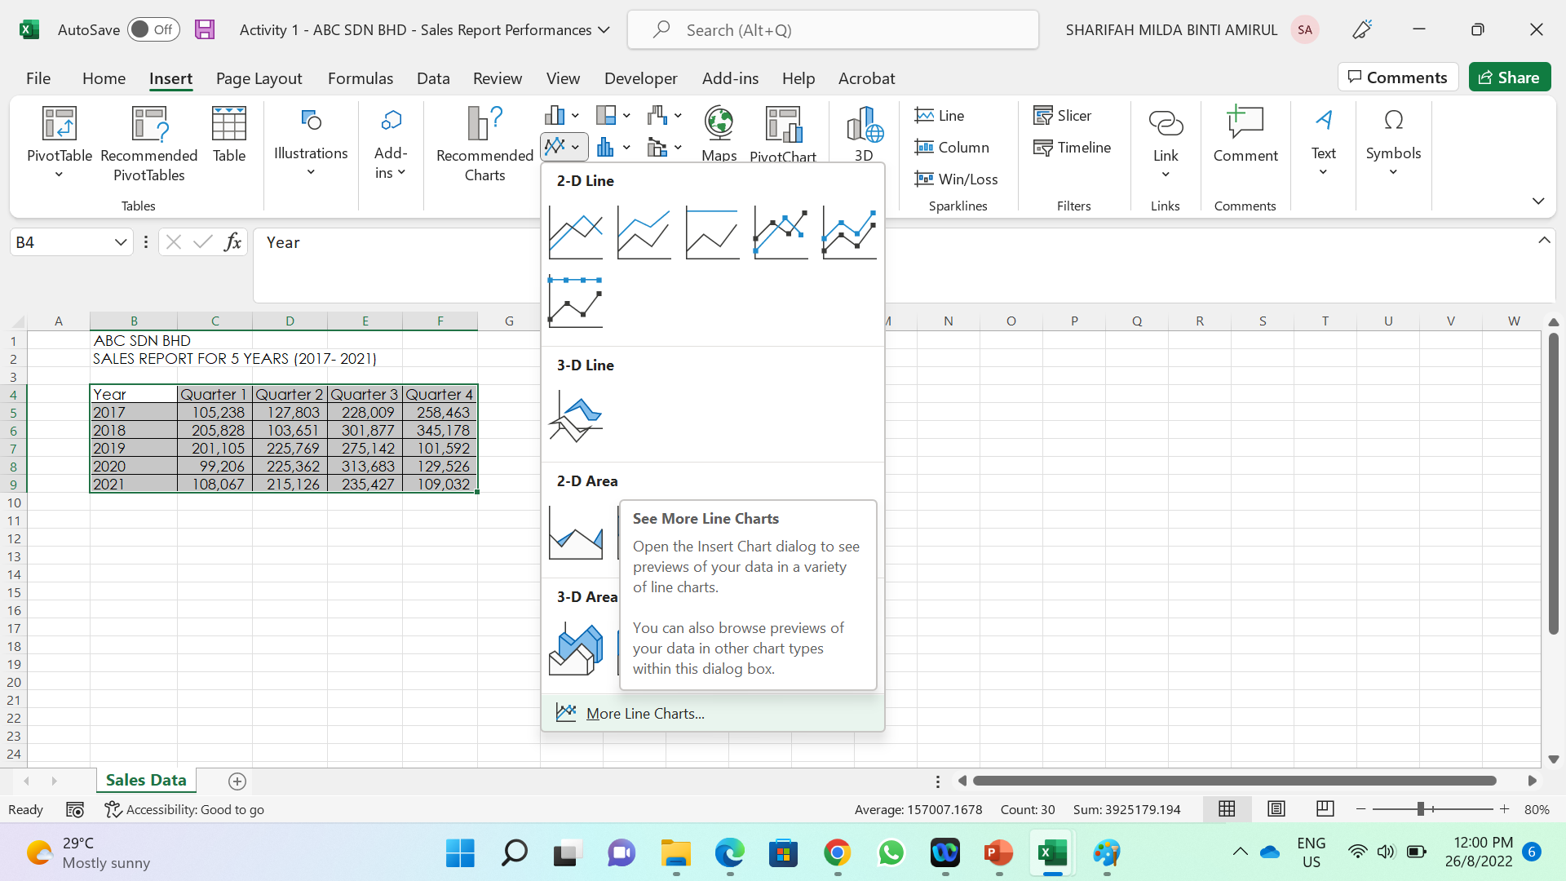
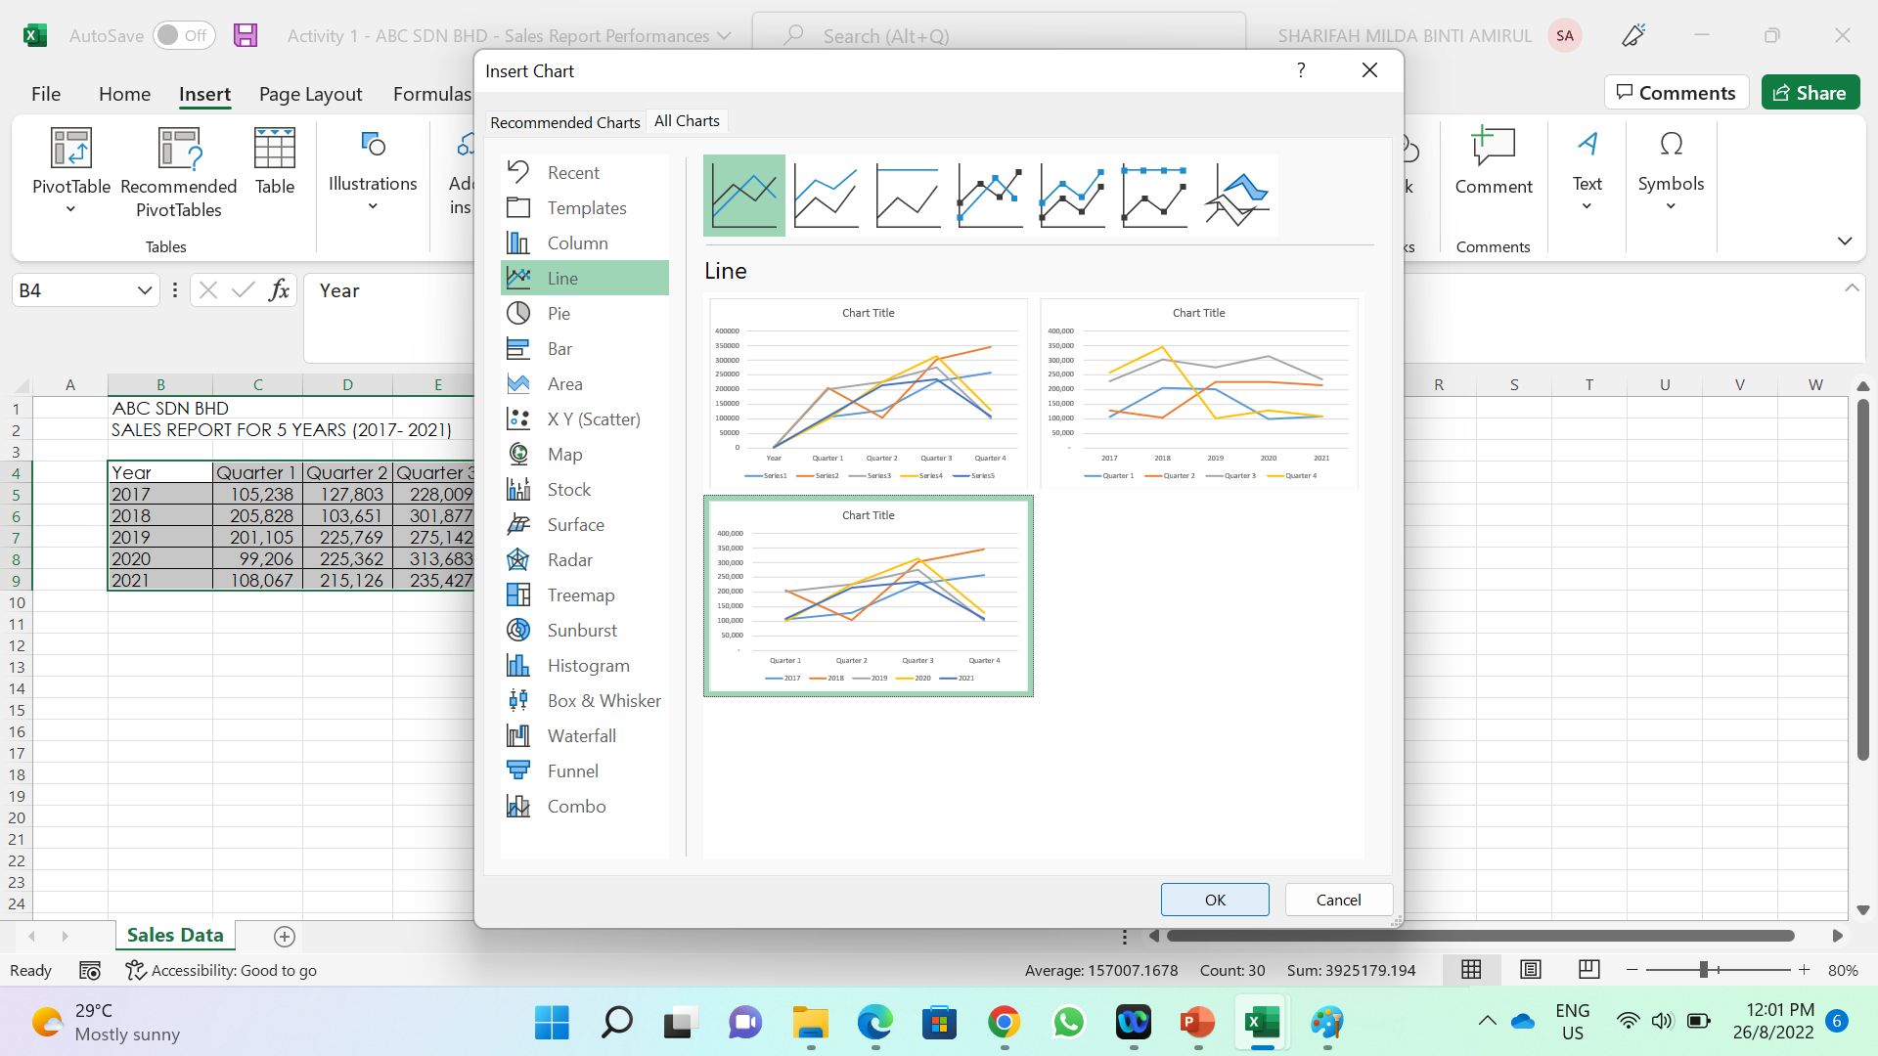
Then, go Insert tab > Line Chart > More Line Charts (see Figure 1.2)
Select chart with Quarterly Representation (see Figure 1.3)
Edit the Chart Title to ABC Sdn Bhd Sales Performances
Figure 2
Figure 1.2
Figure 1.3

Slide 4
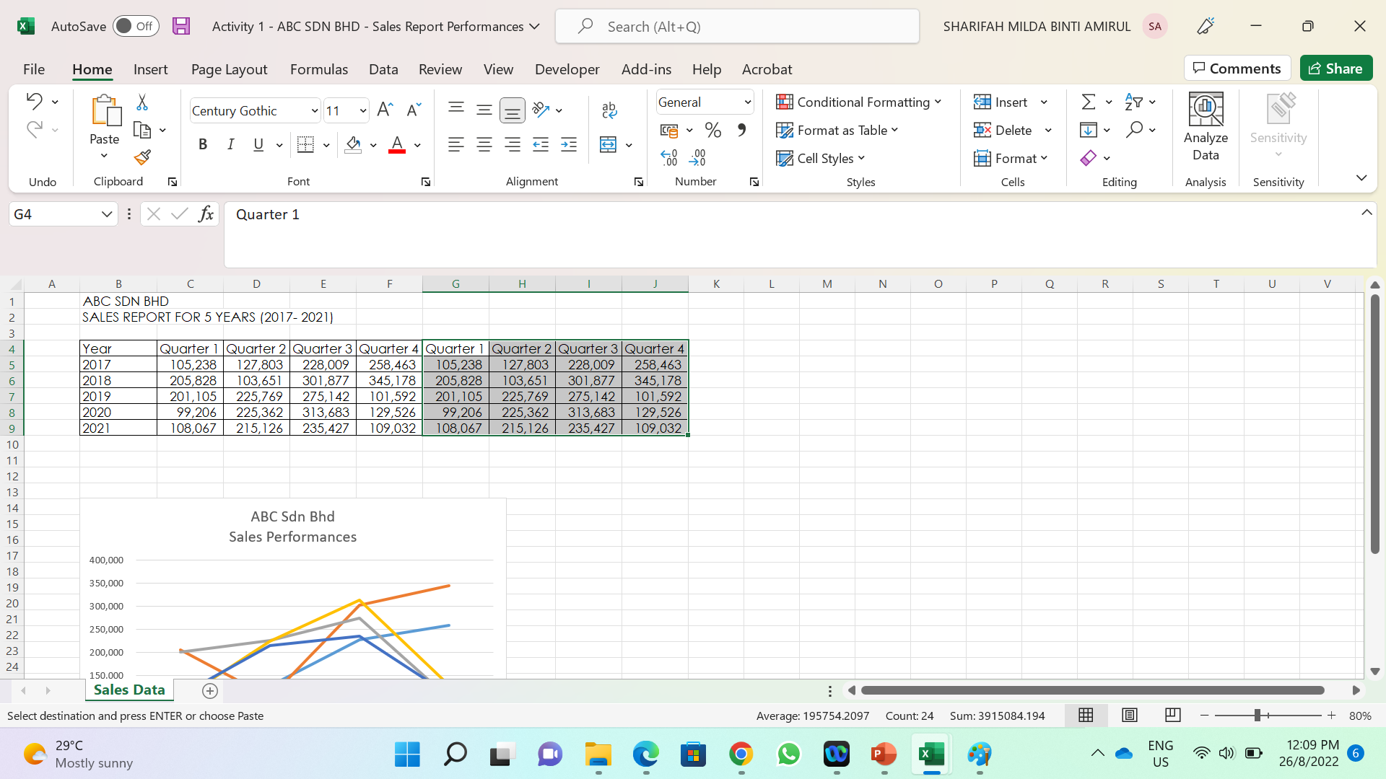
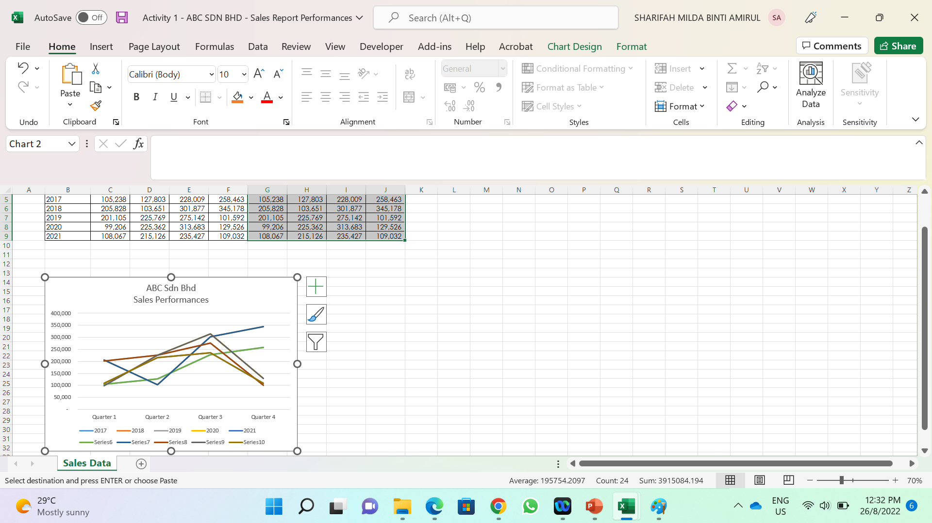
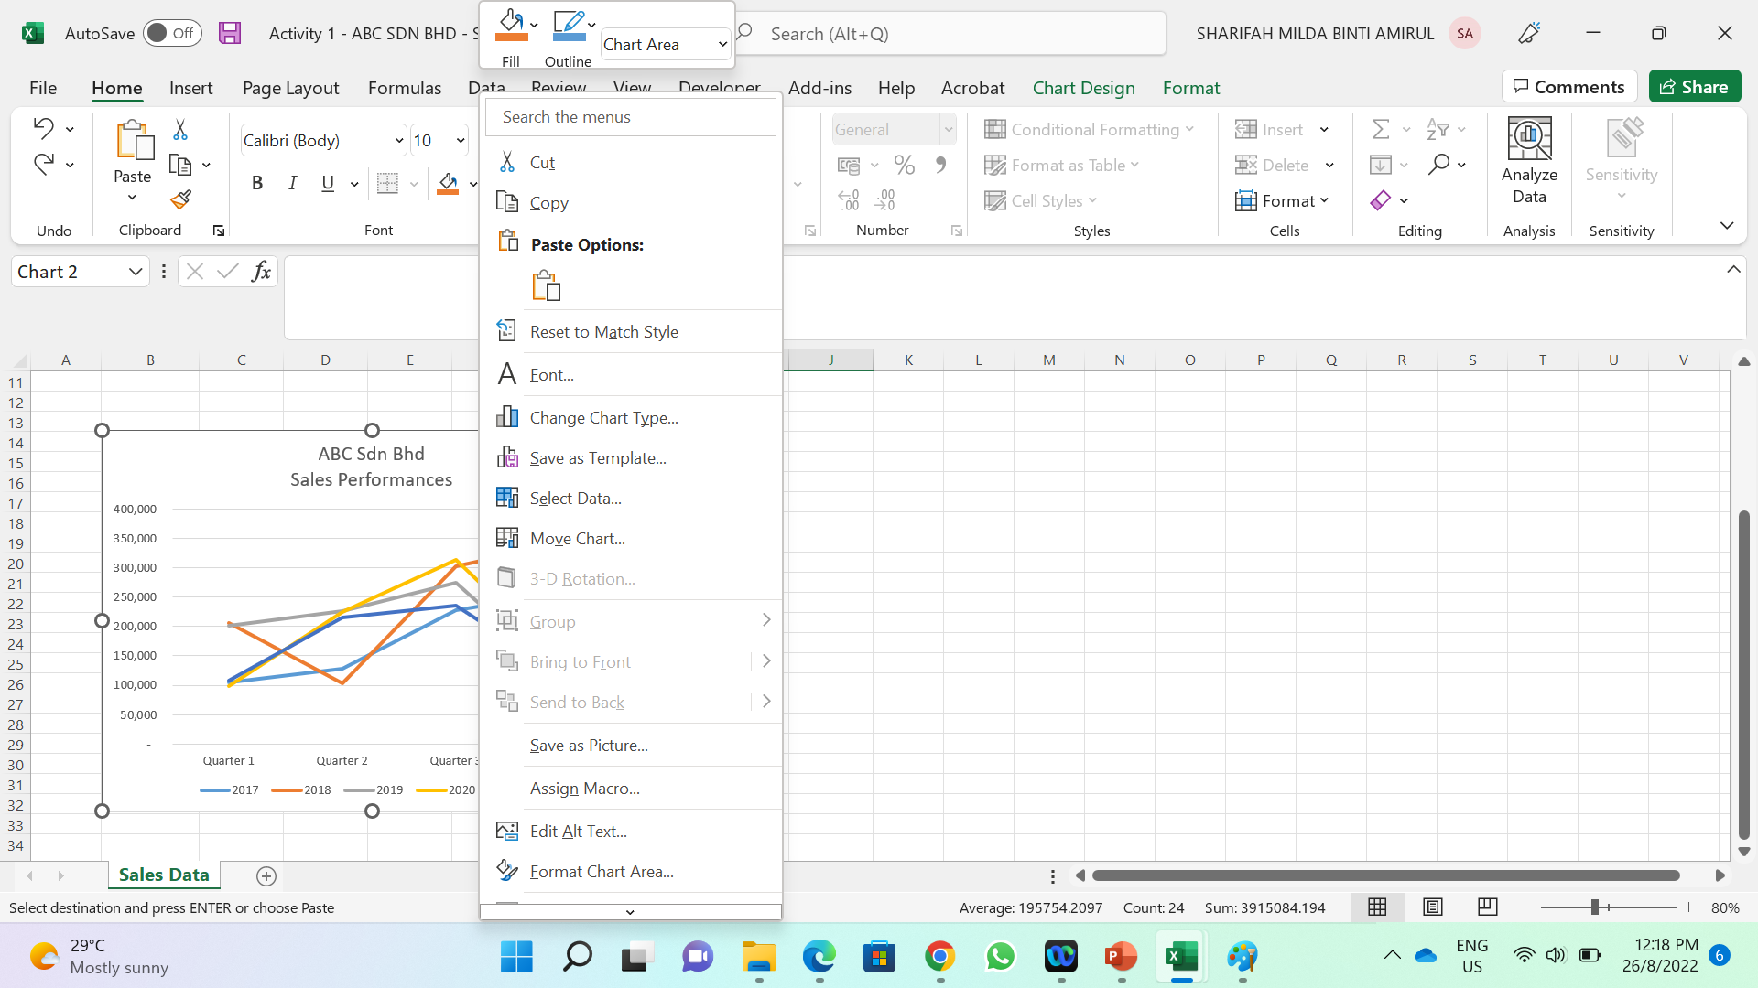
Next, select cells range from C4 to F9, press ctrl C, then go cell G4 then type ctrl V (see Figure 1.4)
Next, select the cells G4 to J9, copy and paste the values on top of the line chart created earlier.
To do so, right click on the line chart, and click paste (see Figure 1.5)
You can see now the Line Chart has changed in colours (there are double lines on each line of the charts, see Figure 1.6)
Figure 1.4
Figure 1.6
Figure 1.5

Slide 5
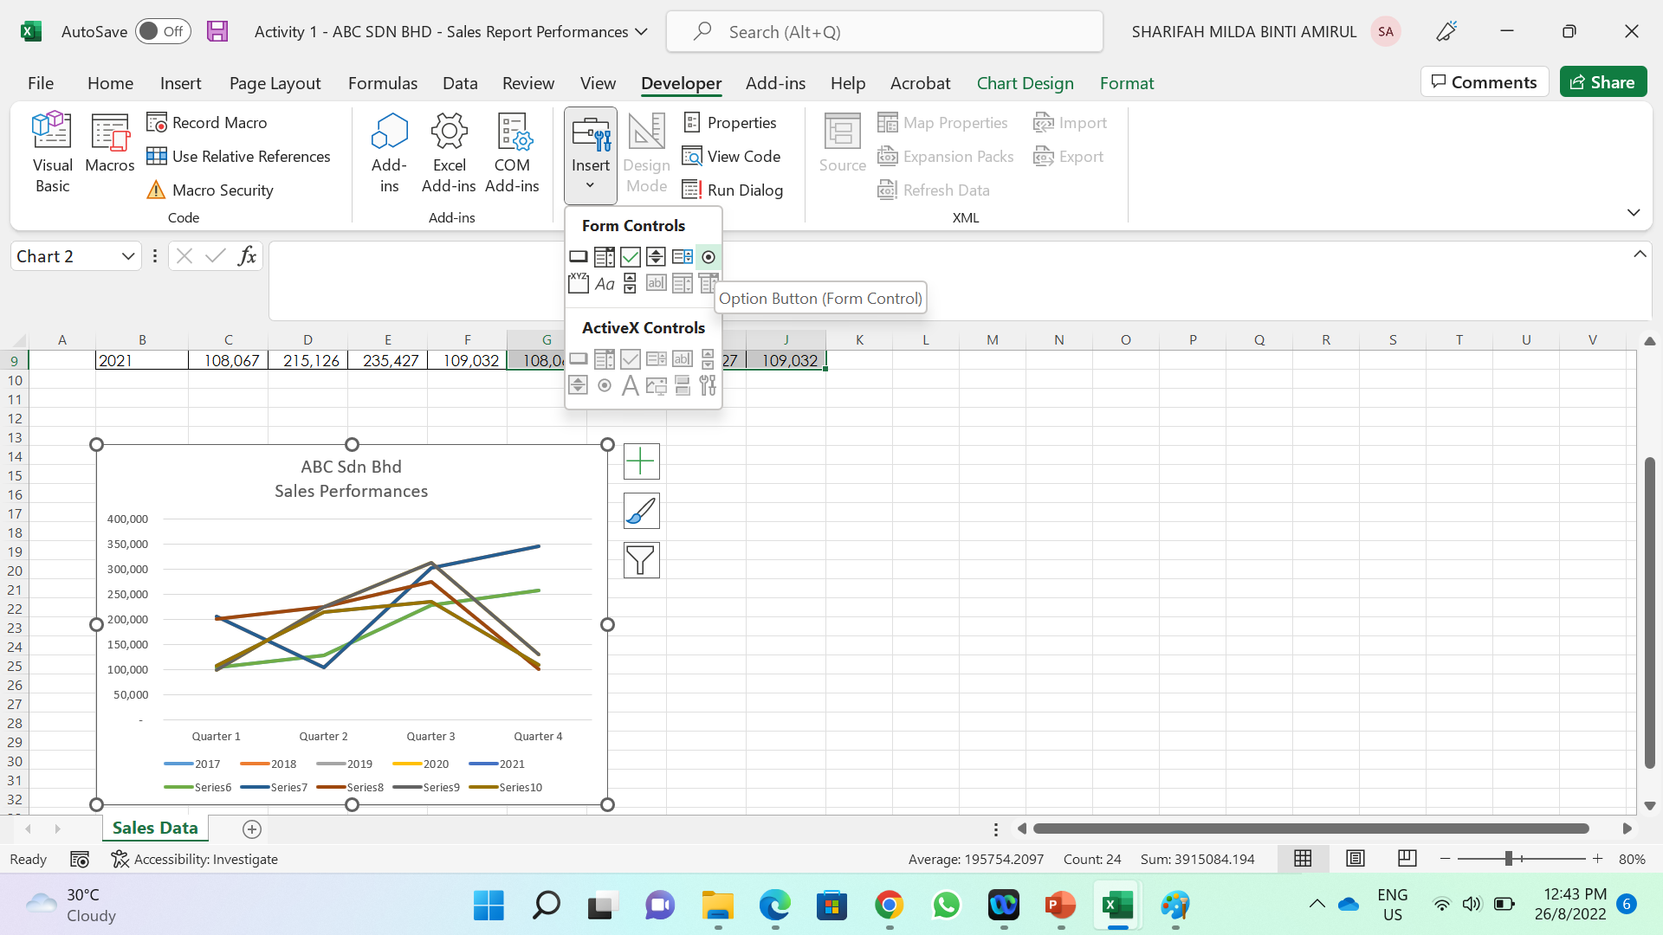
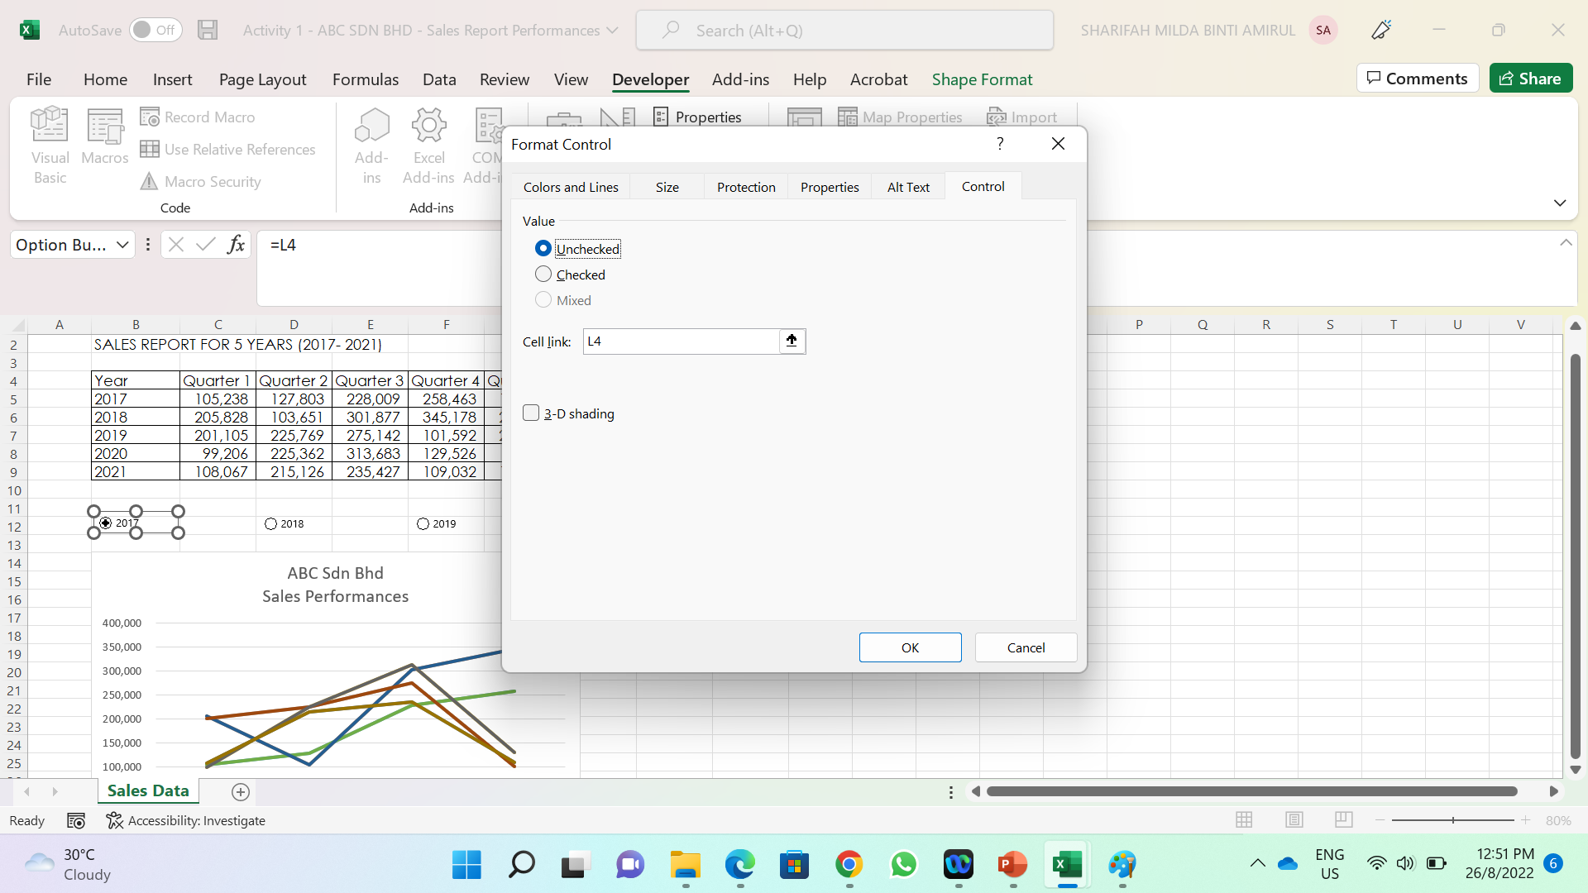
Next, we will insert buttons to easily view our charts based on each year performance. Go to Developer Tab > Insert > Form Controls > Button (see Figure 1.7)
The cursor will change to plus sign, then click on cell B12 to insert the button.
Right click on the button and click on edit text to change the name to 2017.
Then, right click again and now choose form control. In cell link box type L5 (see Figure 1.8).
You can now copy and paste the button for the remaining years (2018, 2019, 2020 and 2021).
To check if buttons are working appropriately click on each button and see if the value in cell L5 changes when you click each button accordingly.
Figure 1.7
Figure 1.8

Slide 6
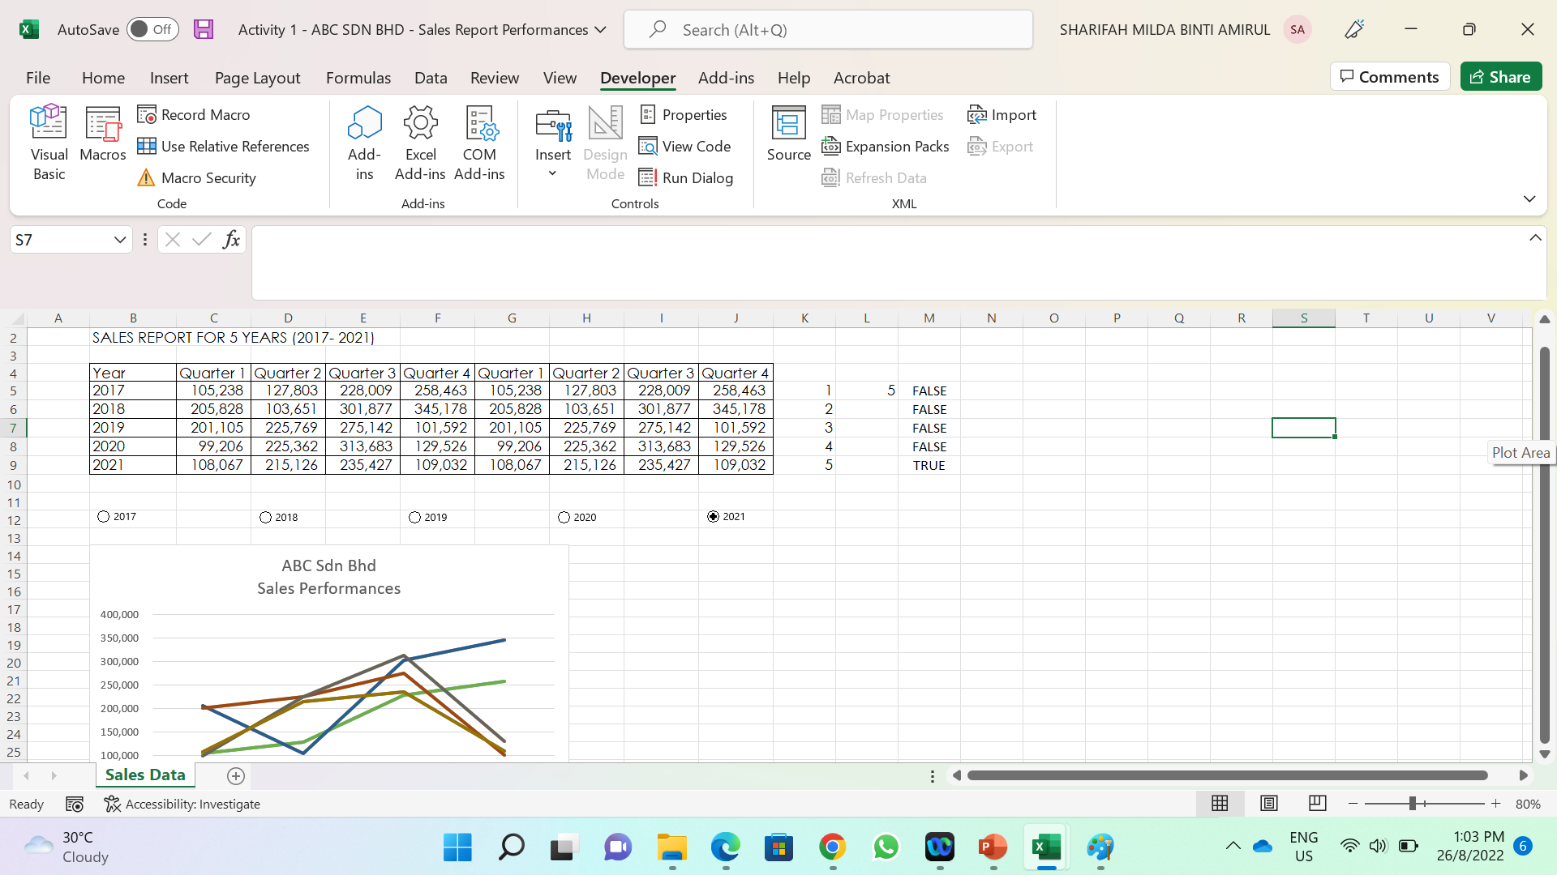
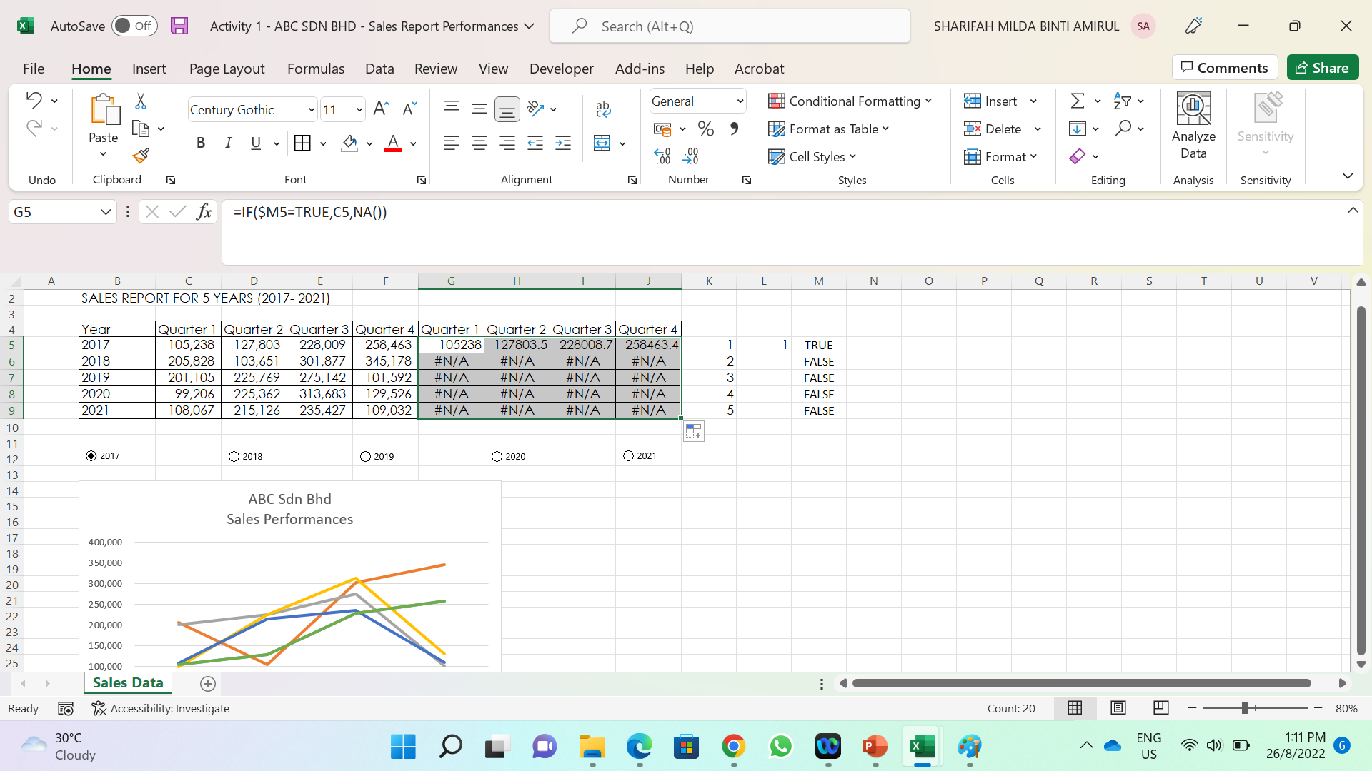
Next, go to cell K5 then type series of number from 1 to 5, across cell K9.
Then, in cell M5, type this formula =$L$5=K5 and drag the fill handle down to cell M9 (see Figure 1.9).
After that, go to cell G4, then replace the existing value with this formula =IF($M5=TRUE,C5,NA()). Drag this formula all the way to cells range from G5 to J9 (see Figure 1.10)
Now, it time to adjust the line chart. Click 2017 button and right click on the relevant data series in the chart. Click Format data series.
Figure 1.9
Figure 1.10

Slide 7
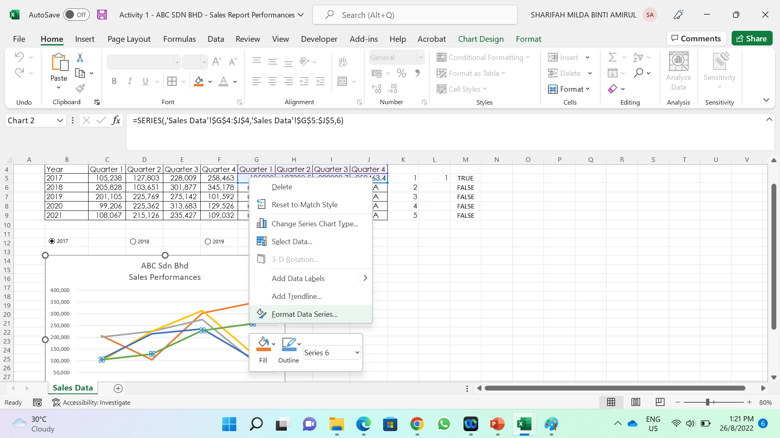
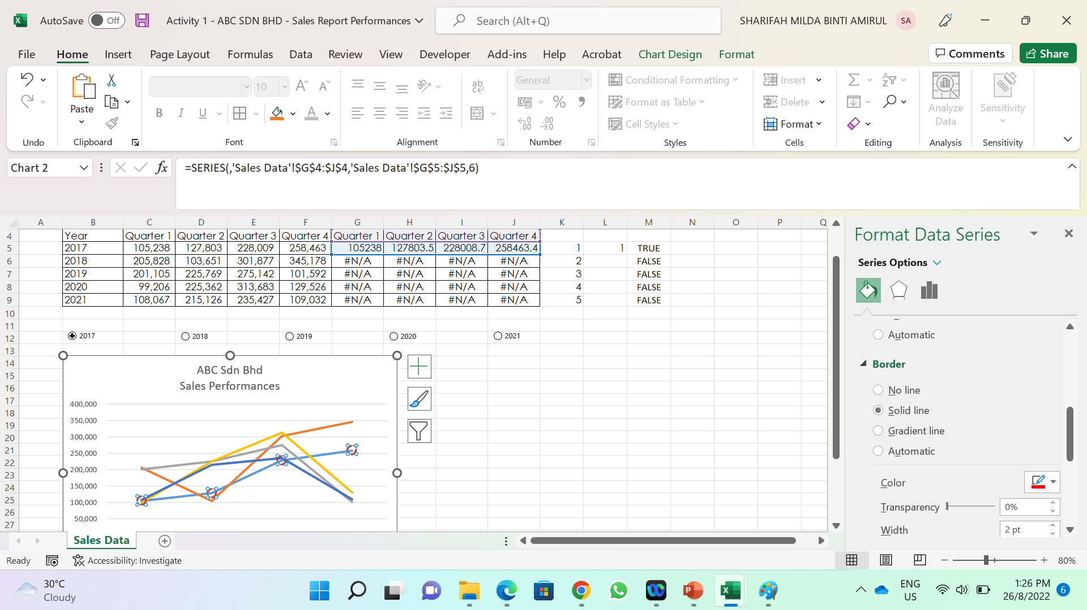
In Format data series:
  Select Fill and Line > then in Line > Select No Line
  Then go to Marker > Marker Option > Built In > Select Type > Size 10.
  Next in the Fill option > No Fill
  In the Border Option > Colour > Width 2pt > Dash Type
  Your Line Chart should look like Figure 1.12.
Repeat steps no 13 and 14 for other data series.
Clear out the unnecessary elements in chart (e.g. the series 6 to series 10)
Then select cells range A11 to K38, then go to fill Tab, select colour for the Line Chart Background.
Figure 1.11
Figure 1.12

Slide 8
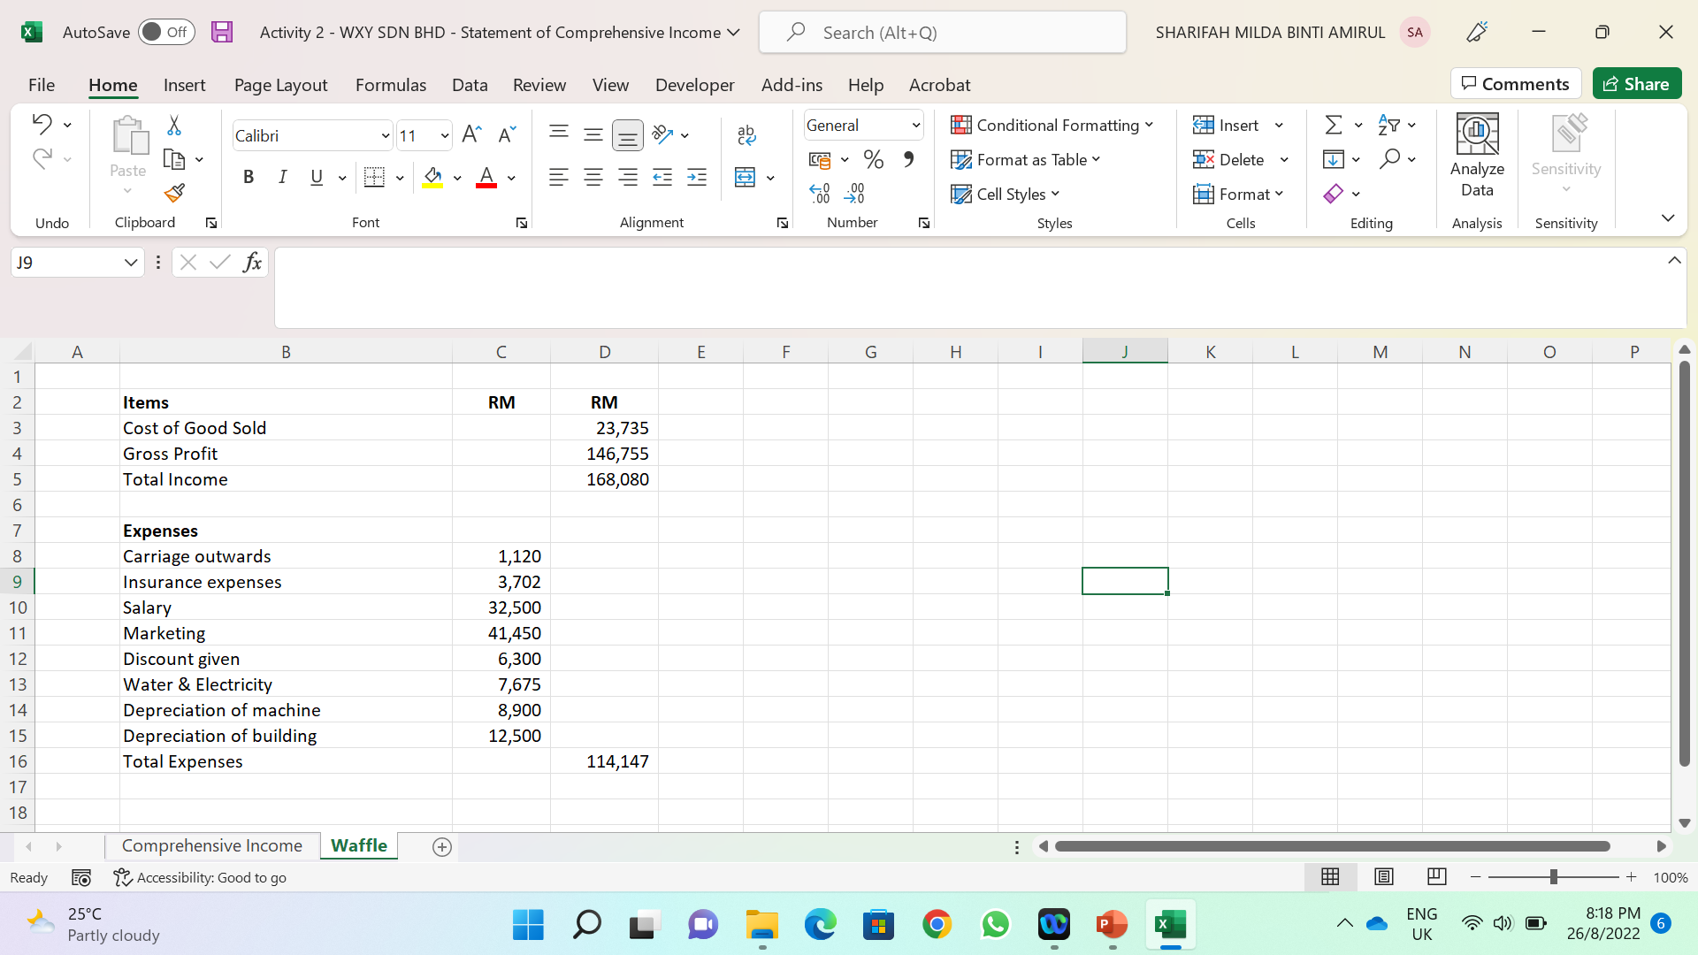
2. Analysing income and expenses: A Waffle Chart Visualisation
To analyse the income statement of WXY Sdn. Bhd utilising a Waffle Chart Visualisation, follows the following steps:
Load the WXY Sdn Bhd Comprehensive Income File.
Click on the “+” symbol to add new sheet. Double click the sheet and renamed it to “Waffle”
In cell B2 type Items. Then, extract the amount of Cost of Good Sold (COGS), Gross Profit, Total Income, all expenses and the total expenses.
Figure 2.1

Slide 9
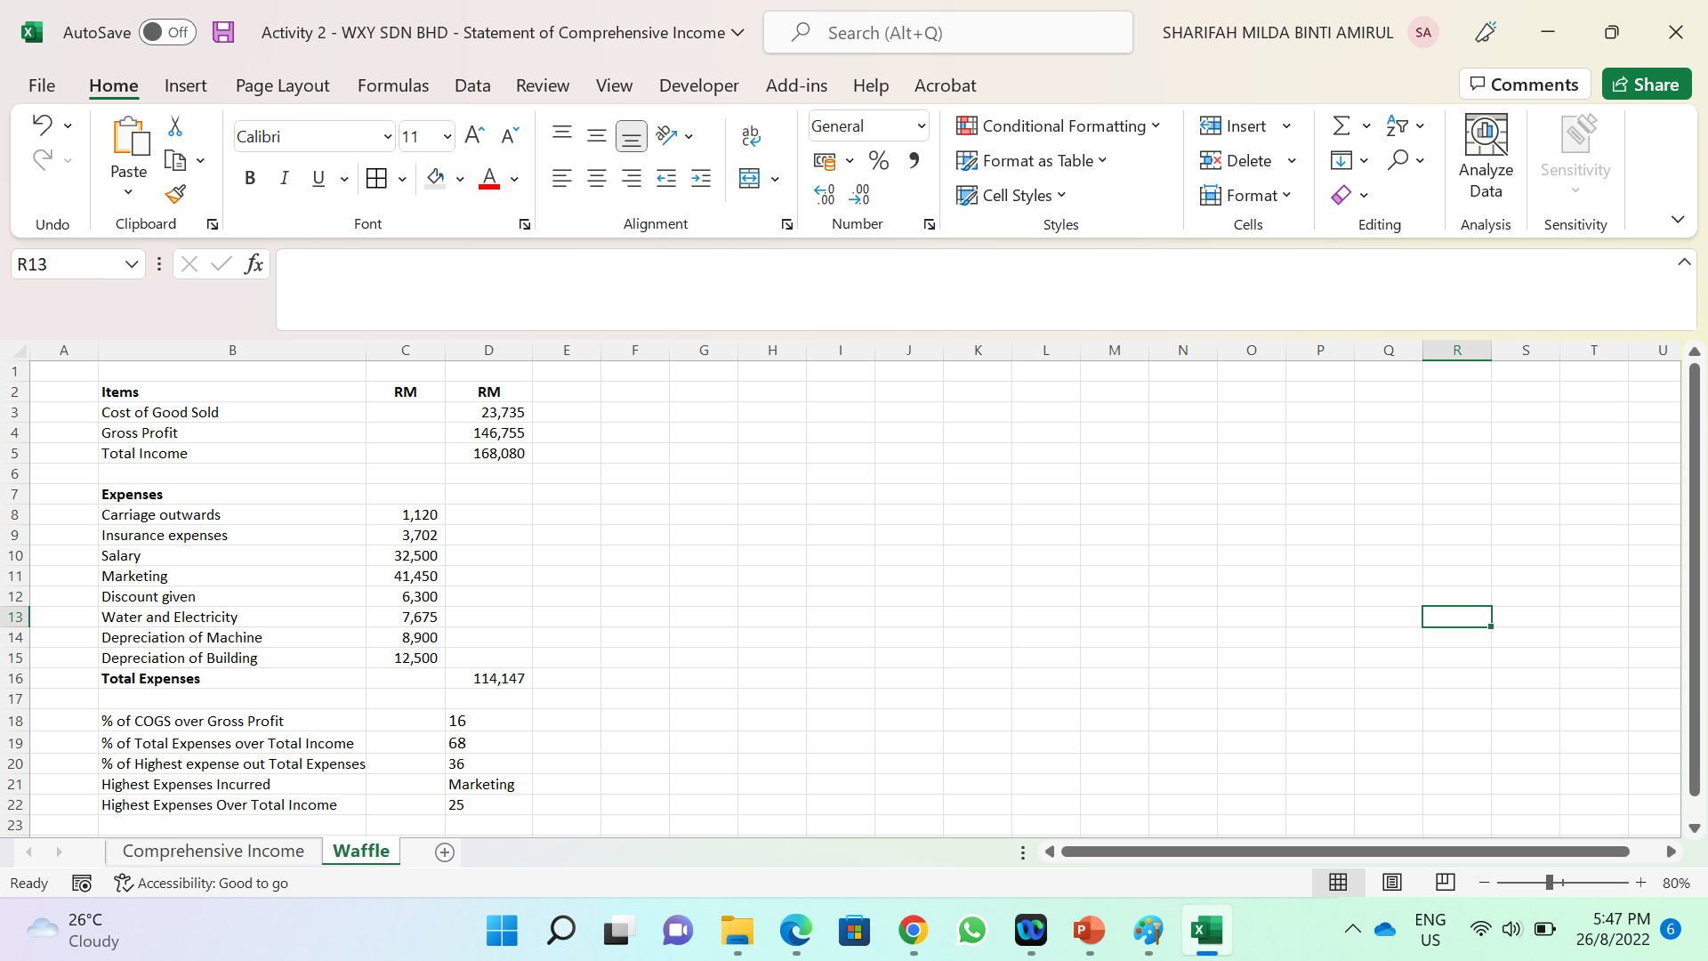
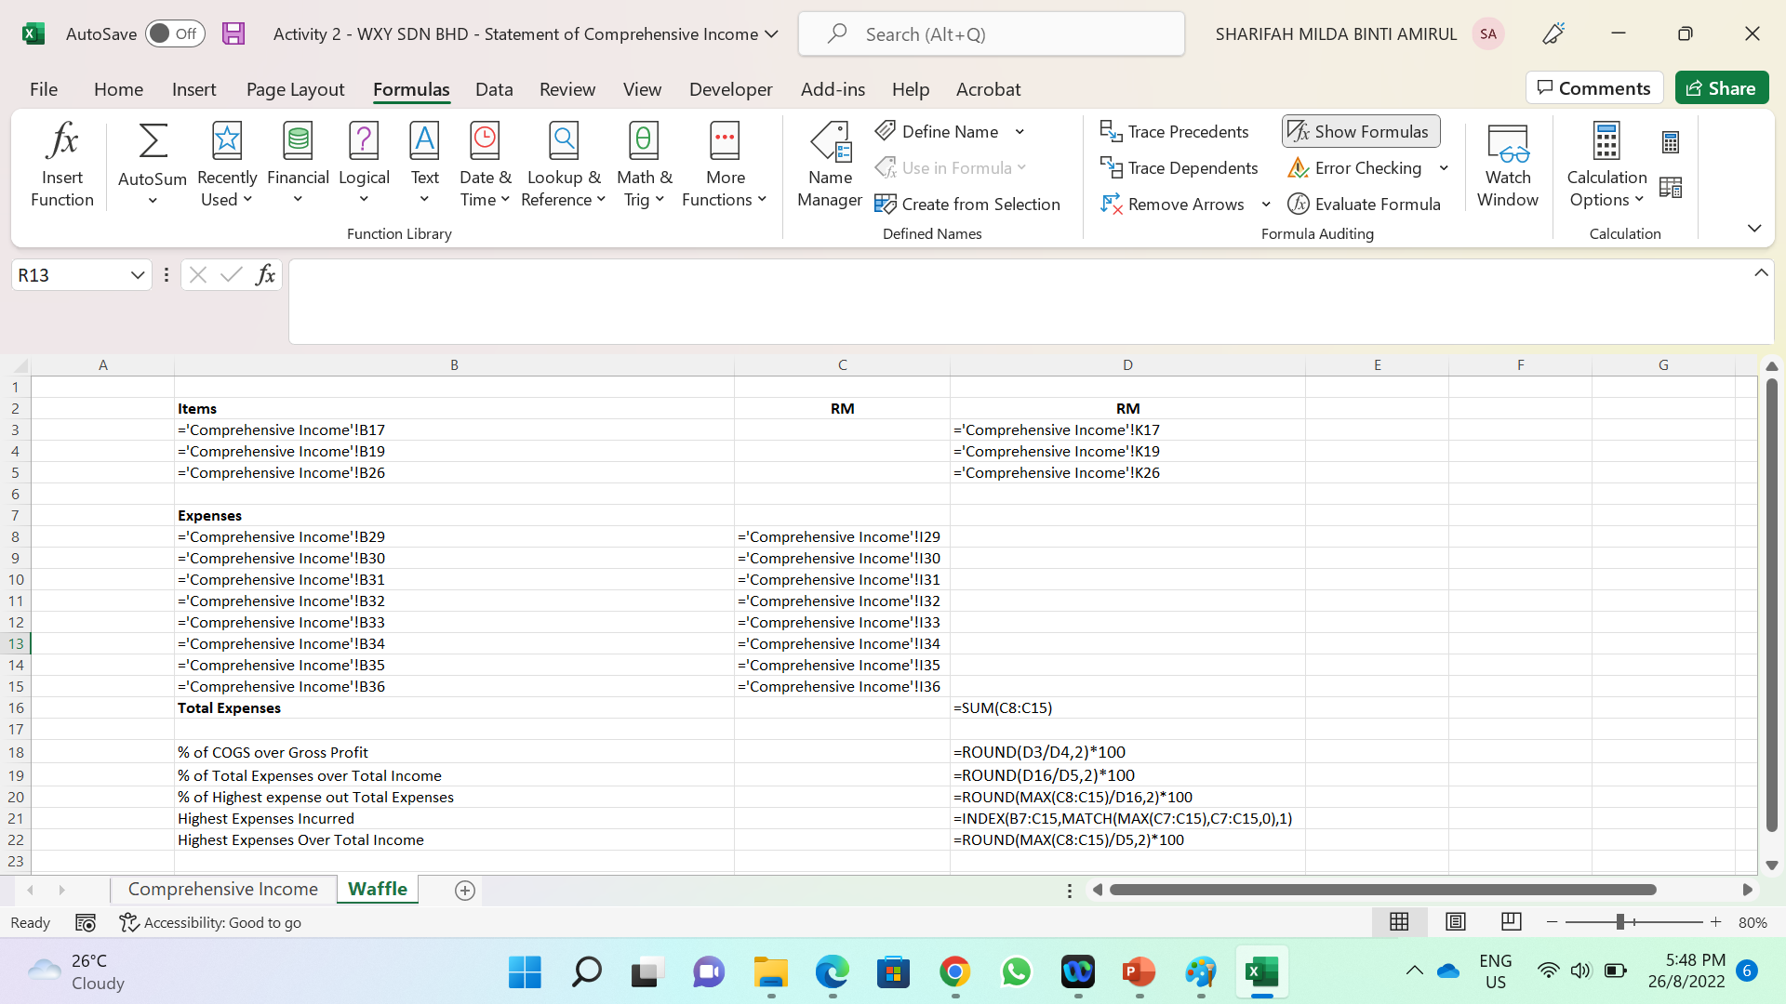
Compute the following for Waffle Chart representation:
  In cell B18, type % of COGS over Gross Profit. Then in cell D18 insert =ROUND(D3/D4,2)*100
  In cell B19, type % of Total Expenses over Total Income. Then in cell D19 insert =ROUND(D16/D5,2)*100
  In cell B20, type % of Highest expense out Total Expenses. Insert this formula =ROUND(MAX(C8:C15)/D16,2)*100 in the cell D20
  In cell B21, type Highest Expenses Incurred. Then, in cell D21 type =INDEX(B7:C15,MATCH(MAX(C7:C15),C7:C15,0),1)
  In cell B22, type Highest Expenses Over Total Income. Type =ROUND(MAX(C8:C15)/D5,2)*100
Figure 2.2
Figure 2.3

Slide 10
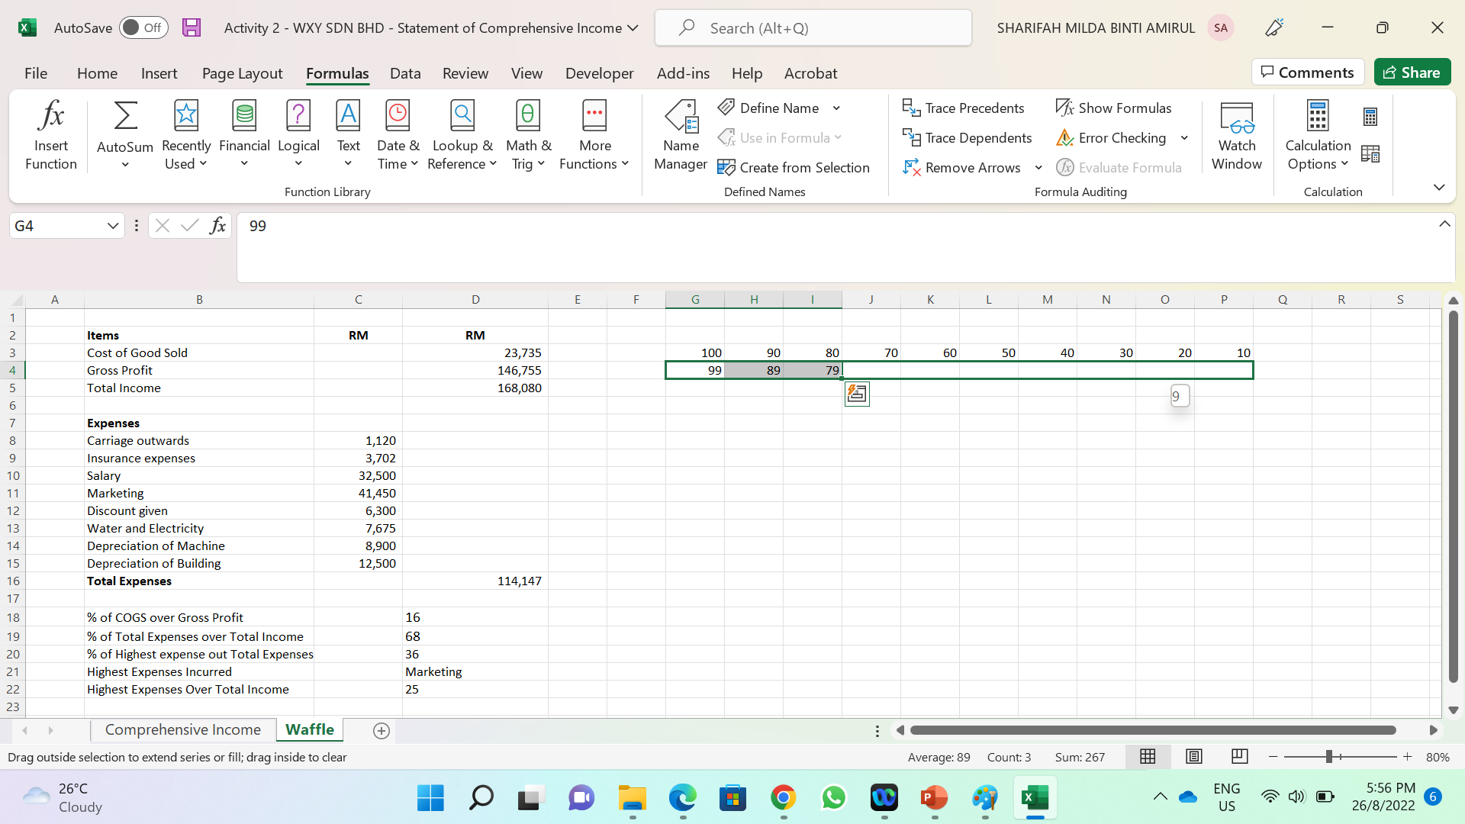
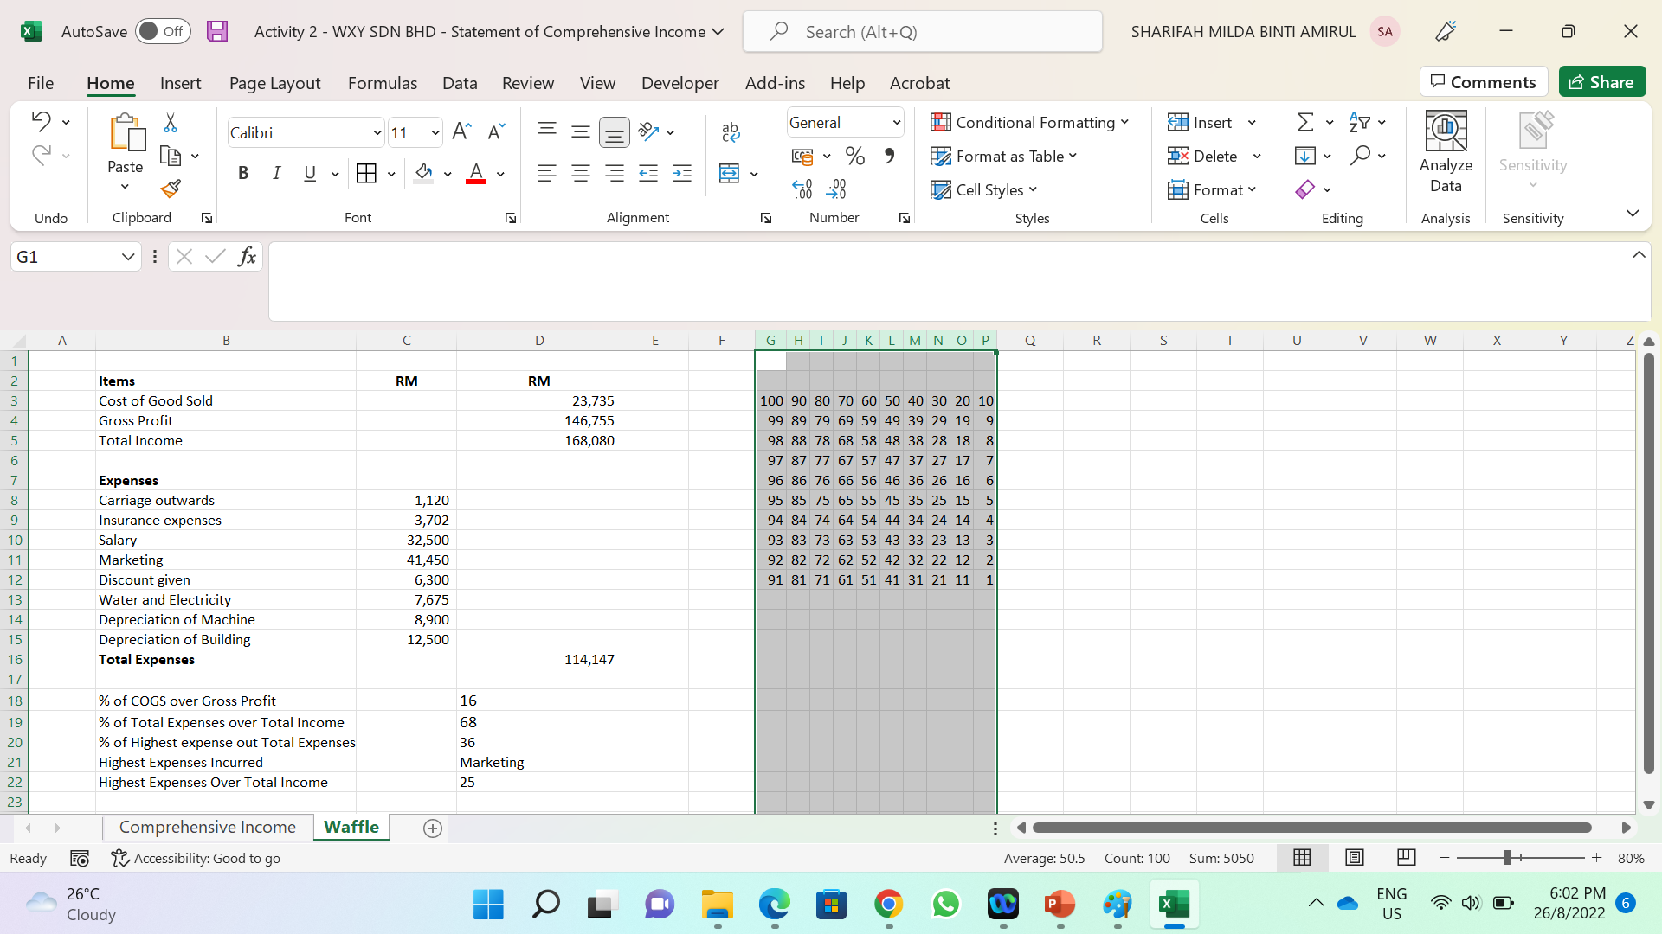
Now, it’s time to make a box of 1 -100. It will be used for logical test to apply conditional formatting to construct the Waffle Visualization.
Type 100, 90, 80, 70, 60, 50, 40, 30, 20, and 10 in cell G3 to P4. Then type 99, 89 and 79 in cell G4 to cell I4. Then drag this all to way to P5 (see Figure 2.4).
Next, select cells range from G3:P4, then drag the cell all the way to cells range G12:P12 (see Figure 2.5).
Next, select column G to column P, then double click on the line of column G to adjust the column width accordingly (see Figure 2.6)
Now, select column R to column AA, then right click, select column width, then type 3.
Figure 2.4
Figure 2.5

Slide 11
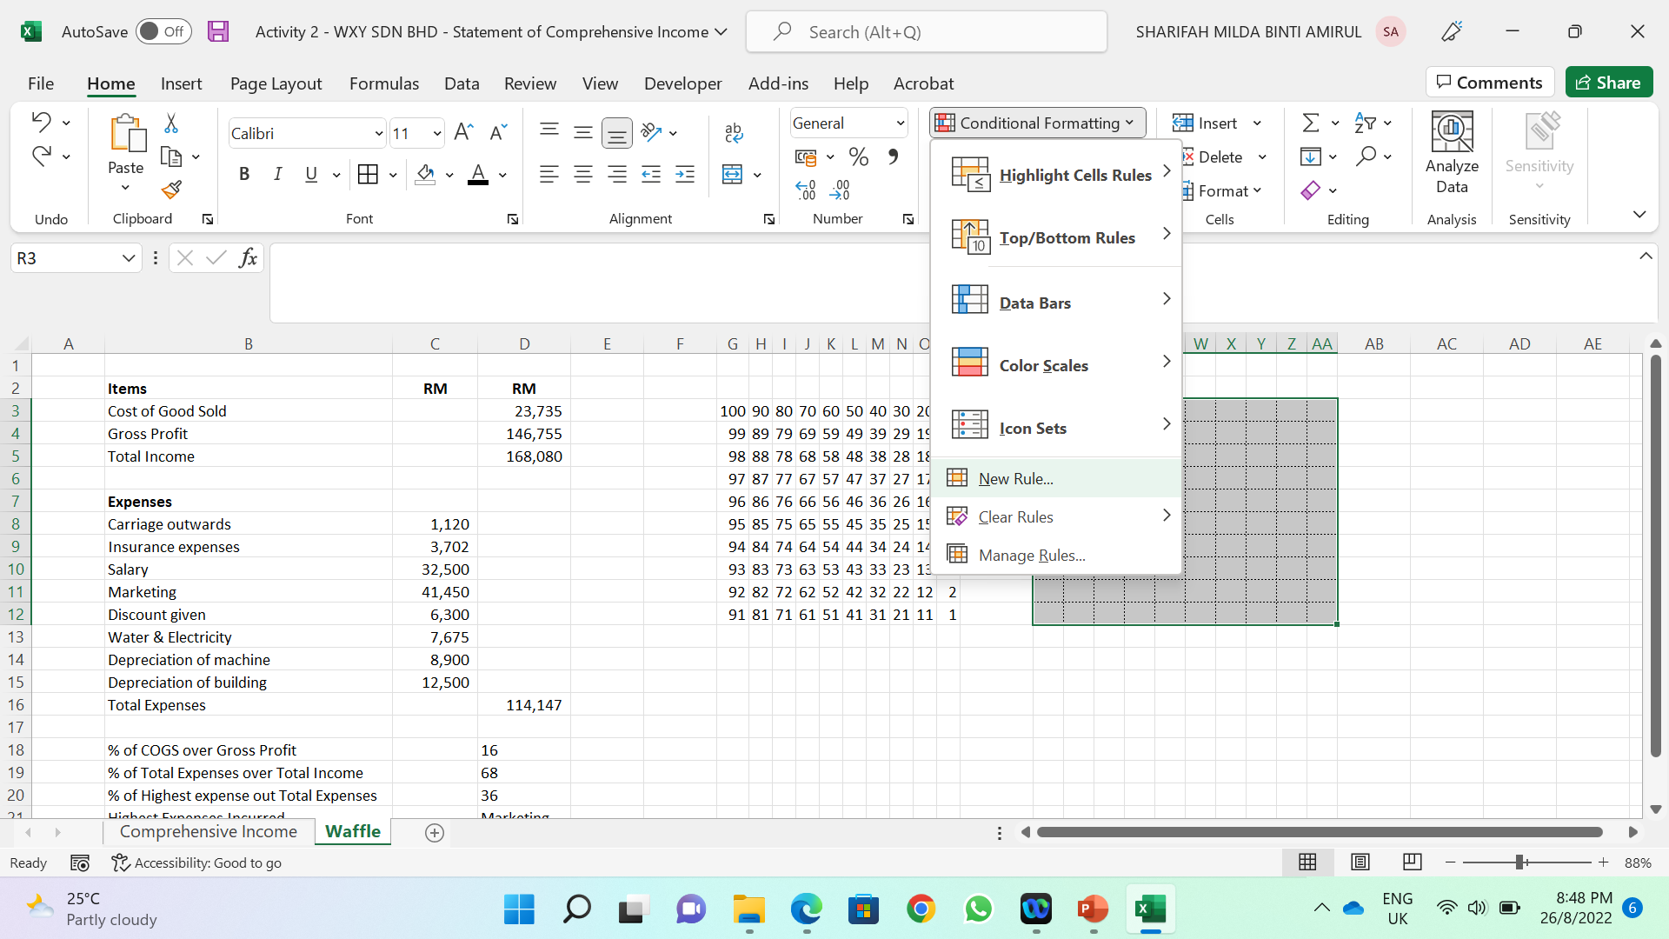
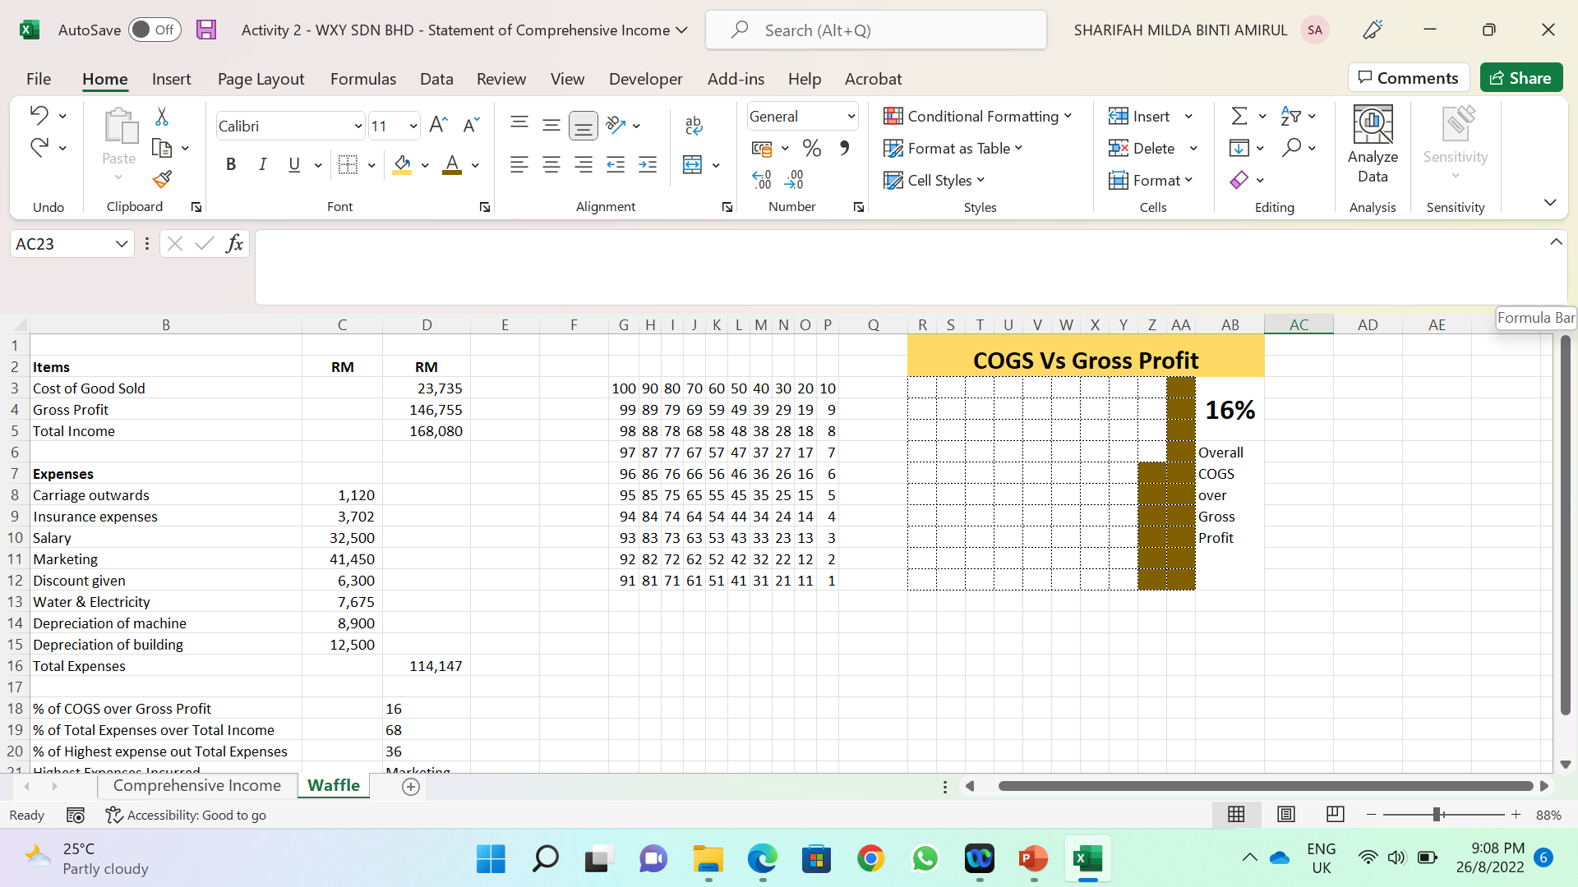
Now to visual the COGS over Gross Profit, select R3:AA12, then go to Conditional Formatting Tab, click new rule, select use formula to determine which cells to format (see Figure 2.6)
In Edit the rule Description, type =G3<=$D$18, click format, select fill, them choose colour.
Merge cells AB1:AB5, then type =D18&"%“. Next, merge cells AB6:AA12, then type Overall COGS over Gross Profit (see Figure 2.7)
Next select R1:AB2> merger > type COGS Vs Gross Profit.
Figure 2.6
Figure 2.7

Slide 12
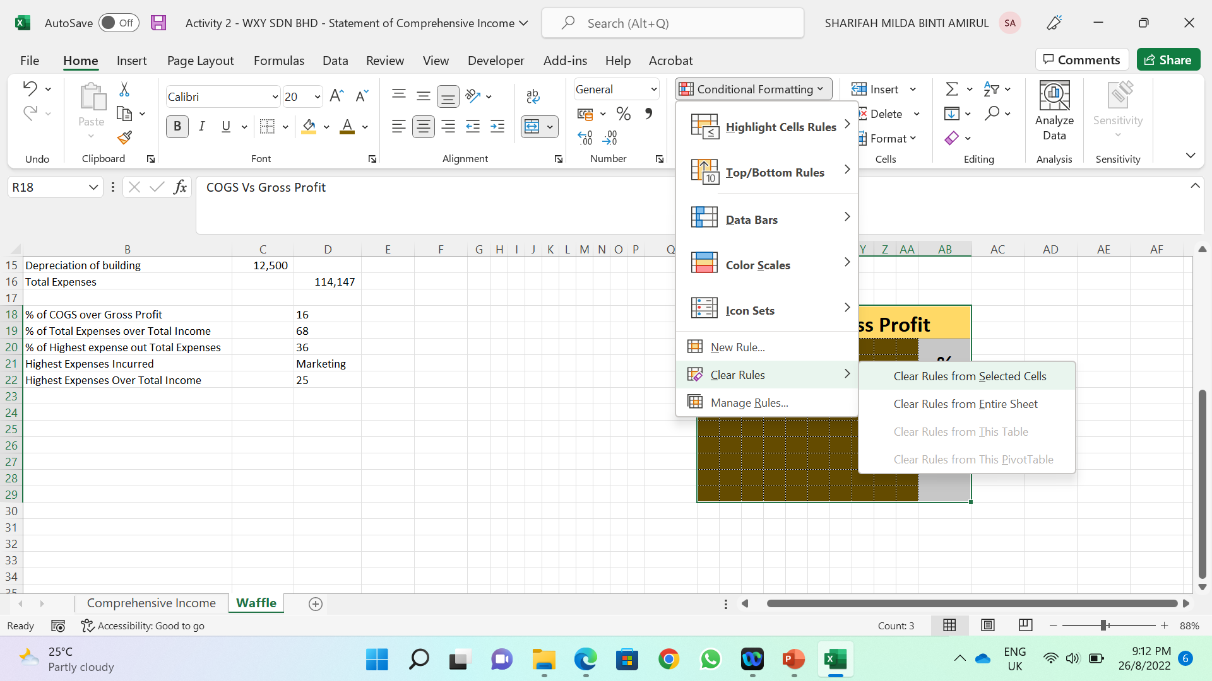
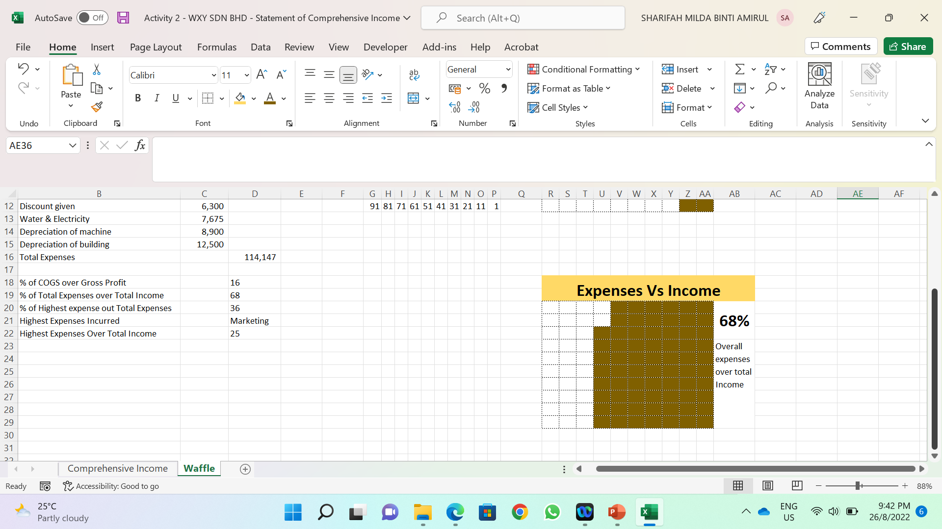
Next is to visual the Expenses over Total Income, select R1:AA12, then copy and paste in cell R18. Then, go to conditional formatting, select clear rules from selected cells. After that, change the heading to Expenses vs Income (see Figure 2.8)
Select cell R20, then go to conditional formatting, insert this formula accordingly, =G3<=$D$19.
In cells AB20:AB21 type =D19&"%“. Press enter, then type overall expenses over total income (see Figure 2.9)
Repeat the step to create the Waffle Chart for highest expenses incurred and highest expenses over income (see Figure 2.10)
Figure 2.8
Figure 2.9

Slide 13
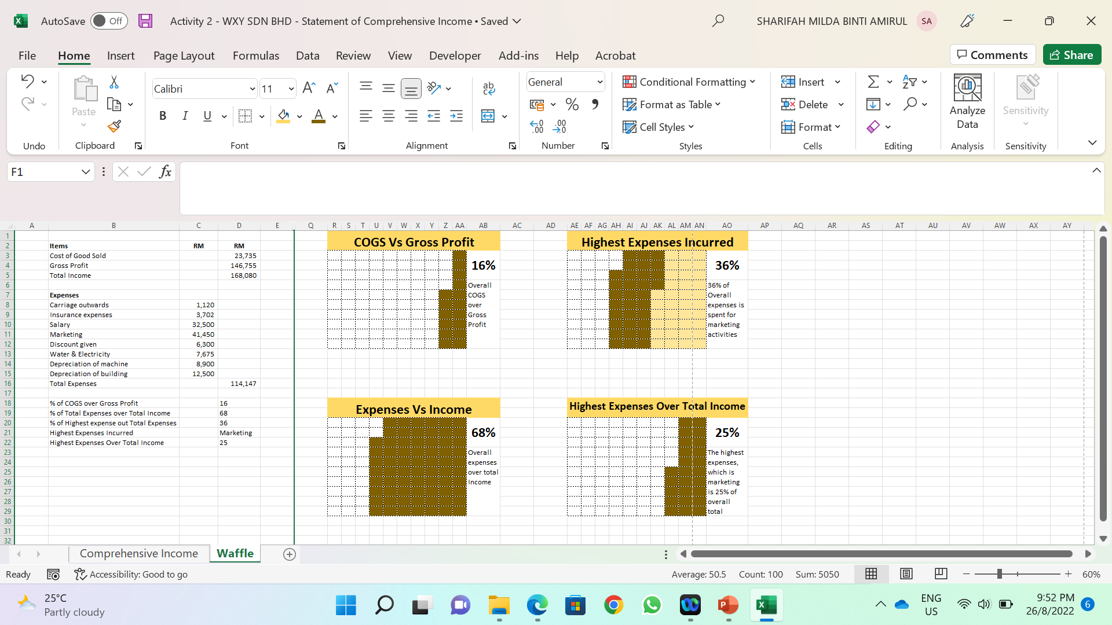
Figure 2.10

Slide 14
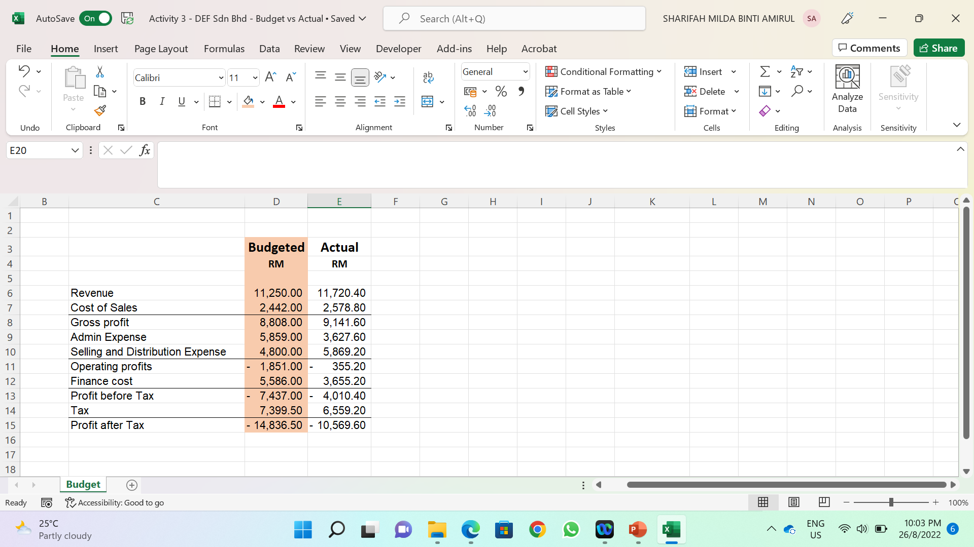
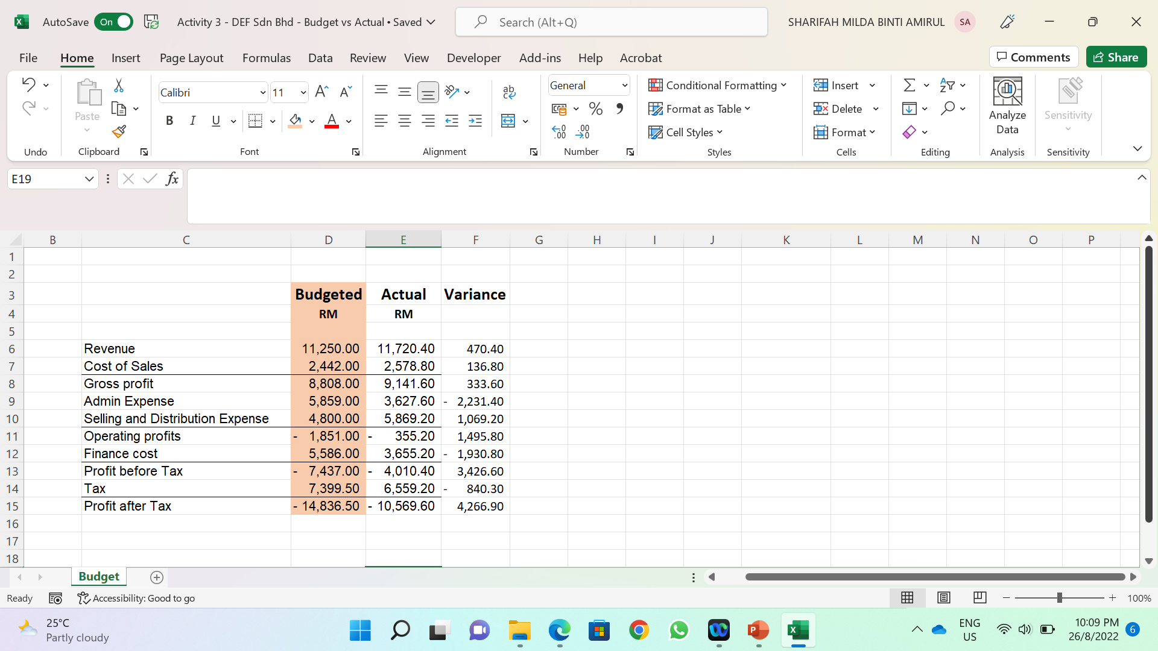
3. Budget vs Actual Variance Reports: In Cell Chart Visualization
To perform the variance analysis of Budget versus Actual for DEF Sdn Bhd, follows the following steps:
Load the WXY Sdn Bhd Comprehensive Income File.
In cell F3 type Variance. Then, insert formula =E6-D6 in cell F6, then drag down until cell F15 (see Figure 3.2)
In cell F3 type Variance. Then, insert formula =E6-D6 in cell F6, then drag down until cell F15. Merge F3:H3 (see Figure 3.3)
Figure 3.1
Figure 3.2

Slide 15
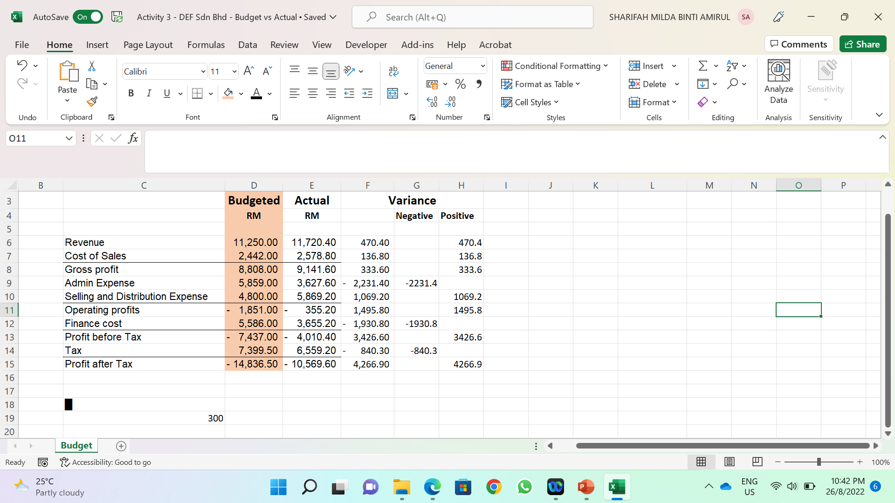
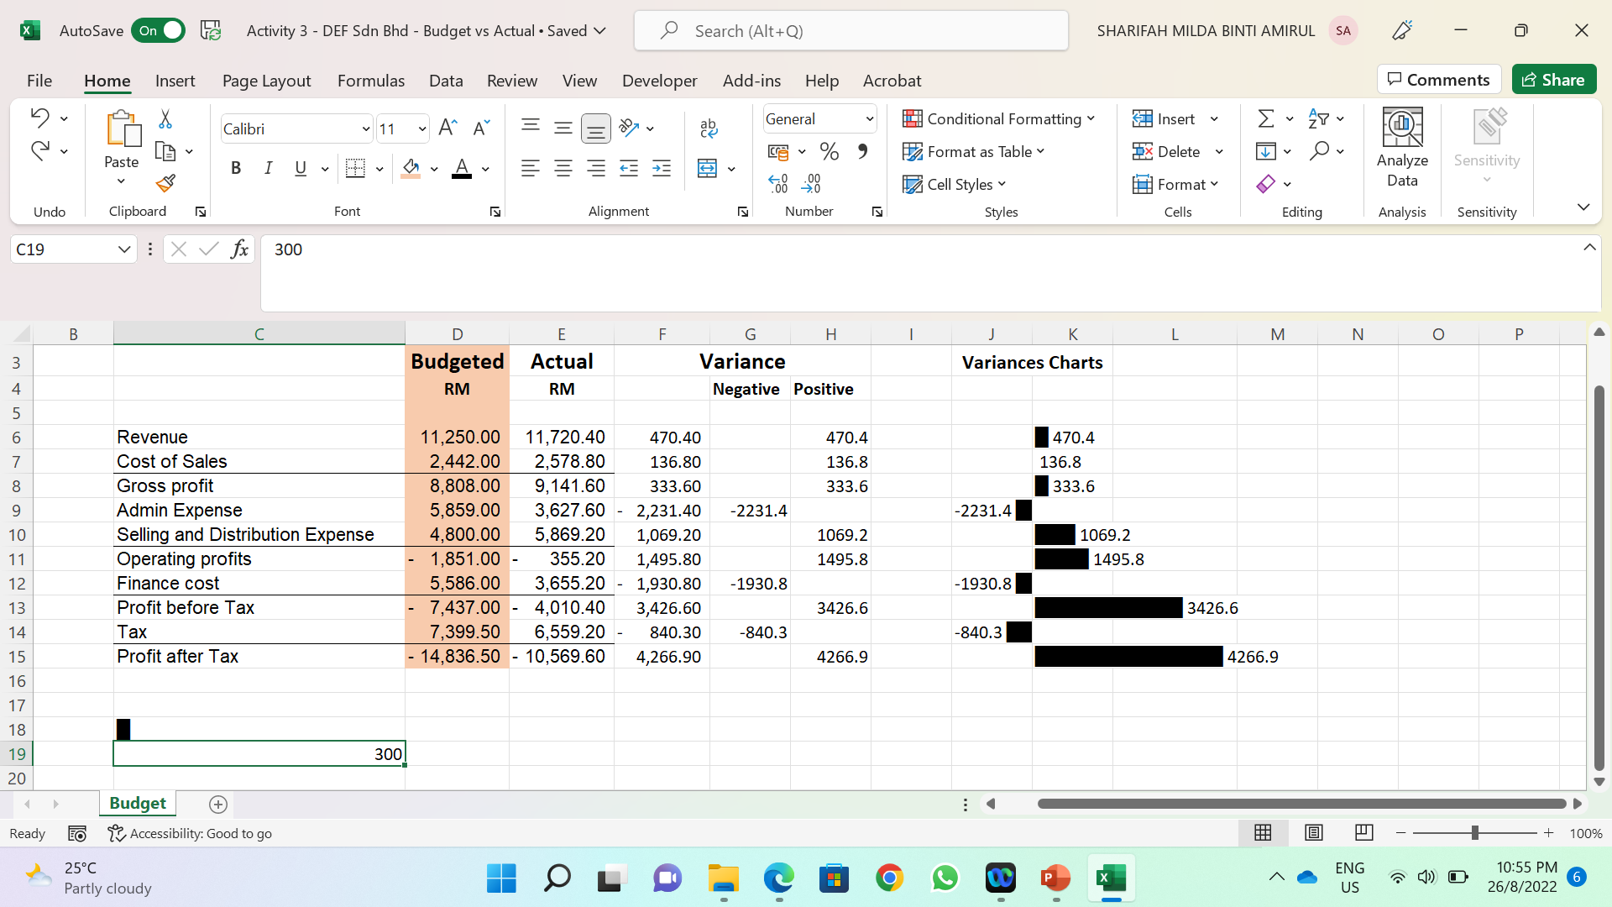
3. Budget vs Actual Variance Reports: In Cell Chart Visualization
In cell G4 type Negative, and type Positive in cell H4.
Next, insert this formula in cell G6 =IF(F6<0,F6,""), then drag it until G15.
In cell H6, type =IF(F6>0,F6,""), then drag it until cell H15
Go to cell C18, Insert a specific symbol which you can find in almost every font once you select “Block Elements”.
Then, type 300 in cell C19. This 300 is a divisor to keep the lines within limits.
Go to cell J3 then type Variances Charts.
In cell J6 type =IF(G6="","",G6&" "&REPT($C$18,ABS(G6)/$C$19))
In cell K6 type =IF(H6="","",REPT($C$18,H6/$C$19)&" "&H6) (see figure 3.4)
Figure 3.3
Figure 3.4

Slide 16
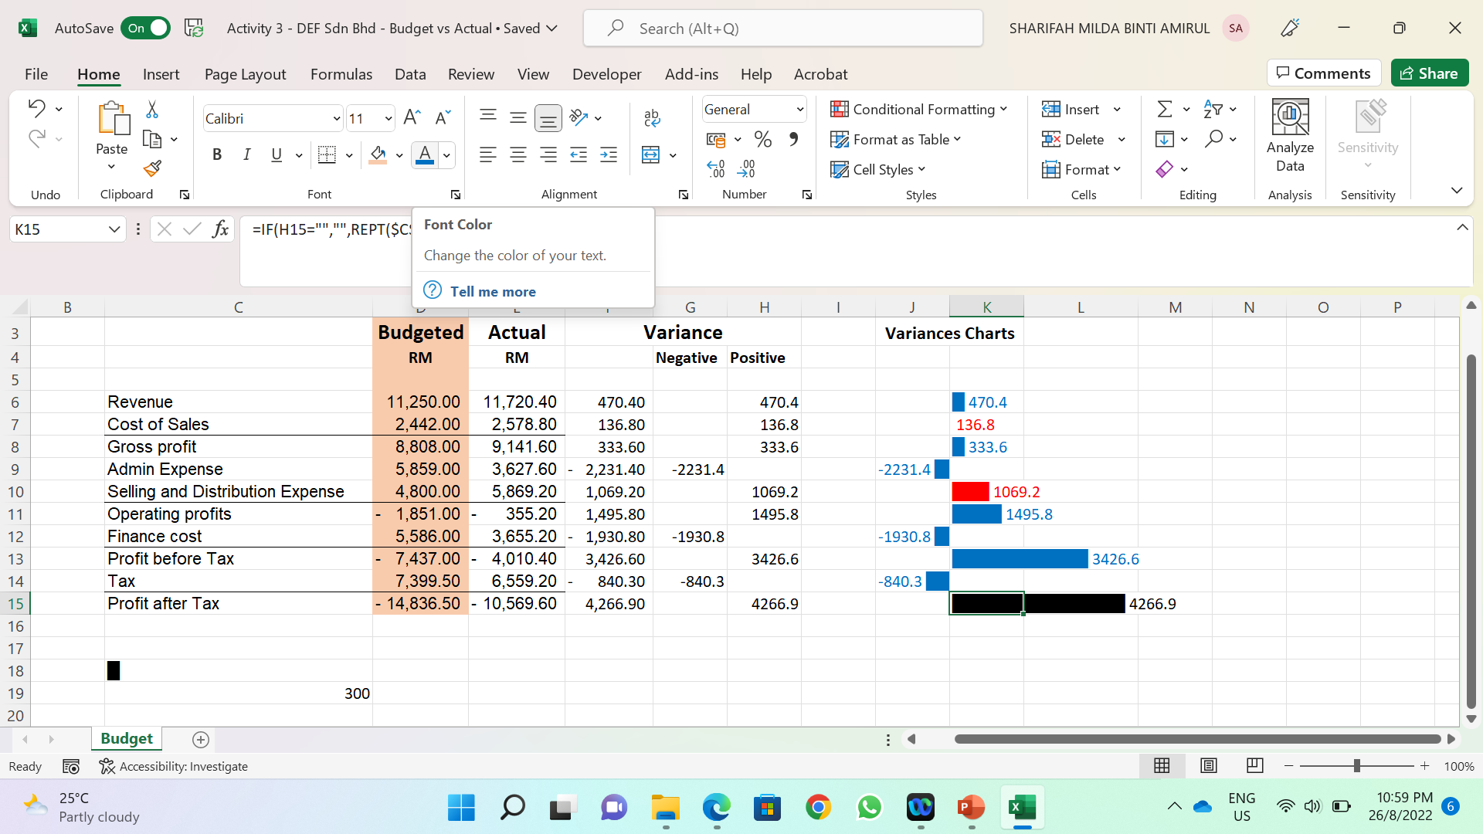
3. Budget vs Actual Variance Reports: In Cell Chart Visualization
You can now adjust the colours of the bar. It is best that the colours chosen represents the favourable and unfavourable results of the variances.
In Figure 3.5, the bar colours were changed by selecting the particular cells then select the colours for the word.
Blue represents favourable, while red represents unfavorable.
Figure 3.5

Slide 17
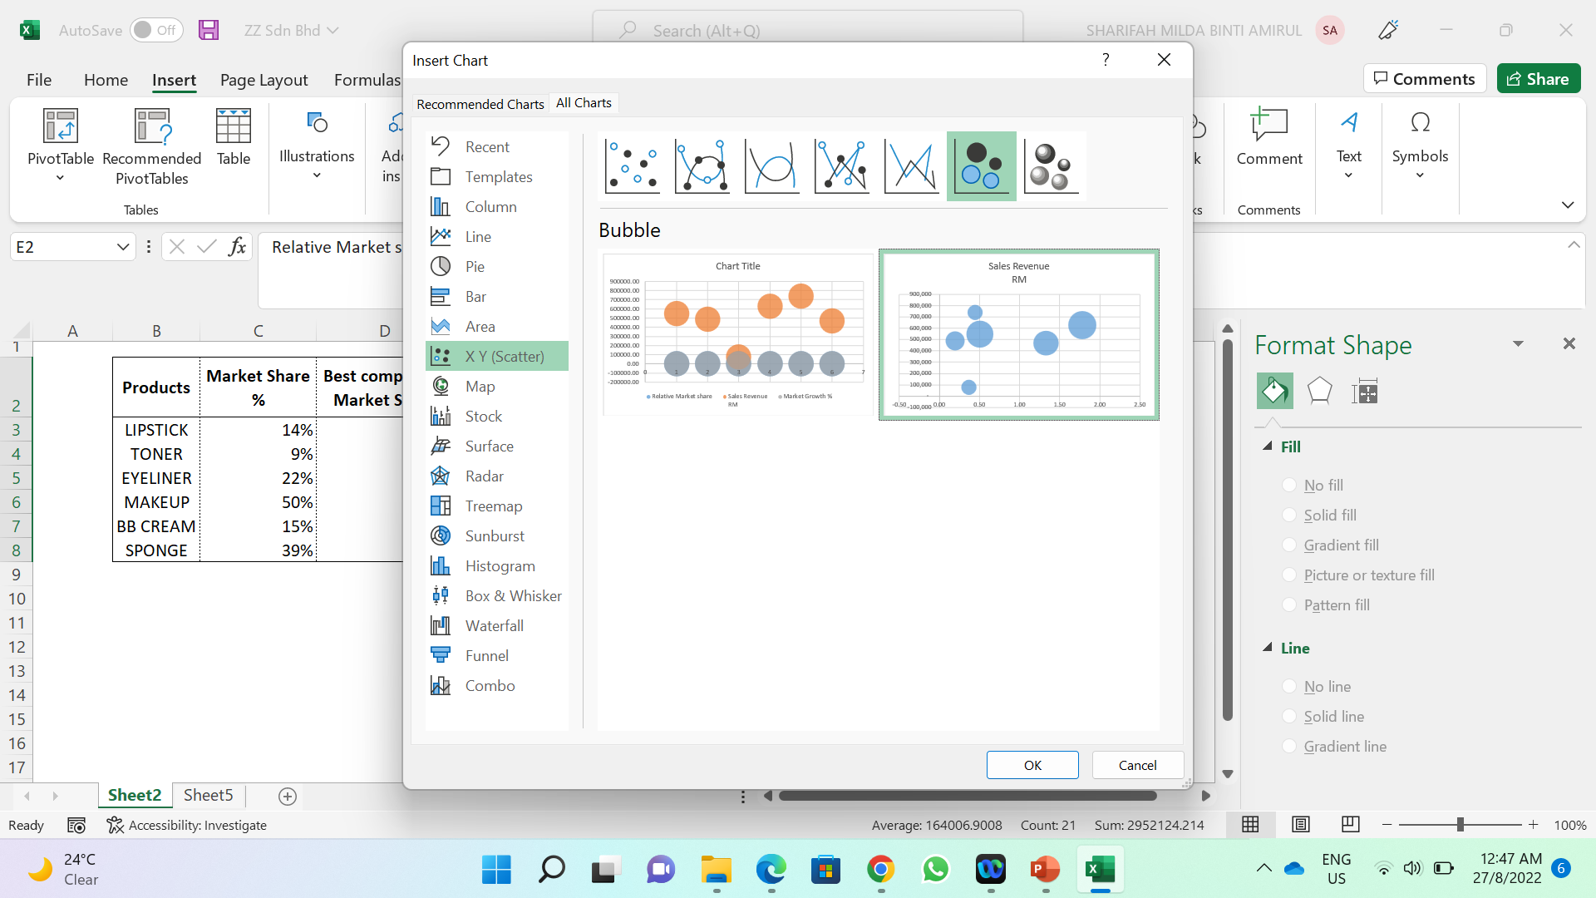
4. Product Growth Analysis: A Visualization Through BCG Matrix In Excel
To perform the BCG Matrix analysis utilising the Microsoft Excel, follows the following steps
Load the ZZ Sdn Bhd- Product Data
To create the BCG matrix select the relative market share, sales revenue, and Market growth % only. Then Go to Insert > click scatter chart button > select more scatter chart > select bubble (see Figure 4.1)
Figure 4.1

Slide 18
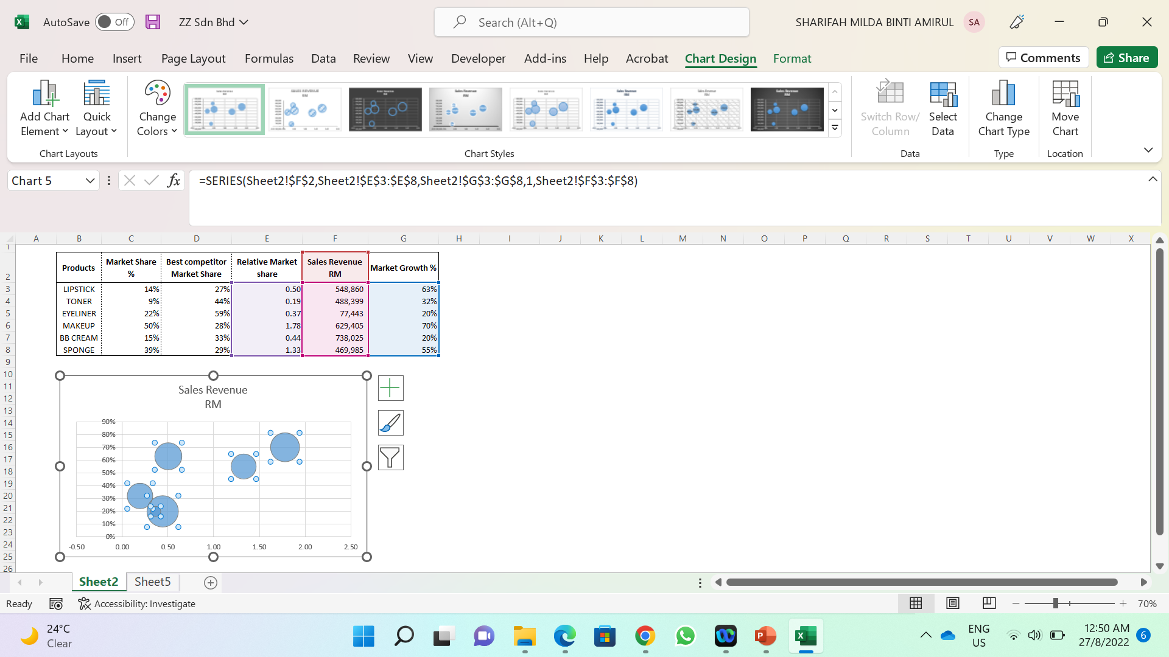
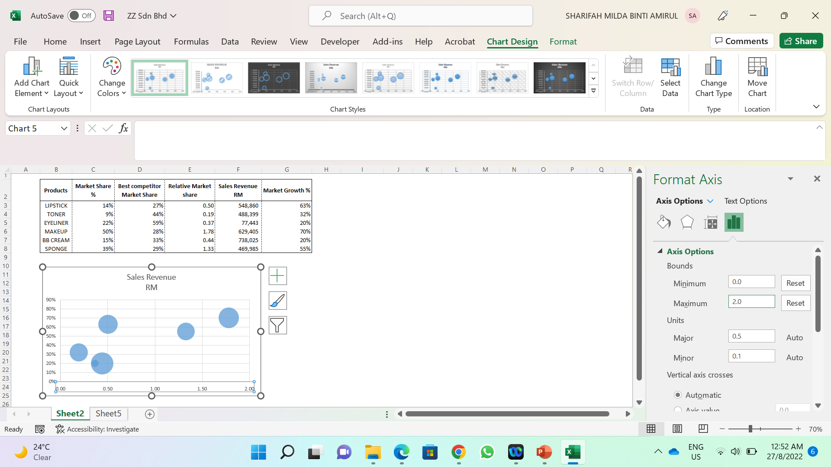
4. Product Growth Analysis: A Visualization Through BCG Matrix In Excel
Adjustment is needed for variables on the Y-Axis. Just click on any bubble, then to shuffle the quadrants of revenue and Market growth with each other (see Figure 4.2)
Next, right click on x-axis > select format axis. Change the minimum bound to 0 under axis options (refer to Figure 4.3)
Then under vertical axis crosses, put 1 as the axis value.
Next, go to Label, and select low from the list of label position.
Figure 4.2
Figure 4.3

Slide 19
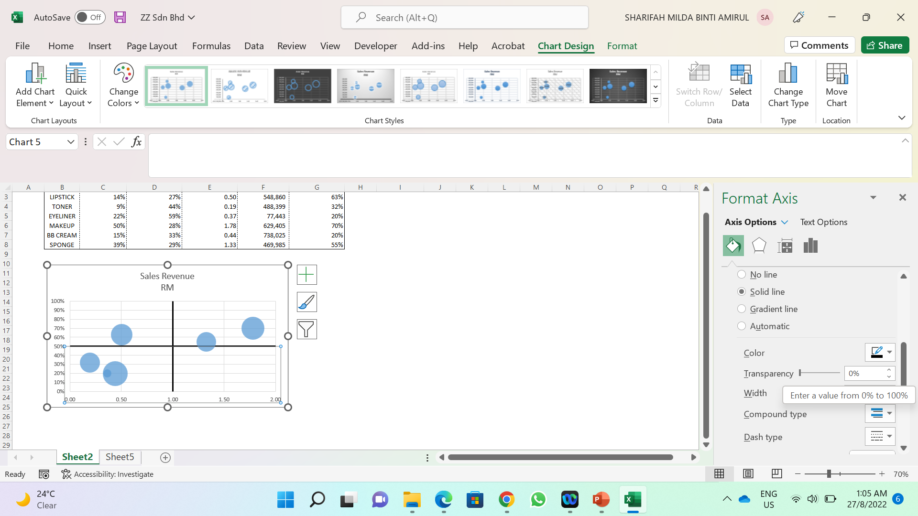
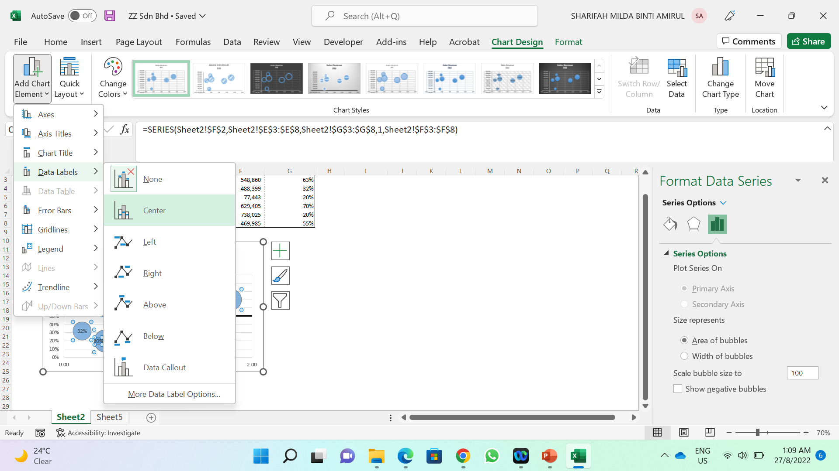
4. Product Growth Analysis: A Visualization Through BCG Matrix In Excel
Now, adjust the y-axis. Set the maximum value to 1.0.
Next, Under “Horizontal axis crosses” set the to 0.5 (represent 50 %). In the Label, select low for label position.
Next, go to fill and line. Adjust the width to 2 and select black colour (see Figure 4.4)
Now, change the label to Product. Click on the bubble, then select tab add chart element (see Figure 4.5).
Then right click on the bubble again, then select format data label. Click on values from cells, then select cell B3:B8. Next, unchecked the Y Value box.
You may adjust the plotting areas, naming each quadrant according (see Figure 4.6)
Figure 4.4
Figure 4.5
Figure 4.5

Slide 20
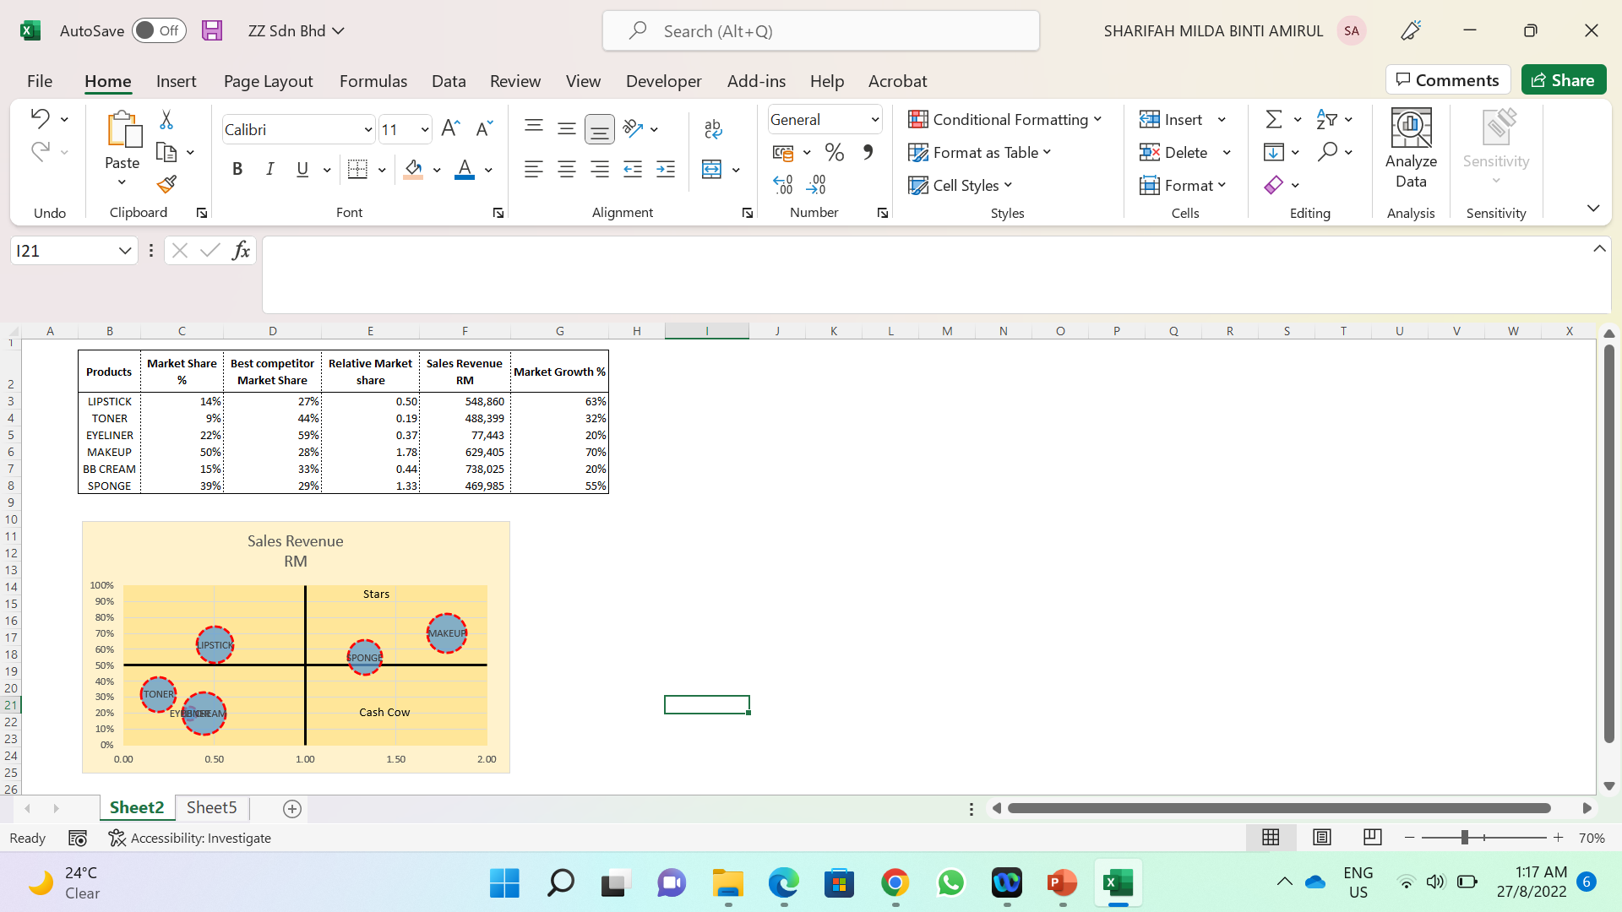
Figure 4.6

