Slide 1
ACTIVITIES PART 2
Excel in Excel : Data Normalisation and DashBoard
by
Sharifah Milda Amirul (Ph.D)
Accounting Lecturer, UMS

Slide 2
1. Data Normalization Using Power Query
Data normalization which is also referred to restructuring data is necessary for PIVOT Tables.
2 conditions for data to be considered as structured/ normalized
Data must be arranged in columns i.e. from top to bottom. No property should be put in row to form intersections of data sets.
Similar data type shall be arranged in one column with its name as column header

Slide 3
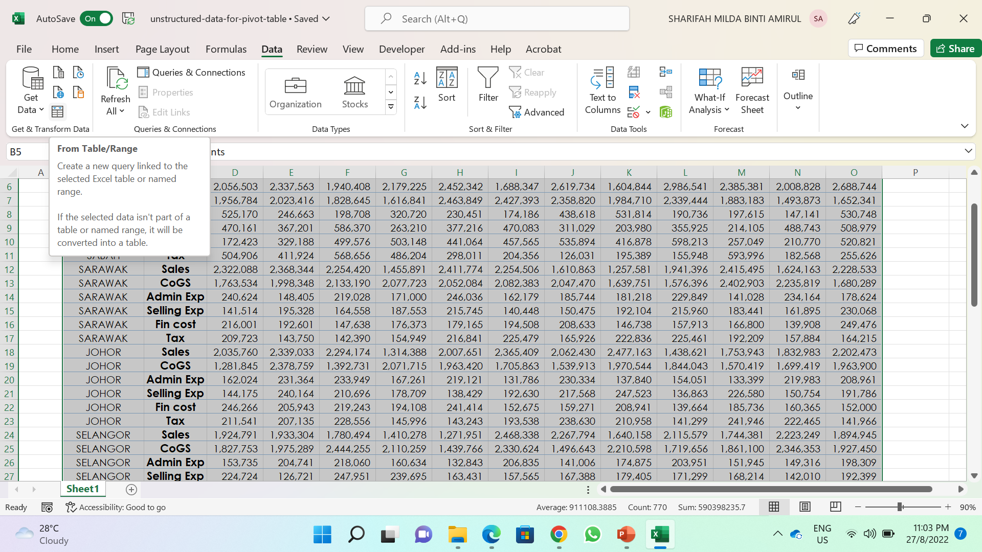
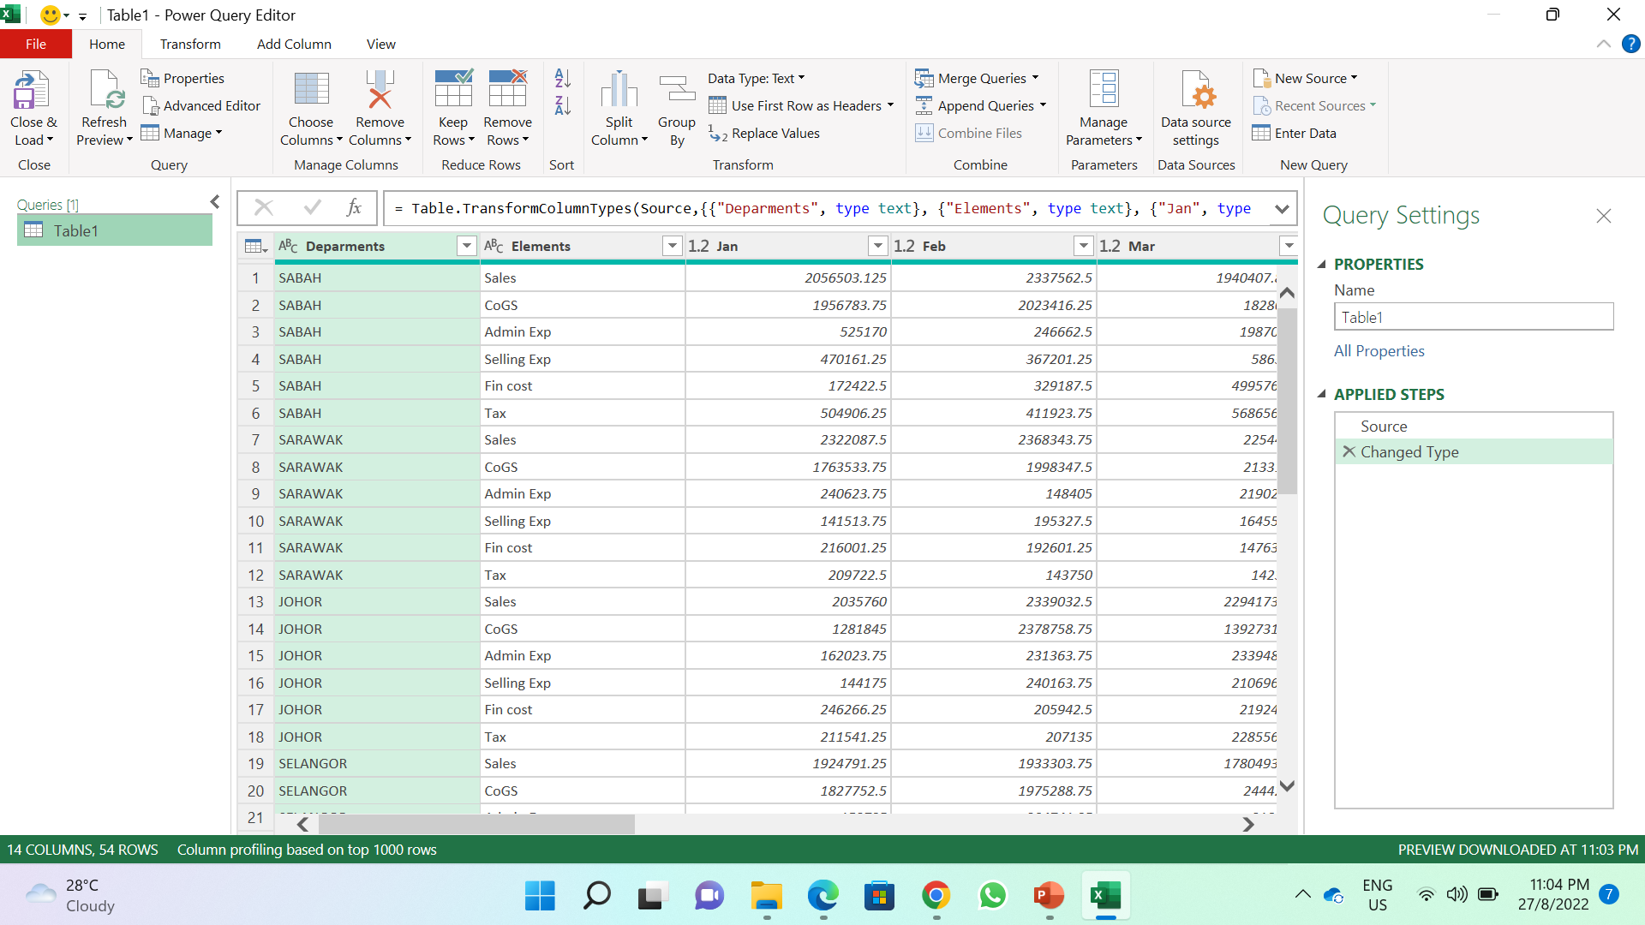
Follow the following steps to begin data normalization using Power Query
Load the TNT BHD Sales Report File.
Select cells range B5:O59 > Data Tab > Get Data & Transform > From Table/Range (see Figure 1.1).
You can see now Power Query Editor is automatically opened for you (See Figure 1.2).
Select column Jan – Dec, go to Transform Tab > Unpivot Columns. Now you can see that all months are rearranged/restructured in one column (see. Figure 1.3)
Figure 1.1
Figure 1.2

Slide 4
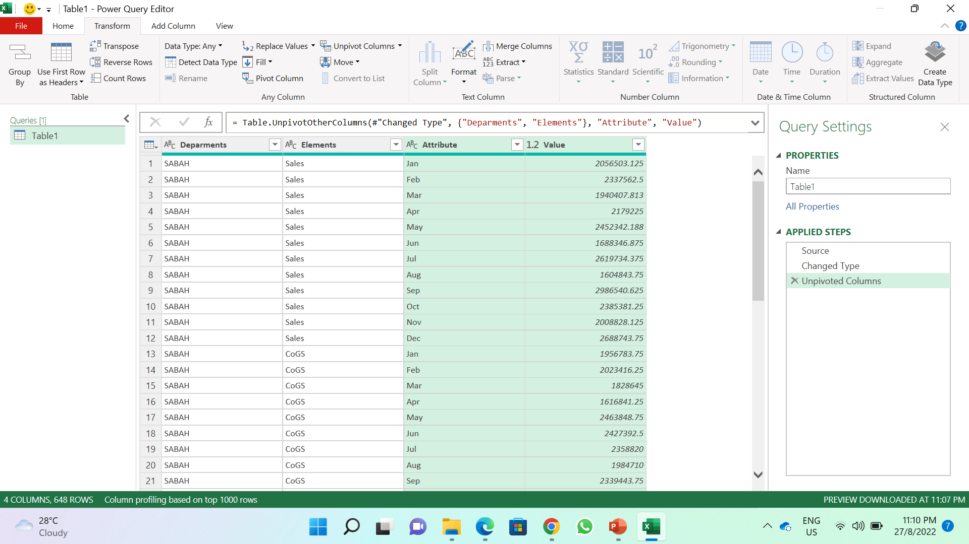
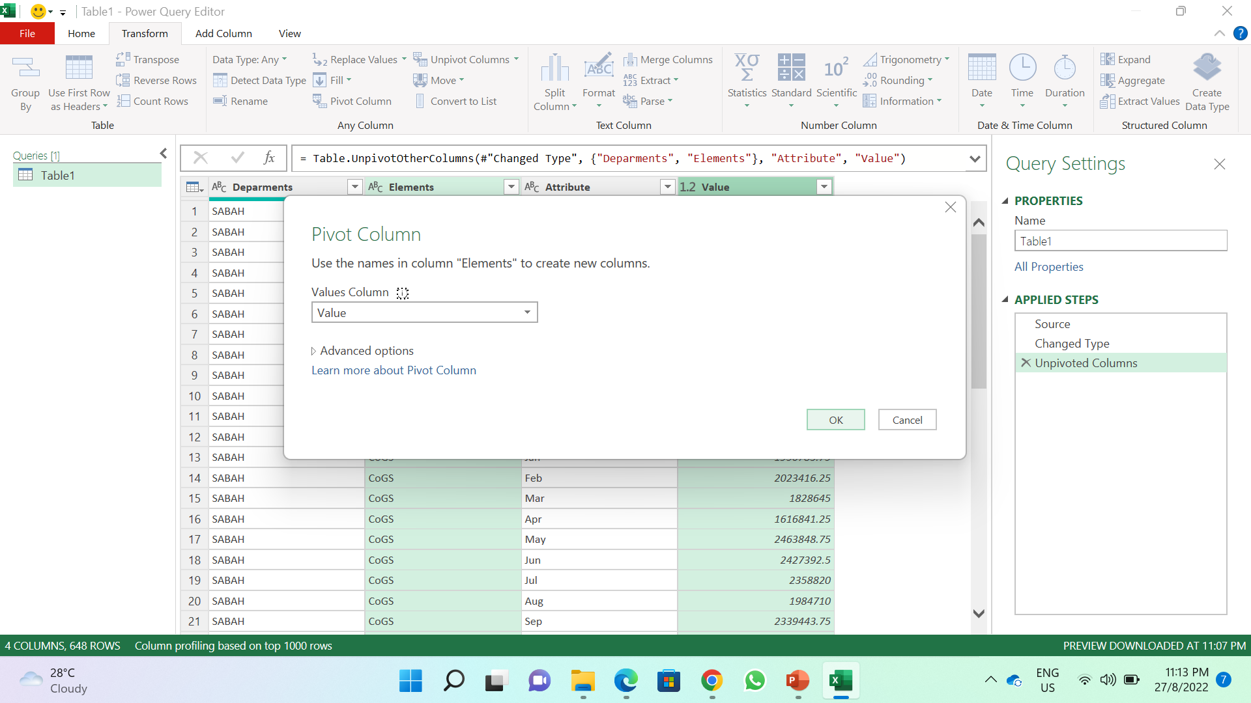
Next, select Element column and Value, then click pivot column, a dialog box will appear, click okay (see Figure 1.4).
Finally, go to Home > Close & Load. It will save and load your data file accordingly (see Figure 1.5).
You can now see your data has been restructured accordingly and ready for PIVOT Tables (see Figure 1.6)
Figure 1.3
Figure 1.4

Slide 5
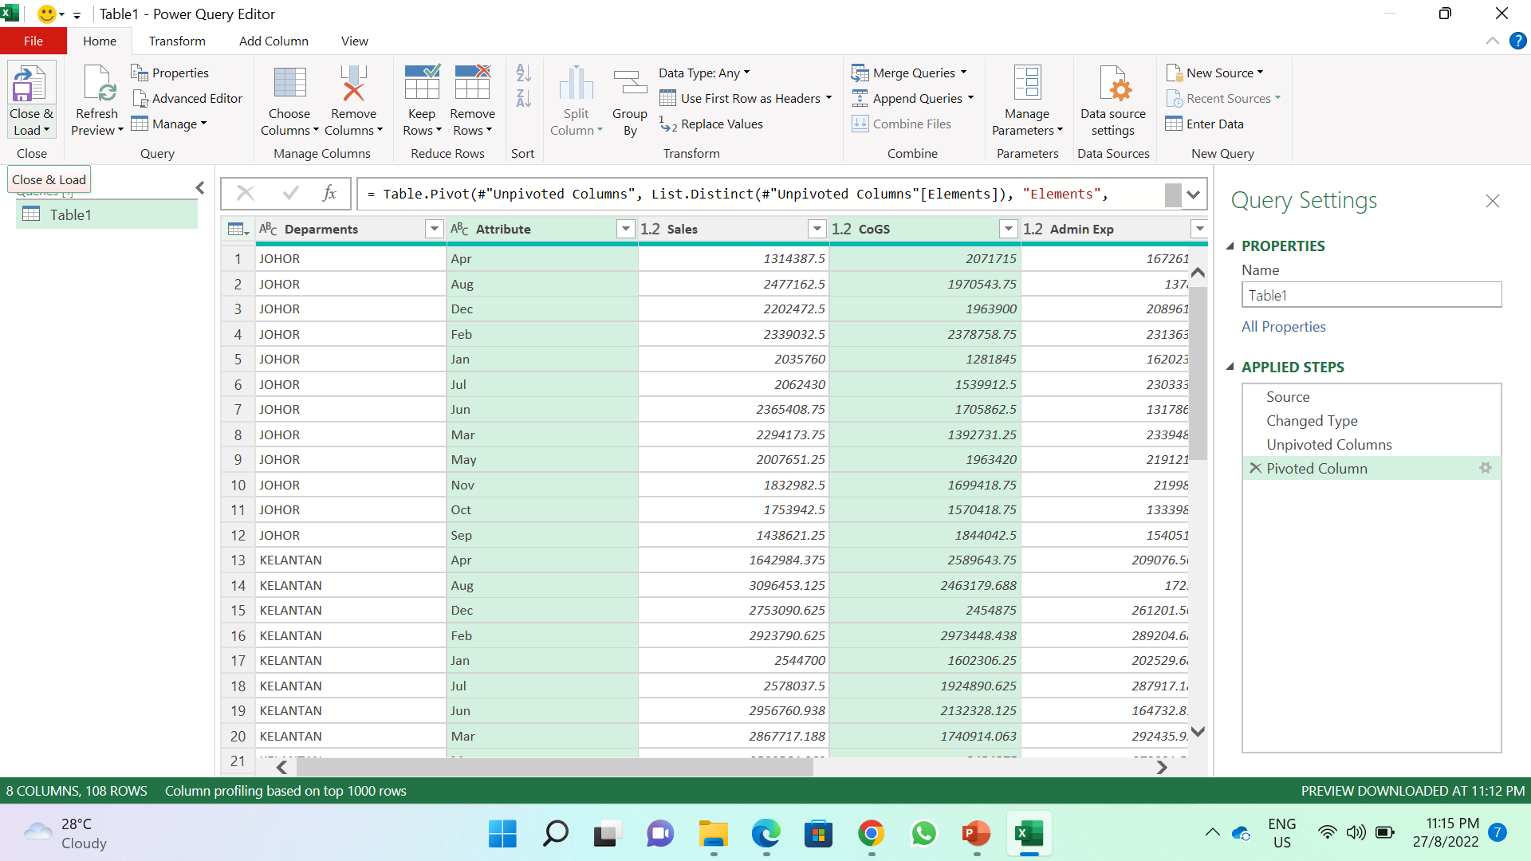
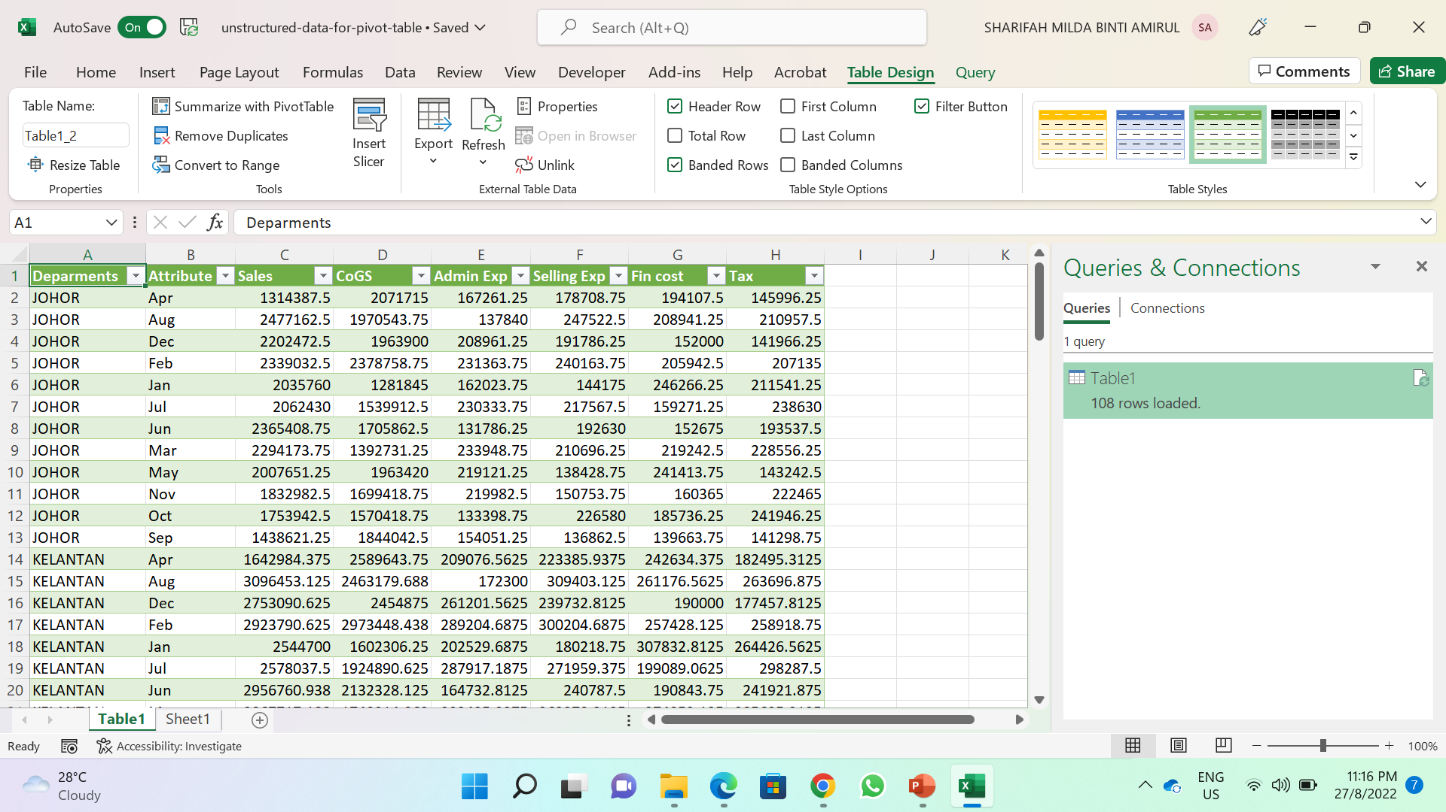
Figure 1.5
Figure 1.6

Slide 6
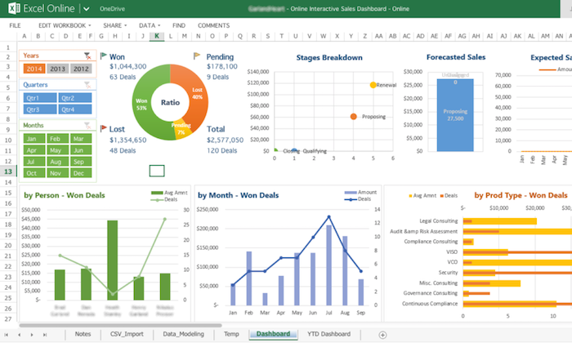
2. Making Sales Dashboard – Utilising Excel Slicer
A Dashboard is a reporting tool for data visualisation to represent data for data analysis and reporting purpose.
A Dashboard may comprise a combination of information to be presented/reported. Example: Sales Report, Expenses Report, etc.
Figure 2.1: Example of Dashboard

Slide 7
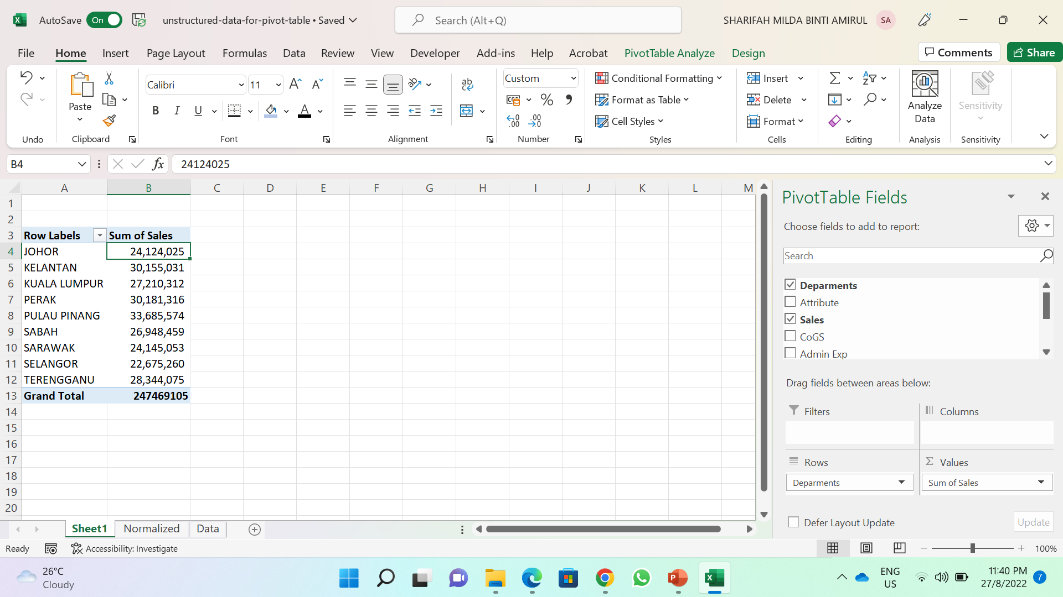
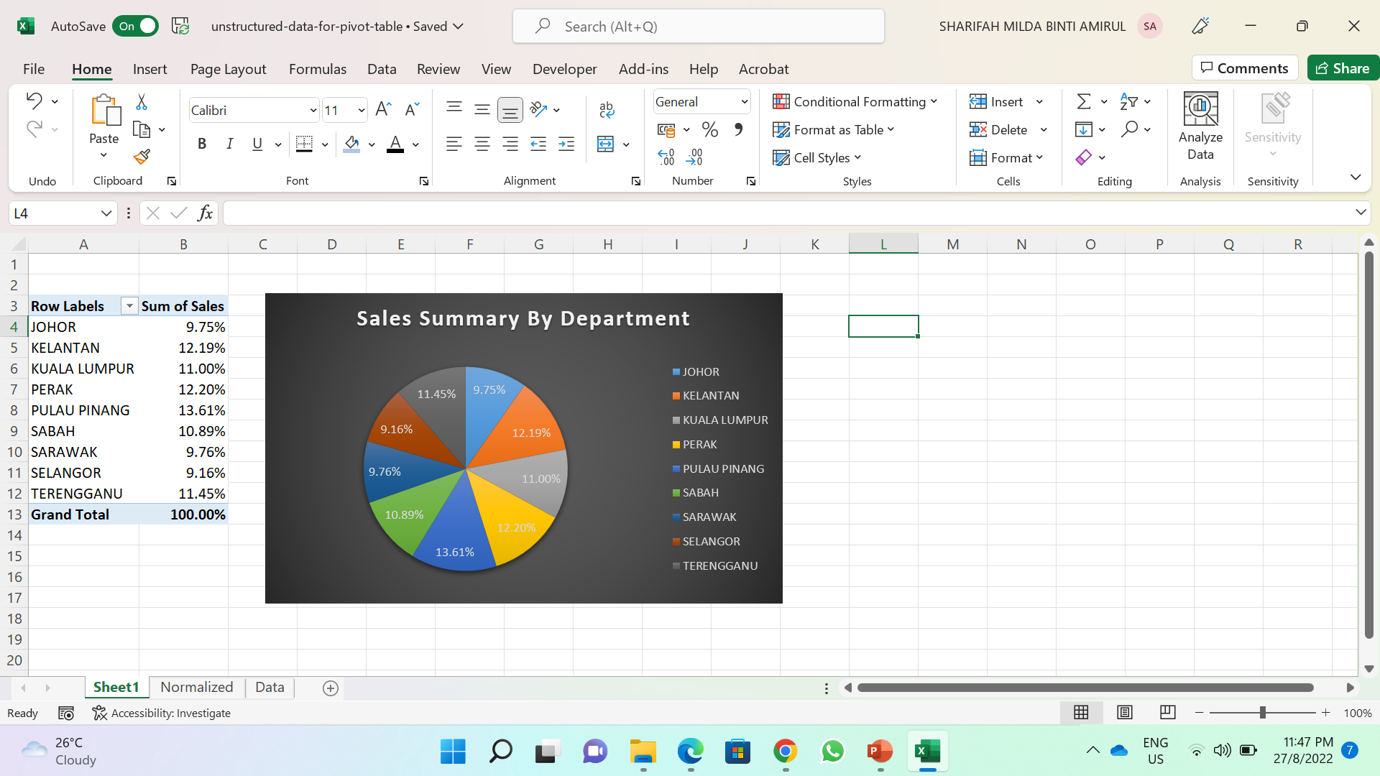
To create a dashboard, follow the following steps:
Load the TNT BHD Sales Report File which you have done the normalization.
Select cells range A1: H109> Insert > Pivot Table.
In the PivotTable Field, select the Department and drag it to Raw Quadrant.
Next, select Sales and drag it to Column Quadrant (see Figure 2.2.
Next, select cells range A2:B10 > Insert > Pie or Doughnut Chart (see Figure 2.3).
Next, lets analyse the expenses. Select the Normalized Sheet. Then repeat the step no 2 – no 5
Figure 2.2
Figure 2.3

Slide 8
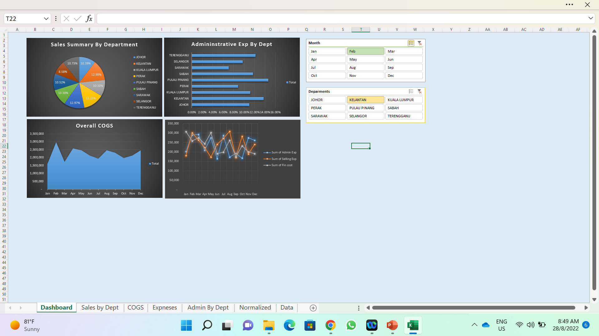
Now, to create a dashboard click on adding new sheet, then rename it to “Dashboard”. Next cut and paste all charts created into this Dashboard Sheet.
To create sliders in the dashboard sheet, select any of the charts, then go to PivotChart Analyze > Insert Slicer (see Figure 2.4)
Figure 2.4

Slide 9
3. DuPont Analysis Financial Statements
DuPont Analysis is regarded as a detailed assessment of the company’s profitability.
The profitability measures business’s ability to generate earnings relative to its expenses and other costs
Source: https://corporatefinanceinstitute.com/resources/knowledge/finance/dupont-analysis/

Slide 10
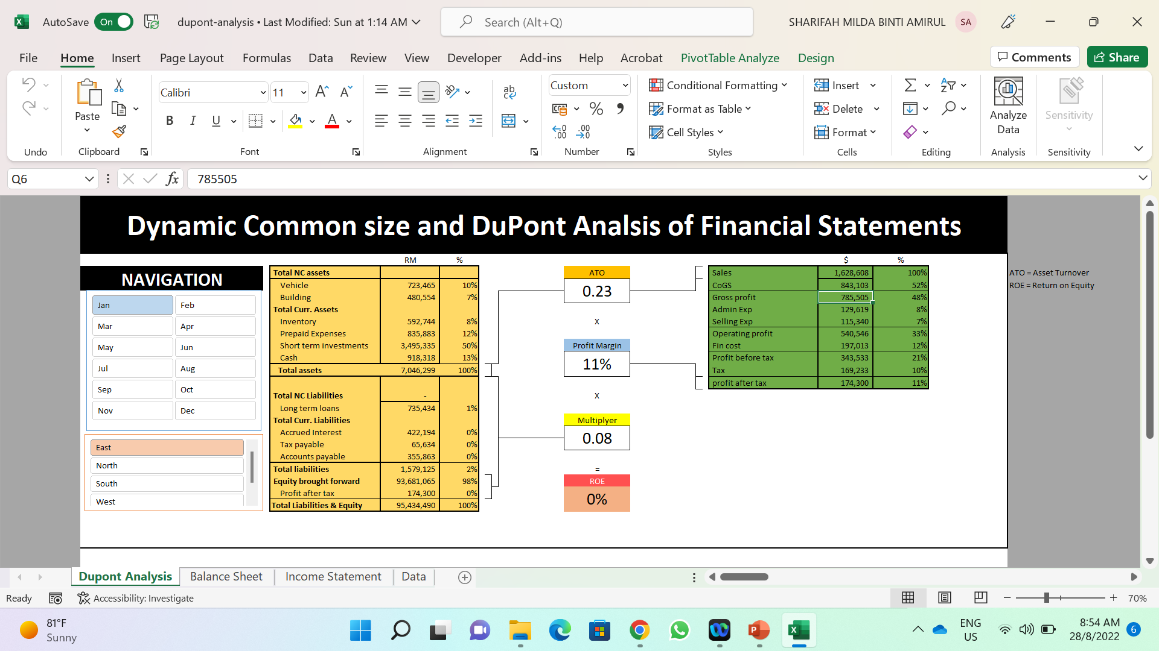
Now, to create a Dashboard for Du Pont Analysis, unload the DuPont Analysis File.
Create a PIVOT Table for the Data.
  Profit and Loss Statement
  Balance Sheet.
Next, create a Dashboard for the Dupont Analysis showing a Navigation for 12 month and Region information (see Figure 3.2)
Figure 3.2

