Slide 1



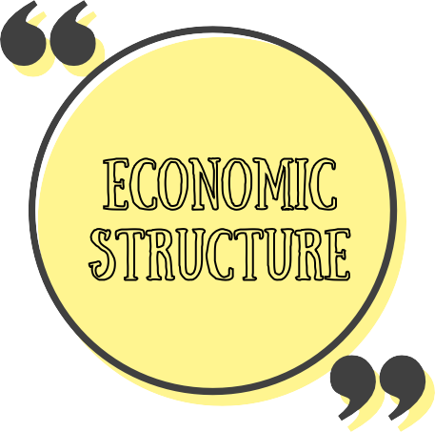

YOUTH UNEMLOYMENT
AGED 15 - 24 YEARS
PREPARED BY: VIVIANNA ANAK MARCUS, CHEONG JIA QI
MALAYSIA VS INDONESIA
WHAT Ift UNEMPLOYMENT ?
According to Morozova (2017), unemployment is defined by the International Labour Organization as the state in which an individual does not have a job but has actively sought employment for the previous four weeks. Therefore, unemployment can lower a person's sense of self-worth by having an impact on their social, physical, and economic performance (Durjadin and Goffette-Nagot , 2007). Hossain (2018) stated that, if the unemployment problem is not addressed, there will certainly be an increase in the number of unemployed graduates, as well as a negative impact on the nation, society, and even the country's development.
“In the middle of difficulty lies opportunity.” —Albert Einstein
who is youth unemployment ?
Youth unemployment refers to the situation in which persons between the ages of 15 to 25 are actively looking for work but are unable to find acceptable positions.
THEORY OF UNEMPLOYMENT
KEYNESIAN THEORY
unemployment can occur when the economy's aggregate demand is insufficient.
MALAYSIA
FRICTIONAL THEORY
transitory unemployment that happens when people are shifting between occupations.
INDONESIA
0 % 2 % 4 % 6 % 8 % 10 % 12 % 14 %
Figure 1 shows unemployment rate in 2022
STRUCTURAL THEORY
unemployment might result from a mismatch between the workforce's abilities
WHAT Ift FACTORft INFLUENCE OF YOUTH UNEMPLOYMENT ?
CLASSICAL THEORY
labor markets spontaneously adapt to equilibrium, with wages and prices adjusting to correct any temporary imbalances
Skills Mismatch
Technology Challenge
Economic Structure
WHAT Ift THE IMPACT OF YOUTH UNEMPLOYMENT ?
Economiic Consequences
Sociial Diiscontent
Long-term Scarriing

Slide 2


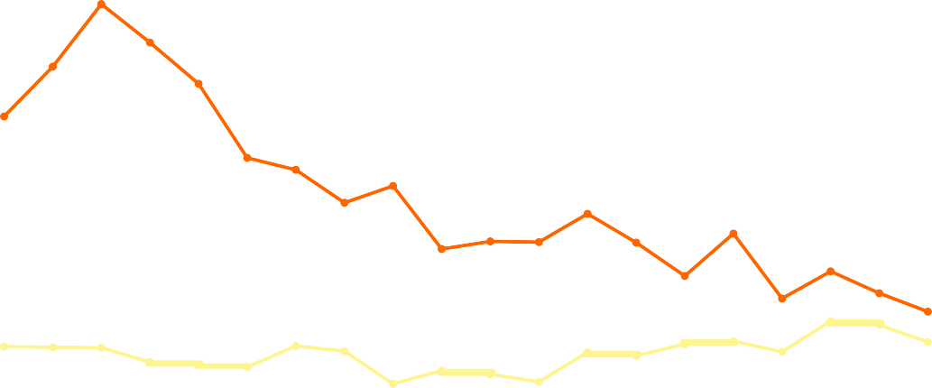




how to reduce youth unemployment ?
UNEMPLOYMENT RATE AMONG YOUTH BETWEEN MALAYSIA AND INDONESIA
OFEER ON-THE-JOB TRAINING
By fostering the growth of tomorrow’s skilled workforce, on-the-job training for young employees benefits both the youths and the long-
30
25
term success of the company.
20
15
ENCOURAGE ENTREPRENUERSHIP
It is imperative that the youth develop business, technical, and life skills that extend beyond the business. These youth might not always be in entrepreneurial roles but having skills that will stand them in good stead.
10
5
0
2003
2004
2005
2006
2007
2008
2009
2010
2011
2012
2013
2014
2015
2016
2017
2018
2019
2020
2021
2022
MALAYSIA
INDONESIA
CROSS-GENERATIONAL MENTORSHIP
When different generations share their ideas,
skills, and experience of the older generations and the fresh ideas, new perspectives, and tech- savvy of the youth, resulting in more productive environment.
2022
Youth unemployment rate in Indonesia in 2022 was 13.02%.
Meanwhile, the youth unemployment rate in Malaysia in 2022 was 11.7%. Malaysia has been known for its relatively stable and diversified economy, which may have contributed to the lower youth unemployment rate compared to Indonesia.
2021
A small recovery brought the rate down to 12.44%, thanks to adapting to the new normal and increased employment in
“Youth must also have the proper attitude to match the requirements of employers, such as being committed to their jobs, are hardworking, being team players, able to work under pressure and have a desire to learn.” - Tun Dr Mahathir Mohamad
various sectors.
2020
COVID-19 hit hard, causing youth unemployment to spike to 12.61%, especially impacting middle and low-skilled jobs.
REFERENCES
Furnham, A. (1985). Youth unemployment: A review of the literature.
Journal of adolescence, 8(2), 109-124.
O'higgins, N. (2001). Youth unemployment and employment policy: A global perspective. O’Higgins, (2001).

