Slide 1


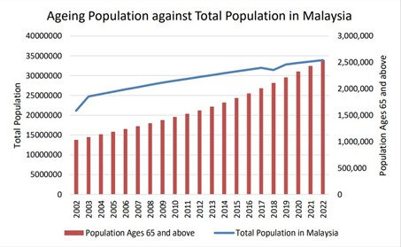
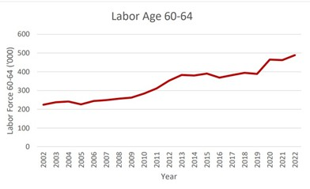
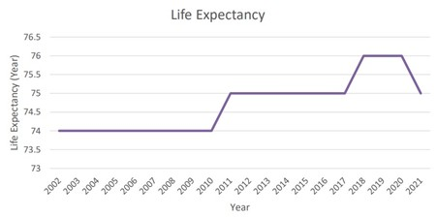

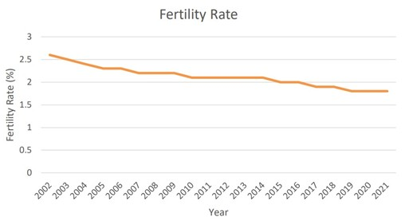
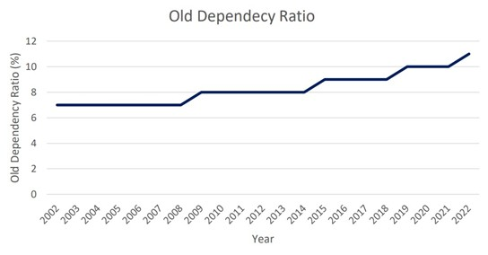

AGEING POPULATION ON
TEO JUE YING
CHEONG JIA QI
ECONOMIC GROWTH IN MALAYSIA
Ageing is a global phenomenon, with Malaysia experiencing an increasing number of older people aged 60 and above and a decreasing number of young people aged 15 and below. The Department of Statistics Malaysia reports that the elderly population is increasing every year, with the 15% threshold expected to be crossed by 2030. This ageing population has impacted Malaysia's economic growth, as it is less likely to contribute to GDP. The effects of ageing population on socioeconomic development are significant, and it is crucial for all parties to work together to minimize the impact of this population increase on the country's economy.
Literature Review
OLD AGE
LABOUR FORCE
FERTILITY RATE
DEPENDECY RATIO
PARTICPATION
The total fertility rate, the average number of children born to a woman throughout her lifetime, has dropped to its lowest level in fifty years in 2022, with 1.6 children per woman between the ages of 15 and 49. This decline in fertility will have a significant impact on economic development, productivity growth, and welfare system components. The ageing population may lead to higher savings rates, which could increase the capital-labour ratio and support individual saving. Malaysia's female labor force participation rate increased from 44.5% in 1982 to 55.2% in 2018, while the fertility rate decreased from 4.0% in 1982 to 1.8% in 2018. Investing in women's education and skill development can strengthen the economy and drive consumer spending. Ensuring the benefits of increased female labor force participation translate into sustainable and inclusive economic development depends on policies supporting gender equality, equal pay, and supportive work conditions.
The ageing population drives up government expenditure and impedes economic growth. Governments invest heavily in social security, pensions, and health care, particularly in sectors related to the elderly. However, the negative effects of ageing vary depending on the policy in place. A one percent rise in the old-age dependence ratio can significantly increase government spending. Additionally, an increasing old-age dependency ratio can raise the saving rate, impacting the economy's growth. However, some researchers argue that larger old-age dependence ratios discourage saving, slowing
Ageing is caused by fertility rates and increased life expectancy, leading to an increase in female labor force participation. However, the female labor force is negatively connected to economic growth and government effectiveness. Additionally, an older population may result in a drop in worker productivity, as employees in fundamental occupations become less productive. This can lead to a decline in GDP per capita growth, with a decrease in labour productivity growth accounting for two-thirds of this
decline.
LIFE E/PECTANCY
Life expectancy plays a significant role in a country's socioeconomic situation, with Malaysia experiencing a significant increase in its population over time. The government's spending on rewards, pensions, and senior health care has increased due to Malaysia's longer life expectancy. This has led to a rise in health expenses and the need for more geriatricians and specialists. Life expectancy rises in countries with higher living standards, as it allows for consumption of goods and services that promote health. Longer life expectancies also encourage people to save more for future needs, contributing to economic growth. As life expectancy rises, savings in the economy increase, contributing to the country's output growth rate.
economic development and capital accumulation. Generally, there is a negative correlation between economic growth and the old-age dependence ratio, with a 1% rise in old-age reliance reducing GDP growth by an average of 6.6043%.
Ageing population against
Labour force PartIcIpatIon of the Elderly
LIfe Expectancy of the Elderly
total population
ANALYSIS
Aging Groups - 60 & above (WHO, 2023) Ameliorating socioeconomics status (Nor & Ghazali, 2021) Healthcare - ↑ life quality Healthcare Index (69.87) & Quality-of-Life Index (124.29)
Fluctuation Incremental aging labor force -
↑monthly household expenditure [RM3,011 (2002) to RM8,479 (2022) Haze Crisis (2005)
Fluctuation Longer life expectancy - nation’s public healthcare system - free/min charge Covid-19
Analysis
fertIlIty Rate of the Elderly
Old Dependency RatIo of the Elderly
CONCLUSION
To summarise, effectively dealing with the difficulties presented by a growing elderly population necessitates a comprehensive and diverse strategy. Policymakers must contemplate approaches to uphold an efficient labour force, guarantee the longevity of social assistance systems, and cultivate innovation. The ultimate influence on economic growth will be contingent upon the effective management of these difficulties and the degree to which societies successfully adjust to demographic shifts.
Decline 2.5 children per woman - 1.8 children per woman Higher education -
↑FLFP (economic growth) Birth rate ≠
Death rate = ↑ Aging population
Old Dependency Fertility rate ↓ - ↑ Old Dependency Ratio - Working age population National expenditure
REC MMENDATI N
A "silver ec n my" industry can be created by rec gnising the
Government is encouraged to extend the retirement age
Malaysia5s current mandat ry retirement age is 60, with l w early retirement pti ns. An increase t 65 c uld indirectly decrease savings and increase the lab r f rce, pr m ting ec n mic gr wth. This c uld als sh rten pensi n peri ds, reduce g vernment spending, and accelerate ec n mic gr wth.
sustainable rise in ld dependency rates. The silver-haired industry pr tects elders. Future impr vements will pri ritise seni rs5 basic and pr f und needs. First, pri ritise healthcare, assisted living, and age-friendly h using f r seni rs. It has f ur key sect rs: medical care, daily c nsumpti n, leisure and entertainment, and life security. Industrial devel pment pri ritises seni r cl thing, f d, h using, transp rtati n, and healthcare. The ec n my gains fr m devel ping these sect rs. H me care, assisted living, age-friendly instituti ns, rem te m nit ring, m bile apps, telemedicine, and seni r rehabilitati n can be pri ritised. Rem te patient m nit ring, m bile health apps, telemedicine, and elder rehab equipment are als available. dwellings can als inspire the c nstructi n f retirement c mmunities, independent r assisted living facilities, nursing h mes, and h me rem delling services, making existing dwellings m re accessible t seni rs. It can attract investment. Venture capitalists and c rp rati ns expl ring new pr spects fund silver industry.
As life expectancy
Malaysia sh uld implement family-friendly p licies, such as paid parental leave and flexible w rk arrangements, t increase fertility rates and reduce the
Hire and retain older workers
increases, healthcare c sts will rise. G vernments sh uld ensure sustainability f public health care pr grams, invest in health infrastructure, and supp rt the elderly health industry. This will help
Malaysia can emulate Japan5s
Silver Human Center5s pr gram,
Res urces
ffering
RŒCOMMŒNDAÜHON
ageing M netary
part-time, paid empl yment
p pulati n.
t retirement age men and w men, free skills training, and j b-interview preparati n. Flexible w rking arrangements can impr ve pr ductivity and ec n mic gr wth.
maintain increase
and b st
rewards and educati nal initiatives can als
health,
pr ductivity, ec n mic empl yment.
enc urage m re children, b sting ec n mic gr wth and pr ductivity.
activity and

