Slide 1
“Breaking Free from the Digital Grip"
(Melepaskan Diri dari Genggaman Digital)
By;
Mazlinda Musa RN
Faculty of Medicine and Health Sciences,
Universiti Malaysia Sabah

Slide 2
Objectives
Raise awareness about the risks and negative consequences of excessive gadget use and addiction.
Identify signs and symptoms of gadget addiction and the impact it has on individuals' well-being and daily functioning.
Promote healthy technology habits and the importance of balancing gadget use with other activities.
Provide strategies and tools to manage gadget addiction, including setting boundaries, practicing digital detox, and cultivating alternative hobbies.

Slide 3
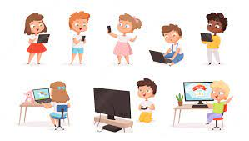
Definition
Excessive and unbalanced use of digital devices such as smartphones, tablets, and computers
Leads to negative consequences on physical, mental, and social well-being.

Slide 4
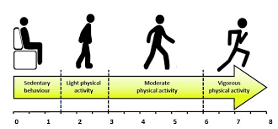

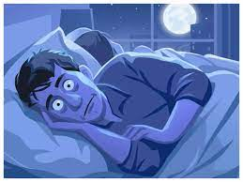
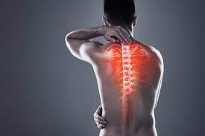
Impact of Excessive Gadget Use on Physical
Sedentary behaviour
Eye strain
sleep disturbances
musculoskeletal issues

Slide 5
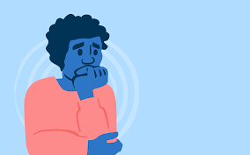
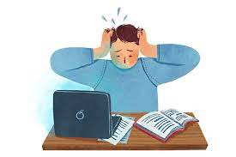
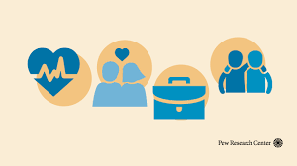

Impact of Excessive Gadget Use on Mental Well-being
Anxiety
Stress
Reduced overall life satisfaction
Depression

Slide 6
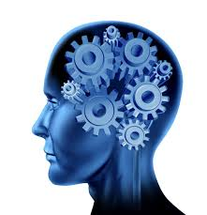
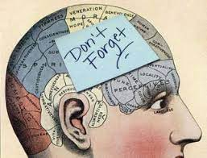

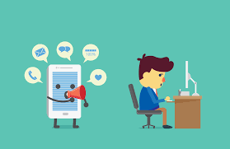
The psychological and physiological effects of gadget overload
Cognitive Function
Memory
Information Processing
Attention Span

Slide 7
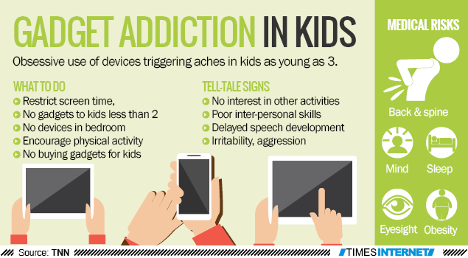

Slide 8
Concept of Digital Dependency
Digital dependency as a reliance on gadgets and digital technology for daily functioning and emotional well-being.
The consequences of digital dependency, including:
  reduced self-regulation,
  decreased self-esteem,
  impaired social interactions.

Slide 9
Signs of Gadget Overload
Preoccupation with gadgets,
Withdrawal symptoms when not using them, and
unsuccessful attempts to cut back on usage.
Nomophobia (fear of being without a mobile device).

Slide 10
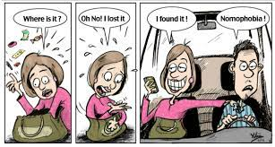

Slide 11
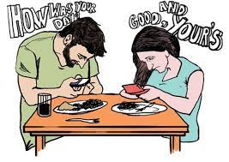



Negative Effects on Relationships, Productivity, and Overall Quality of Life
Interpersonal Relationship
Eg: Decreased face-to-face interactions
Impaired Social Skills
Reduced Academic Performance
Eg: Decreased focus
Productivity

Slide 12
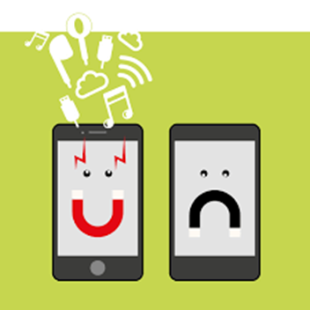

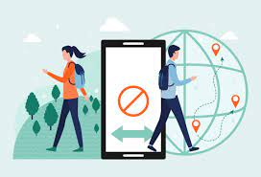
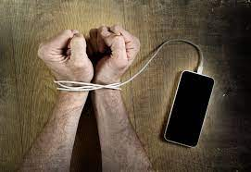
Differences Between Healthy and Unhealthy Gadget Use
Healthy Gadget Use
Unhealthy Gadget Use
Devices are used intentionally
In moderation
compulsive
uncontrolled usage.

Slide 13
Thank you
Any questions?

