Slide 1
5. Palliative nursing care for patients with cancer and HIV-AIDS
By;
Mazlinda Musa
MNSc (UM, Msia),BNSc (Hons)(UKM, Msia), Cert III Individual Support, (INHA,Aus), RN
Faculty of Medicine and Health Sciences,
Universiti Malaysia Sabah,
Tel: +6013 8155734 (mobile)

Slide 2
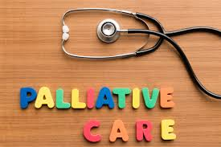
Introduction
Palliative nursing care for patients with cancer and HIV/AIDS is a specialized area of healthcare focused on improving the quality of life for individuals facing these serious illnesses.
It aims to provide physical, emotional, and spiritual support to patients and their families throughout the disease trajectory, with a particular focus on managing symptoms, relieving suffering, and enhancing overall well-being.
Nursing care for a terminal patient with HIV/AIDS focuses on providing comfort, support, and maintaining their dignity and quality of life.
It is essential to approach the care of these patients with empathy, respect, and a holistic perspective.

Slide 3

Overview about HIV& AIDS

Slide 4
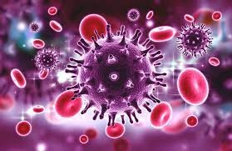
HIV (Human Immunodeficiency Virus)
HIV is a virus that attacks the immune system, specifically the CD4 cells (T cells), which are essential for the body's defences against infections.
  HIV weakens the immune system over time, making it harder for the body to fight off infections and diseases.
HIV is primarily transmitted through the exchange of certain body fluids, including blood, semen, vaginal fluids, rectal fluids, and breast milk.
  Common modes of transmission include unprotected sexual intercourse, sharing needles for drug use, and from mother to child during childbirth or breastfeeding.

Slide 5
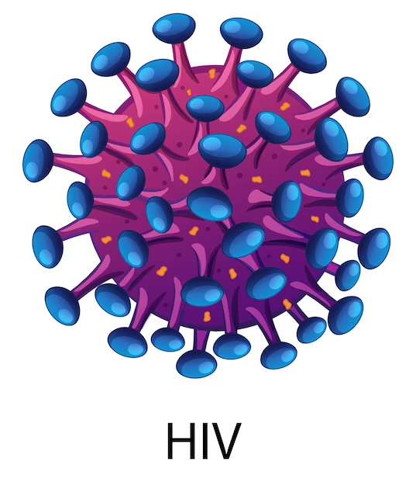
HIV (Human Immunodeficiency Virus)
HIV infection has several stages, including acute infection, clinical latency (a period of no symptoms), and eventually, if left untreated, progression to AIDS.
Antiretroviral therapy (ART) is the standard treatment for HIV. It involves taking a combination of medications that can suppress the virus, allowing the immune system to recover and preventing the progression of the disease. ART can also significantly reduce the risk of transmitting HIV to others.

Slide 6
The stages of HIV infection
HIV infection, stage 0: first positive HIV test result within 6 months after a negative HIV test result. The stage remains stage 0 until 6 months after the first positive test result.
After 6 months, the stage may be classified as 1, 2, 3, or unknown if based on a CD4 test result or the diagnosis of an AIDS-defining condition.
The diagnosis of an AIDS-defining condition or a low CD4 test result before the 6 months have elapsed does not change the stage from stage 0 to stage 3.
https://www.cdc.gov/HIV/library/reports/HIV-surveillance/vol-26-no-2/content

Slide 7
The stages of HIV infection
HIV infection, stages 1, 2, and 3: documentation of an AIDS-defining oi (excluding stage 0 as described above) is stage 3.
Otherwise, the stage is determined by the lowest CD4 lymphocyte test result:
  Stage 1—CD4 lymphocyte count of ≥500 or a CD4 percentage of total lymphocytes of ≥26
  Stage 2—CD4 lymphocyte count of 200–499 or a CD4 percentage of total lymphocytes of 14–25
  Stage 3—CD4 lymphocyte count of <200 or a CD4 percentage of total lymphocytes of <14 or documentation of an AIDS-defining condition.
HIV infection, stage unknown: no reported information on AIDS-defining conditions and no information available on cd4 count or percentage.
https://www.cdc.gov/HIV/library/reports/HIV-surveillance/vol-26-no-2/content

Slide 8
Signs and symptoms
The symptoms of HIV vary depending on the stage of infection.
The disease spreads more easily in the first few months after a person is infected, but many are unaware of their status until the later stages.
In the first few weeks after being infected people may not experience symptoms. Others may have an influenza-like illness including:
  Fever
  Headache
  Rash
  Sore throat.

Slide 9
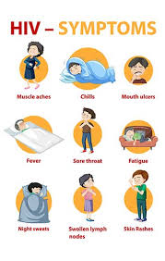
Signs and symptoms
The infection progressively weakens the immune system.
This can cause other signs and symptoms:
  Swollen lymph nodes
  Weight loss
  Fever
  Diarrhoea
  Cough.

Slide 10
Signs and symptoms
Without treatment, people with HIV infection can also develop severe illnesses:
Tuberculosis (TB)
Cryptococcal meningitis
Severe bacterial infections
Cancers such as lymphomas and kaposi's sarcoma.
HIV causes other infections to get worse, such as Hepatitis C, Hepatitis B and Mpox.
  (Mpox is Monkeypox : an infectious disease caused by the Monkeypox virus.)

Slide 11
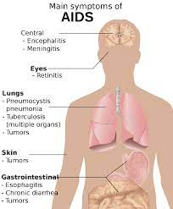
AIDS (Acquired Immunodeficiency Syndrome):
AIDS is a late stage of HIV infection.
It occurs when the immune system is severely damaged, and the body becomes vulnerable to opportunistic infections and certain cancers.
AIDS is diagnosed based on specific clinical criteria, such as the presence of certain opportunistic infections or a very low cd4 cell count.

Slide 12
key points about AIDS:
People with AIDS often experience a wide range of symptoms and illnesses, which can vary depending on the specific infections or conditions they develop.
These may include severe weight loss, fever, night sweats, chronic diarrhea, and neurological problems, among others.
AIDS can be life-threatening if not managed with appropriate medical care. However, with the advent of antiretroviral therapy (ART), the progression from HIV to AIDS has become less common in regions with access to treatment.
Cd4 count of 200 or fewer cells per cubic millimeter means that you have AIDS.
AIDS is not directly transmitted from person to person.
Instead, it is a condition that develops as a result of untreated or inadequately treated HIV infection.

Slide 13
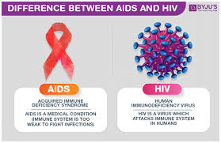
The Relationship between HIV and AIDS:
HIV is the virus that causes AIDS.
  Not everyone who is infected with HIV will develop aids.
  With proper medical care, including timely initiation of antiretroviral therapy, the progression from HIV infection to AIDS can be delayed or even prevented.
  HIV treatment helps maintain a person's immune system function and prevents the development of opportunistic infections that characterize aids.
It's important to note that there is no cure for HIV, but with ongoing treatment and care, people with HIV can lead long and healthy lives.
  Additionally, efforts in HIV prevention, education, and testing are crucial in reducing the spread of the virus.

Slide 14
The key components and details of palliative nursing care for patients with cancer and HIV/AIDS

Slide 15
Holistic Assessment:
Palliative nursing care begins with a comprehensive assessment of the patient's physical, emotional, psychological, and spiritual needs.
This assessment guides the development of an individualized care plan.

Slide 16
Symptom Management:
Effective symptom management is a cornerstone of palliative care. Nurses work closely with healthcare teams to address symptoms such as pain, fatigue, nausea, vomiting, dyspnea (difficulty breathing), and others.
Assess and manage pain and other distressing symptoms such as nausea, vomiting, diarrhea, and dyspnea (difficulty breathing).
Pain management may involve medications, physical therapy, relaxation techniques, and psychological support.
Palliative nurses help patients and families understand the importance of medication adherence and the management of side effects.
Administer prescribed medications promptly and adjust them as needed to provide relief.
Collaborate with the healthcare team to ensure pain and symptom control.

Slide 17
Nutritional support:
Monitor the patient's nutritional status and provide guidance on maintaining a balanced diet.
Address issues such as anorexia, weight loss, and difficulty swallowing, and adjust the diet as needed.
Collaborate with a registered dietitian if necessary.

Slide 18
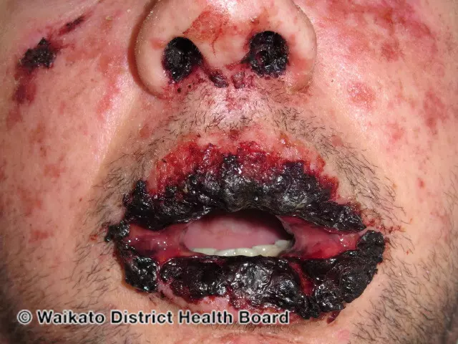
Skin and wound care:
Prevent and manage pressure ulcers (bedsores) by regularly repositioning the patient, using pressure-reducing surfaces, and providing meticulous skin care.
Assess and manage any wounds or skin infections promptly to prevent complications.

Slide 19
Infection control:
Emphasize strict infection control measures to reduce the risk of opportunistic infections.
Educate the patient and their family about hand hygiene, safe food handling, and avoiding exposure to sick individuals.
Monitor for signs of infection and initiate appropriate treatment promptly.

Slide 20
Medication management:
Ensure that the patient takes their antiretroviral therapy (ART) and other prescribed medications consistently.
Address any medication side effects or adherence issues.
  Anxiety, depression, diarrhoea, fatigue, flatulence, stomach discomfort, headache, nausea, skin reactions, sleep disorders, vomiting.
Collaborate with the healthcare team to adjust medication regimens as needed.

Slide 21
Emotional and Psychological Support:
Palliative nurses provide emotional support to patients and their families, helping them cope with the emotional challenges that often accompany cancer and HIV/AIDS diagnoses.
They offer counselling, facilitate communication within families, and connect patients with mental health professionals when necessary.
Grief and bereavement support is an essential component, including anticipatory grief for families facing terminal illness.

Slide 22
Communication:
Effective communication is crucial in palliative care.
Nurses help facilitate open and honest discussions about the patient's prognosis, treatment options, and goals of care.
They assist patients in making informed decisions about their treatment and end-of-life preferences.
  DNR

Slide 23
Advance Care Planning:
Palliative nurses guide patients in advance care planning, helping them document their healthcare wishes in advance directives or living wills.
They ensure that patients' preferences for end-of-life care are communicated and respected.

Slide 24
Spiritual and cultural care:
Palliative care includes addressing the patient's spiritual needs, which can vary widely. Nurses may facilitate access to spiritual counselors or ustaz/imam.
They support patients in finding meaning, purpose, and hope in their lives, even in the face of a serious illness.
Respect the patient's spiritual and cultural beliefs and incorporate them into their care plan.
Offer spiritual support, such as access to a chaplain or religious leader if desired.

Slide 25
Caregiver Support:
Palliative nurses recognize the importance of supporting family caregivers who often bear a significant burden in caring for their loved ones.
They provide education, respite care, and emotional support to caregivers to help prevent burnout.

Slide 26
Complex Care Coordination:
Palliative nurses work closely with the entire healthcare team, including physicians, social workers, pharmacists, and other specialists, to coordinate care and ensure the patient's needs are met.
They help navigate the complex healthcare system, assist with accessing resources, and advocate for the patient's preferences and well-being.

Slide 27
End-of-Life Care:
For patients with advanced cancer or HIV/AIDS, palliative nursing care includes end-of-life care, which focuses on ensuring comfort, dignity, and a peaceful transition.
Nurses provide expert symptom management, emotional support, and assistance with making the patient's final moments as comfortable as possible.
Assist the patient and family in discussing and documenting their wishes regarding end-of-life care, resuscitation, and organ donation.
Help create an advance directive and ensure that it is up to date and legally valid.
Initiate discussions about hospice or palliative care options if appropriate.

Slide 28
Emotional support:
Provide emotional support to the patient and their family. A terminal diagnosis can cause anxiety, depression, and fear.
Encourage open communication and active listening to address the patient's concerns and feelings.
Offer referrals to support groups or mental health professionals if necessary.

Slide 29
Family support:
Include the patient's family in care discussions and decisions.
Offer family members emotional support and education on caregiving and end-of-life issues.
Help the family access resources for grief counselling and bereavement support.

Slide 30
Bereavement Support:
After a patient's death, palliative nurses offer ongoing bereavement support to the family, helping them cope with grief and loss.
Palliative nursing care is a collaborative effort, and nurses work closely with interdisciplinary teams to provide comprehensive support to patients and their families.
The goal is to improve the patient's quality of life and relieve suffering, whether the patient is living with cancer or hiv/aids

Slide 31
Conclusion
Nursing care for terminal patients with HIV/AIDS should be tailored to the individual's needs, preferences, and stage of illness.
It is essential to work collaboratively with the healthcare team, involve the patient and their family in decision-making, and provide compassionate care throughout the end-of-life journey.

Slide 32
References
National Hospice And Palliative Care Organization (NHPCO): Website: Https://Www.Nhpco.Org/ NHPCO Offers A Wealth Of Resources, Publications, And Educational Materials Related To Hospice And Palliative Care, Including Nursing Care For Patients With Serious Illnesses.
World Health Organization (Who) Palliative Care: Website: Https://Www.Who.Int/Health-topics/Palliative-care WHO Provides Information And Guidelines On Palliative Care, Which Can Include Nursing Care For Cancer And HIV/AIDS Patients.
American Cancer Society (Acs): Website: Https://Www.Cancer.Org/ ACS Offers Resources And Information On Cancer Care, Including Palliative Care And Support For Patients And Their Families.
The Joint Commission: Website: Https://Www.Jointcommission.Org/ The Joint Commission Provides Accreditation And Certification Information For Healthcare Organizations, Including Those That Offer Palliative Care Services.
National Institute Of Nursing Research (Ninr): Website: Https://Www.Ninr.Nih.Gov/ NINR, Part Of The National Institutes Of Health (NIH), Conducts Research Related To Nursing Care, Including Palliative Care, And Provides Resources For Healthcare Professionals.
International Association For Hospice And Palliative Care (Iahpc): Website: Https://Hospicecare.Com/Home/ IAHPC Is A Global Organization That Provides Resources, Research, And Education In The Field Of Palliative Care.
Centres for Disease Control and Prevention (CDC). HIV Basics. Https://Www.Cdc.Gov/HIV/Basics/Index.Html
UNAIDS. HIV/AIDS Basics. Https://Www.UnAIDS.Org/En/Resources/Fact-sheet
World Health Organization (WHO). HIV/AIDS. Https://Www.Who.Int/Health-topics/HIV-AIDS#tab=tab_1

