Slide 1


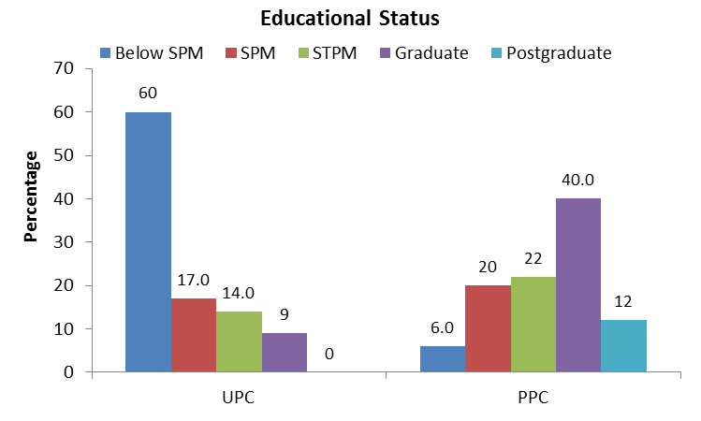
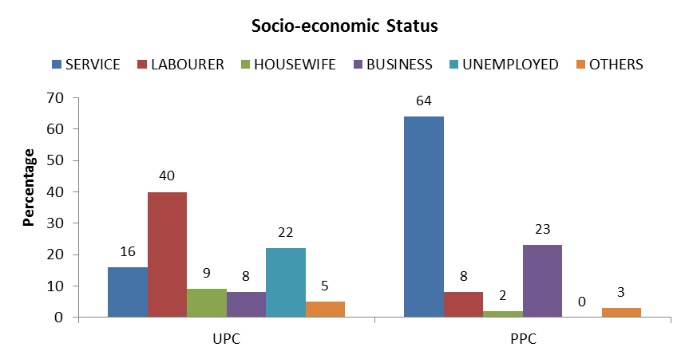
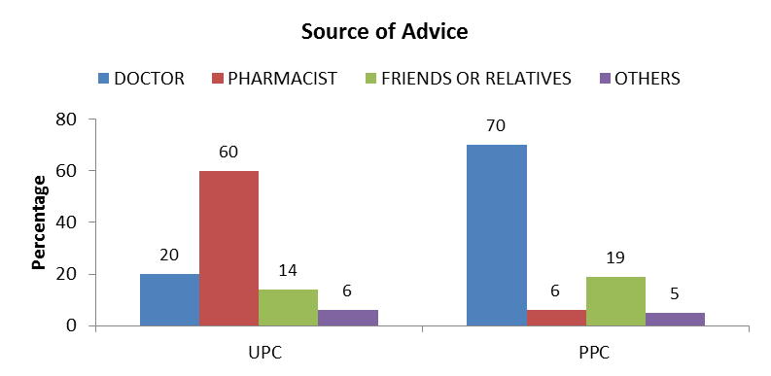
Rational Use of Drugs: A way to improve the quality of health care
Md.Shamsur Rahman^{1*}, Che Ismail Che Noh¹, Mohd.Hijaz Mohd Sani¹, Wan Salman Wan Saudi¹, Fairrul Kadir²
¹Department of Biomedical science and Therapeutics, Faculty of Medicine and Health Sciences, Universiti Malaysia Sabah, Jalan UMS, 88400 Kota Kinabalu, Sabah, Malaysia.
²Department of Medicine based discipline, Faculty of Medicine and Health Sciences, Universiti Malaysia Sabah, Jalan UMS, 88400 Kota Kinabalu, Sabah, Malaysia.
*Corresponding author: shamsur@ums.edu.my
Introduction
Methodology
Patients have been using drugs for a long time to cure or control diseases and symptoms. Drugs can do good or can do harm to the users. Indiscriminate use of drugs also can endanger patient’s lives. Drug therapy therefore requires knowledge, judgment, skill and wisdom, but above all a sense of responsibility¹.
Irrational prescribing has further complicated the drug use problem. Numerous studies done at developed and developing countries, describe it as a pattern consisting of polypharmacy, use of drugs that are not related to the diagnosis, irrational use of antibiotics and self-medication, with many drugs taken in insufficient quantities. Rational prescribing is therefore one important aspect of rational use of drugs² . The impact of irrational use of drug is reduction in the quality of drug therapy leading to increased morbidity and mortality.
One of the most widely used and abused drugs all over the world are pain-killers. Fever and pain are usually the early symptoms of most of the inflammatory diseases. The introduction of non-steroidal anti-inflammatory drugs (NSAIDs) was a landmark event and soon these drugs became the most widely used medication not only for the relief of pain and fever but also for their anti-inflammatory effect³.
The main aim of this study was to obtain information regarding the prescribing pattern with respect to pharmacological subclasses of NSAIDs by the medical prescribers in the OPDs of some selected polyclinics in Kota Kinabalu, Sabah.
This is a prospective cross sectional (descriptive) study. The study was carried out in outpatient departments of two selected polyclinics in Kota Kinabalu, Sabah, namely: UMS polyclinic (UPC) and a private polyclinic (PPC). Duration of study period was one year.
Four hundred (200 from each polyclinic) prescriptions containing NSAIDs were collected, photocopied and later analyzed. The patients having prescriptions that did not contain NSAIDs were excluded. A total of 200 patients (100 from each polyclinic) attending OPDs were selected for an in depth interview. After obtaining their consent, they were interviewed using a questionnaire.
Sample size was determined as per guideline of WHO/DAP⁴. Sample size for prescriptions was 200 from OPD of each polyclinic. On the other hand, sample size for patients was 100 from OPD of each polyclinic in this study. Patients were interviewed using a questionnaire. Data were analyzed by using percentage according to WHO guideline. As it was a descriptive study statistical analysis was not done.
Results
Pharmacological sub-classes of NSAIDs | UPC (n=200) | PPC (n=200)
Analgesic with no or minimal anti-inflammatory effect. (eg. Paracetamol, Ibuprofen, Mefenamic acid) | 94.5% | 24%
Analgesic with anti-inflammatory effect. (eg. Diclofenac sodium, Aceclofenac, Indomethacin, Naproxen, Ketorolac). | 5.5% | 76%
Average cost of drugs per prescription (RM)
UPC (n=200) | PPC (n=200)
29.79 | 47.17
Discussion
Conclusion & Recommendation
It was observed that educated and higher income group of patients mostly attended OPDs in PPC whereas less educated and lower income group of patients generally attended UPC. This was probably responsible for the substantial variations in the prescribing pattern with respect to pharmacological sub-classes of NSAIDs in the medical OPDs of two polyclinics. Analgesics with no or minimal anti-inflammatory effects were the most commonly prescribed NSAIDs in the medical OPDs of UPC, whereas analgesics with potent anti-inflammatory effects were the most commonly prescribed NSAIDs in the same OPD of PPC ⁵. Due to the nature of potent drugs, socioeconomically advantaged patients attending PPC is more likely to develop adverse effects.
Moreover, the prescribers in PPC had to prescribe more additional drugs than the prescribers of UPC to counter the adverse effects of NSAIDs. Ultimately the cost of prescribed NSAIDs per prescription and the cost of total drugs per prescription became greater in PPC compared to UPC. Therefore, educational and socio-economic status of the patients may have some effects on the prescribing pattern of NSAIDs. The patients taking NSAIDs before coming to hospital were influenced by pharmacists, friends and doctor’s advice given previously.
In conclusion, it may be said that the overall prescribing pattern of NSAIDs among two polyclinics is satisfactory. However, appropriate educational intervention can be designed for rational prescribing to improve the quality of health care and better quality of life of the public.
References
Bennett PN, Brown MJ. (2008). Topics in drug therapy. In: Clinical Pharmacology.10th Edition. New York: Churchill Livingstone p.5-31
Hogerzeil HV. (1988). Promoting Rational Prescribing: an International Perspective. In: Chowdhury RR. International Experience in Rational Use of Drugs; The College of Public Health, Chulalongkoron University, Bangkok, Thailand p.1-2.
Fernandez UR, Pedregal GM, Torrecila RMT. (2008). Development of NSAIDs prescription indicators based on health outcomes. Eur J ClinPharmacol. 64(1): 61-70.
WHO/DAP. (1993). How to investigate drug use in health facilities p 25-31.
Md.Shamsur Rahman, David Matanjun, Mohammad Tauffik Mohd Noor, Fairrul Kadir, Nur Asikin. (2014). Prescribing pattern of non-steroidal anti-inflammatory drugs at outpatient departments in government and private polyclinics in sabah state. Borneo Journal of Medical Science.8:21-26.

