Slide 1


Noor Kaziemah Sariman, Rozaidy Mahadi & Junainah Jaidi
CORPORATE GOVERNANCE AWARENESS & DISCLOSURE PRACTICES AMONG MALAYSIAN SMES:
AN EXPLORATORY STUDY
The 1st Borneo International Accounting Conference 2024
(BIAC 2024)
25 – 26 NOVEMBER 2024
UNIVERSITI MALAYSIA SABAH
Funded by UMS SBK RESEARCH GRANT (Grant no.: SBK0434-2018)
Notes:
+`

Slide 2


INTRODUCTION
In the last few decades, corporate governance (CG) has gained significant prominence in both developed and developing economies as businesses have come under increasing pressure to demonstrate accountability and transparency in their operations.
Most of CG guidelines focus on the public listed companies, neglecting the micro, small and medium sized enterprises (SMEs).
However, good corporate governance remains relevant for small businesses to ensure transparency and accountability of all financial information for the betterment of the enterprises.
Furthermore, governance mechanisms might be demanded from external parties such as financial institutions.
Funded by UMS SBK RESEARCH GRANT (Grant no.: SBK0434-2018)

Slide 3



RESEARCH OBJECTIVE
The research attempts to achieve the following research objectives:
RO1
To examine the level of awareness and corporate governance practices among Malaysian SMEs.
RO2
To examine the existence of corporate governance disclosure practices among Malaysian SMEs.
Why Malaysian SMEs?
1,101,725 firms of overall business establishments in Malaysia in 2023 (SME Corp Malaysia, 2024).
RM613.1 billion of GDP contribution, grew by 5.0% in 2023, according to the Department of Statistics Malaysia (The Star, 2024).
Funded by UMS SBK RESEARCH GRANT (Grant no.: SBK0434-2018)

Slide 4
RESEARCH METHODOLOGY
The research utilized the followings:
Research Design
Quantitative approach
Online questionnaire
Data Collection Technique
Respondents
Malaysian SMEs*
*Definition of SMEs is according to the SME definitions by SME Corp Malaysia.
Funded by UMS SBK RESEARCH GRANT (Grant no.: SBK0434-2018)

Slide 5
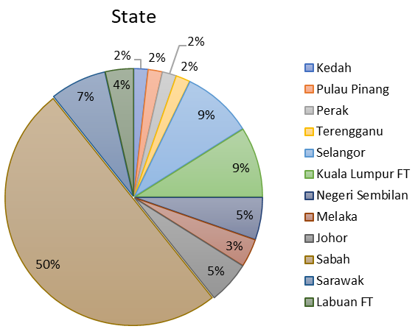
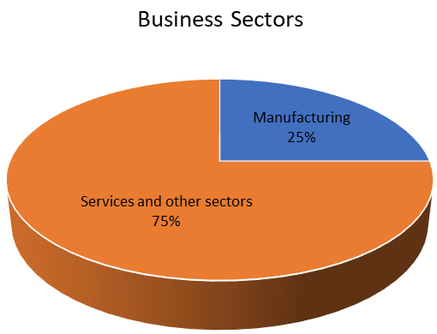
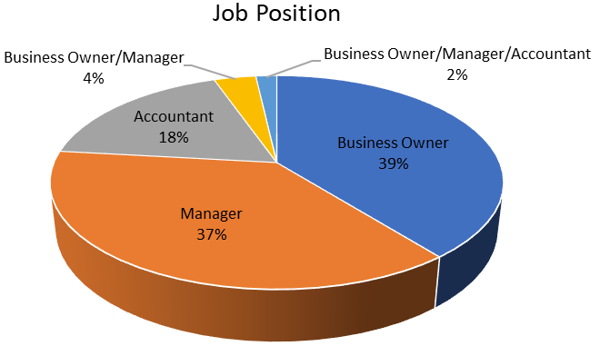
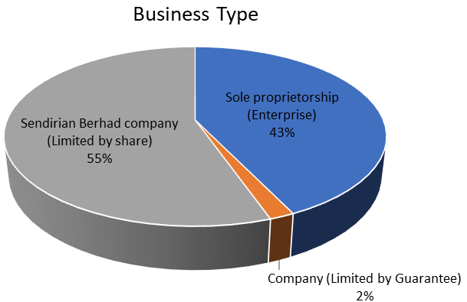
DEMOGRAPHIC RESULTS
Funded by UMS SBK RESEARCH GRANT (Grant no.: SBK0434-2018)

Slide 6
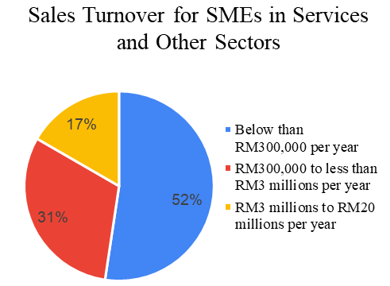
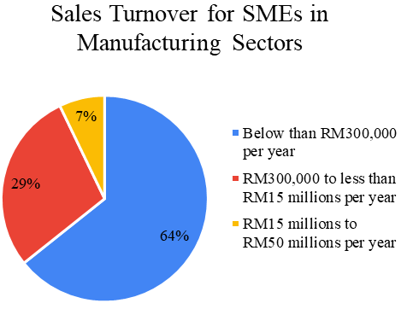
DEMOGRAPHIC RESULTS
Funded by UMS SBK RESEARCH GRANT (Grant no.: SBK0434-2018)

Slide 7
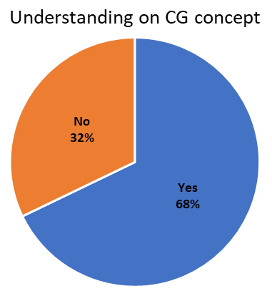
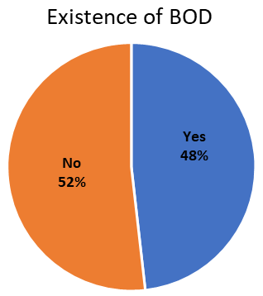
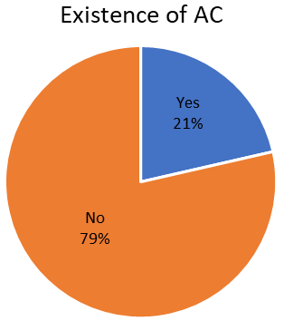
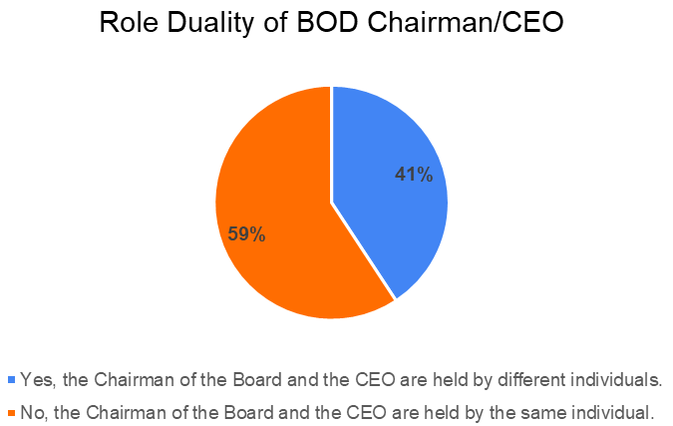
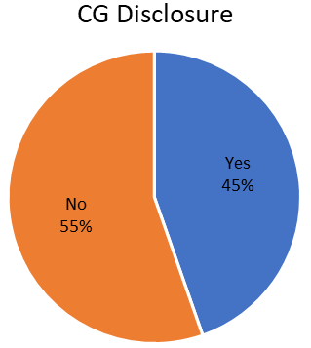
FINDINGS
Funded by UMS SBK RESEARCH GRANT (Grant no.: SBK0434-2018)

Slide 8
FINDINGS
The summary of research findings are as follows:
Corporate Governance Awareness & Disclosure Practices among Malaysian SMEs
Good awareness on the concept of corporate governance
Existence of Board of Directors (BOD) and Audit Committee (AC) are uncommon
Disclosure of CG practices are still very low
CEO role duality is lacking
Funded by UMS SBK RESEARCH GRANT (Grant no.: SBK0434-2018)

Slide 9
DISCUSSION & CONCLUSION
Corporate Governance Awareness & Disclosure Practices among Malaysian SMEs
Good awareness of CG concept does not translate to implementation of CG practices
Malaysian SMEs might not see tangible benefits of implementing & disclosing CG practices
The need for an establishment of CG code specifically tailored to SMEs
Possible causes: no regulatory requirements/ no external pressures/lack of resources
Funded by UMS SBK RESEARCH GRANT (Grant no.: SBK0434-2018)

Slide 10
RESEARCH LIMITATIONS
These are the limitations of this study:
Research limitations and future research
This is preliminary research, number of respondents are not representing the whole population
Only basic questions are asked to garner the basic understanding from Malaysian SMEs
Future research might employ interview methods to get deeper understanding on the barriers of implementing CG in smaller businesses
Funded by UMS SBK RESEARCH GRANT (Grant no.: SBK0434-2018)

