Slide 1

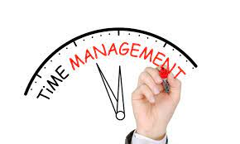
Time management
By;
Mazlinda Musa

Slide 2
Learning Objectives:
At the end of the session student should be able to:
Utilize time management in personal life and professional practice.
Identify stressors which lead to burnout in nursing.
Examine time wasters in nursing.
Identify barriers to time management.
Describe personal perceptions of time.
Discuss the rationale for good time management skills.
HOMEWORK : Describe the Rhythm Model for Time Management

Slide 3
OBJECTIVES
Differentiate and create short and long term goals.
Discuss methods nurses can improve on time management and organizational skills.
Analyze activities at work using time log.
Incorporate time management techniques into clinical practice.
Organize work to make more effective use of available time.
Set limits on the demands made on one’s time.
Create personal calendar using a computerized calendar system for nursing.

Slide 4
Why do you need time management?
To save time
To reduce stress
To function effectively
To increase our work output
To have more control over our job respinsibilities

Slide 5
The Value of Time
Time cannot be saved, so it must be used wisely
To accomplish a variety of tasks and goals, time management skills are needed

Slide 6
Time management
A method of organizing and monitoring time so that patient care tasks can be scheduled and implemented

Slide 7

How to use time effectively?
Effective planning
Setting goal and objectives
Setting deadlines
Delegation of responsibilities
Prioritizing activities as per their importance
Spending the right time on the right activities

Slide 8

Process of time management
Cost of your time
Making activities logs
Goal setting
Planning
Prioritizing
Scheduling

Slide 9
Perception of Time
Affects our use of time
Affects our response to time
Affects how we calculate time
Culture and environment interact to influence our perception of time
Time perception is a fundamental element of human awareness.
  Our consciousness, our ability to perceive the world around us and, ultimately, our very sense of self are shaped upon our perception of time in loop connecting memories of the past, present sensations and expectations about the future.

Slide 10
How Nurses Spend Their Time
One study showed that nurses spend only 35% of time in patient care
Documentation accounts for 20% of time
Much time is spent on administrative duties

Slide 11
Setting Limits
Learning to say “No”
Many requests are negotiable
  You may not refuse to accept an assignment; however, you can discuss possible alternatives to the situation
Eliminating unnecessary work
You may refuse to work overtime

Slide 12
Streamlining Work
Work smarter, not harder
Keep a time log
Reduce interruptions
Categorize activities
Find the fastest way
Automate repetitive tasks

Slide 13
Common time wasters
External time waster
Internal time waster
Interruption such as telephone call or drops visitor (socialization)
Meeting, both schedule & un schedule.
Ineffective communication
Lack of information
Lack of daily and weekly plan
Lack of clear goal, objectives and priorities
Failure to delegate

Slide 14
Common time wasters (continue)
External time waster
Internal time waster
Poor filing system
Paperwork & reading
Incompetent co-worker
Lack of adequate describe policy & procedure
Inability to say “No”
Procrastination
Lack of self discipline

Slide 15
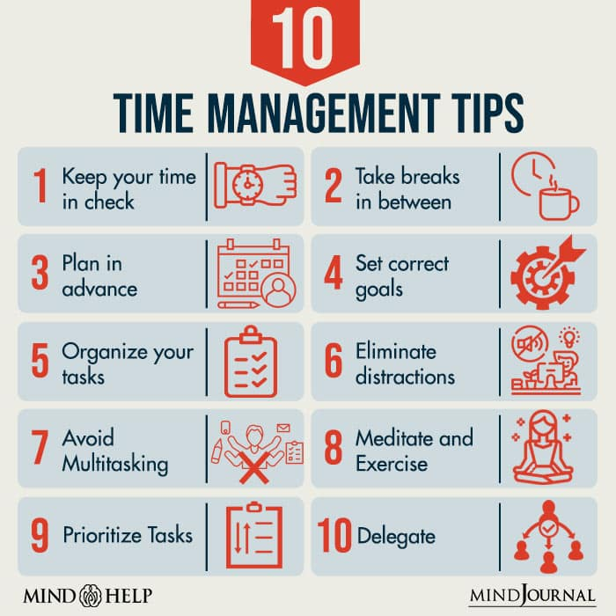
Organizing the Work
Setting goals
  Long-term goals
  Short-term goals
Lists
  Tickler files
  Time blocks
  Filing systems

Slide 16
10 best time management tips for nurses
Get into the habit of arriving early.
Make a note
Estimate how long it will take
Prioritize
Avoid task that aren’t in your list
6. Learning to say “NO”
7. Listen to your patients
8. Take a breather
9. Be flexible
10. Don’t be too hard on yourself.

Slide 17
Conclusion
It is important for the nurse to learn and use time management skills
Learn to delegate
Learn to say, “I would really like to help you; can it wait until I finish this?”
Learn to say “No”

Slide 18
HOMEWORK : Describe the Rhythm Model for Time Management
Please go to iTELUMS forum and Describe the Rhythm Model for Time Management!
Not to forget to put your references ya!

Slide 19
Further reading
H., Yadav et al., (2011). Nursing Management, 1st ed., OXFORD
P.,Kelly (2012) Nursing Leadership& Management.3rd ed., Delmar, Cengage.
Cook, M. J. (1996) Time Management, Massachusetts: Adams Media Corp.
Bird, M. (1986) The Time Effective Manager, London: Ebury Press.
Scot, M. (1992) Time Management, Sydney: Rando House.
Taylor, H. L. (1988) Time Management, Selangor: Pelanduk Publications.

Slide 20

Thank you
Any questions?

