Slide 1
3. Nutrition and fluid management for palliative patients
By;
Mazlinda Musa
MNSc (UM, Msia),BNSc (Hons)(UKM, Msia), Cert III Individual Support, (INHA,Aus), RN
Faculty of Medicine and Health Sciences,
Universiti Malaysia Sabah,
Tel: +6013 8155734 (mobile)

Slide 2
LEARNING OUTCOMES
State the importance of appropriate nutrition and hydration of the terminally ill patients.
State the nutritional and hydration assessment of the terminally ill patients.
Outline the appropriate diet regime for the terminally ill patients.
Describe the collaborative care for cancer patients.

Slide 3
Definition of terms
Terminally ill defined as
The status of a person expected to die within six months from a specific condition and thus may need hospice care. Mcgraw-hill concise dictionary of modern medicine © 2002
A final fatal illness. Taber’s cyclopedic medical dictionary (2009)
An advanced stage of a disease with an unfavorable prognosis and no known cure.

Slide 4
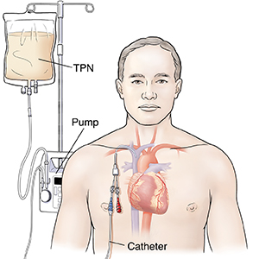
NUTRITIONAL NEEDS
Many patients or families raise the possibility of using total parenteral nutrition (TPN) when a patient with advanced cancer is eating poorly and losing weight.
Generally, in these situations, a clear, careful, discussion should take place to explain why TPN is only an option for rare selected cases, given that the vast majority of patients with advanced cancer die from the cancer process, not starvation.

Slide 5
Cont.
Loss of appetite, fatigue, and weight loss can, in fact, be part of the dying process.
Randomized studies of nutritional support in patients with advanced cancer have failed to show any benefit in improving either survival or quality of life.
If it is justified on the best clinical grounds, then it is ethically right to give
……… if not, it should not be done.

Slide 6
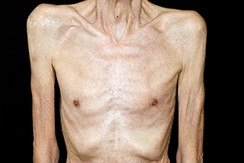
Causes of weight loss and wasting in advanced cancer
Is nearly always due to the cachexia syndrome.
Is caused by changes to metabolism secondary to the disease process.
Is never responsive to enteral or parenteral nutrition ….. i.e. They are futile

Slide 7
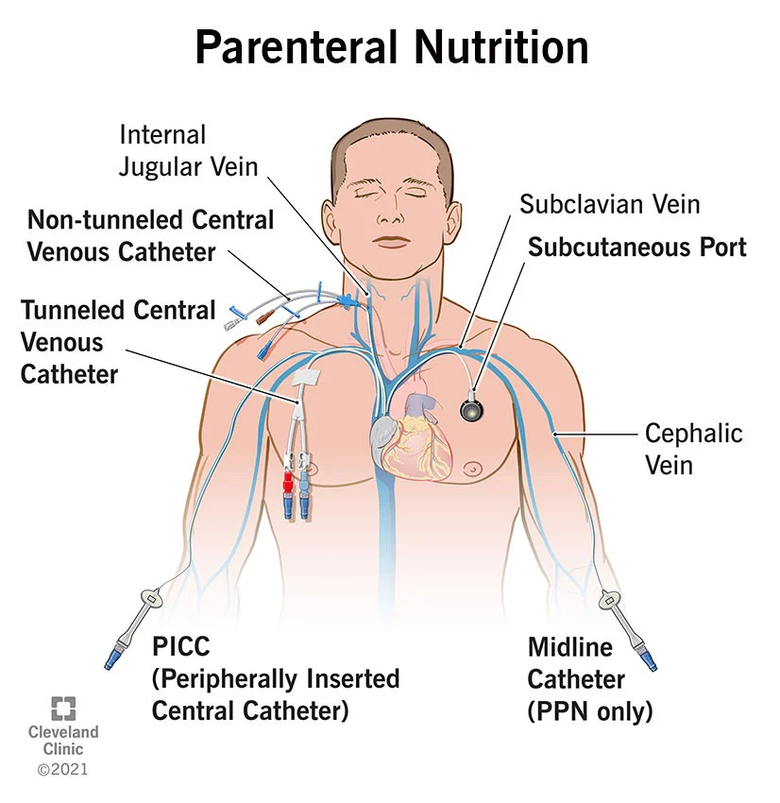
Parenteral nutrition
Is associated with:
Central venous catheterization
Infections
Expense

Slide 8
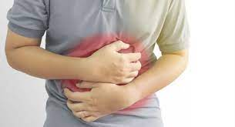
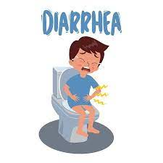
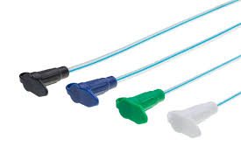
Enteral nutrition
Is associated with:
Abdominal cramps
Diarrhea
Feeding tubes

Slide 9
CONDITION OF PATIENTS
It is occasionally due to malnutrition and starvation
Patients with upper gastrointestinal obstruction, not terminally ill from their cancer warrant feeding by a nasogastric tube or gastrostomy.
Patients receiving therapy that will prevent them eating for 2 weeks or more warrant consideration for parenteral feeding.

Slide 10
Cont.
Or patients with persistent or recurrent bowel obstruction, whether parenteral nutrition is warranted depends on individual clinical circumstances …
….. e.G. Availability of that service

Slide 11
ARTIFICIAL FEEDING IN THE TERMINALLY ILL
Nutritional supplementation is very important in:
Chemotherapy/radiotherapy to maintain weight and functional status.
Facilitating quality of life (QOL).
Pre and post surgery.
Reversible metabolic derangement.

Slide 12

Bowel obstruction pre-operatively especially in gastric stasis early (decompression).
Long-term neurological dysphagia (CVA).
Burns and wound healing.

Slide 13
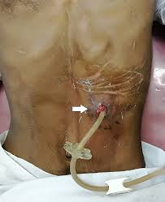
percutaneous endoscopic gastrostomy (PEG) complications
Wound infection
Leakage
Cutaneous or gastric ulceration
Temporary ileus
Tube blockage and breakdown
Major complications : esophageal or gastric perforation
Aspiration – most common – 60% mortality

Slide 14
Artificial feeding in terminally ill patients
Not encouraged:
Terminal phase (normal to eat and drink less).
Advanced bowel obstruction.
Anorexia cachexia alone in context of cancer.
Just to prolong life if futile in context of whole patient and quality of life.

Slide 15
Cont..
Once initiated… very difficult to withdraw.
Must be reviewed regularly.
Acknowledge that further deterioration is due to disease and not insufficient intake of nutrition.
Abdominal discomfort and nausea when they are to please their family.

Slide 16
Aspiration
Terminal phase:
Risk/benefit ratio of intervention needs to be considered.
May be acceptable to allow patient to eat and drink.
When survival measured in weeks to months then thickened feeds may be preferred to reduce risk.

Slide 17

When very close to death and is important to patient, any fluids and foods may be acceptable.
Explanation to patient and family is very important.

Slide 18
"you have to do something!"
…….
Is never a justification for artificial nutrition!

Slide 19
Hydration in terminally ill patients
The question is whether or not a particular treatment or intervention will restore or enhance the quality of life for a particular patient…
If yes, and it can be justified on the best clinical grounds, then it is ethically right to do it …
If not, it should not be done.

Slide 20
Effects of dehydration in terminally ill patients
Dry mouth
- mouth wash / topical comfort
Thirst
- although dying …usually do not complain of thirst
Diminished conscious state
- no reported correlation between hydration and cognition in these patients.

Slide 21
Possible benefits of dehydration in terminally ill patients
Less urine output means less movement and less incontinence.
Less pulmonary secretions reduce dyspnea and terminal congestion.
Less gastrointestinal secretions will lessen nausea and diarrhea.
Less problems with edema and effusions.

Slide 22
Dehydration before death
Decreased GIT secretions - less vomiting.
Decreased cerebral edema - increased rationality.
Decreased edematous reactions around tumors may decrease pain.
Decreased pulmonary secretions - less coughing, choking and rattles.

Slide 23
Possible disadvantages of artificial hydration in terminally ill patients
May have the opposite effects and worsen the patient’s situation.
May give an ambiguous signal or false hope to the patient or family.
Iv drips act as a physical barrier between patient and family.

Slide 24
Clinical judgments
Individual decisions based on individual patient
Pathophysiology
- Reversibility
- Harm vs. Benefit
Expressed wishes
- Patient
- Relatives
Socio-cultural background

Slide 25
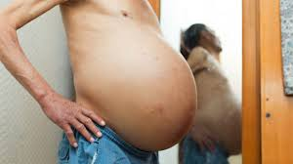
Possible contraindications
Raised intra-cranial pressure
Fluid overload
Massive ascites
Pleural effusions
Edematous extremities
Lymphedema
Gastrointestinal obstruction

Slide 26
Possible indications
Reversible causes of dehydration
Hypercalcaemia
Hypoglycaemia
Hyponatraemia
Vomiting
Acute renal failure
Diuretic overuse
Metabolic derangement

Slide 27
The Medical Perspective
Death is the enemy.
Death reflects failure of our professional skills.
Iv hydration as expression of the urge to provide care, rather than as a means of achieving it.
Failure to recognize that death is imminent.
Fear of legal liability.

Slide 28
Ethical Decision Making at the end of life
Governed by ethical principles
Autonomy (freedom of self determination)
Beneficence (doing good)
Non-maleficence (doing no harm)
Justice (fairness)
Individual case based

Slide 29
Summary
Thirst may be due to dry mouth and may both be unrelated to the patient’s level of hydration, and unresponsive to artificial hydration.
Hydration therapy will not reverse an underlying dying process.

Slide 30
THANK YOU
Any questions?

