Slide 1


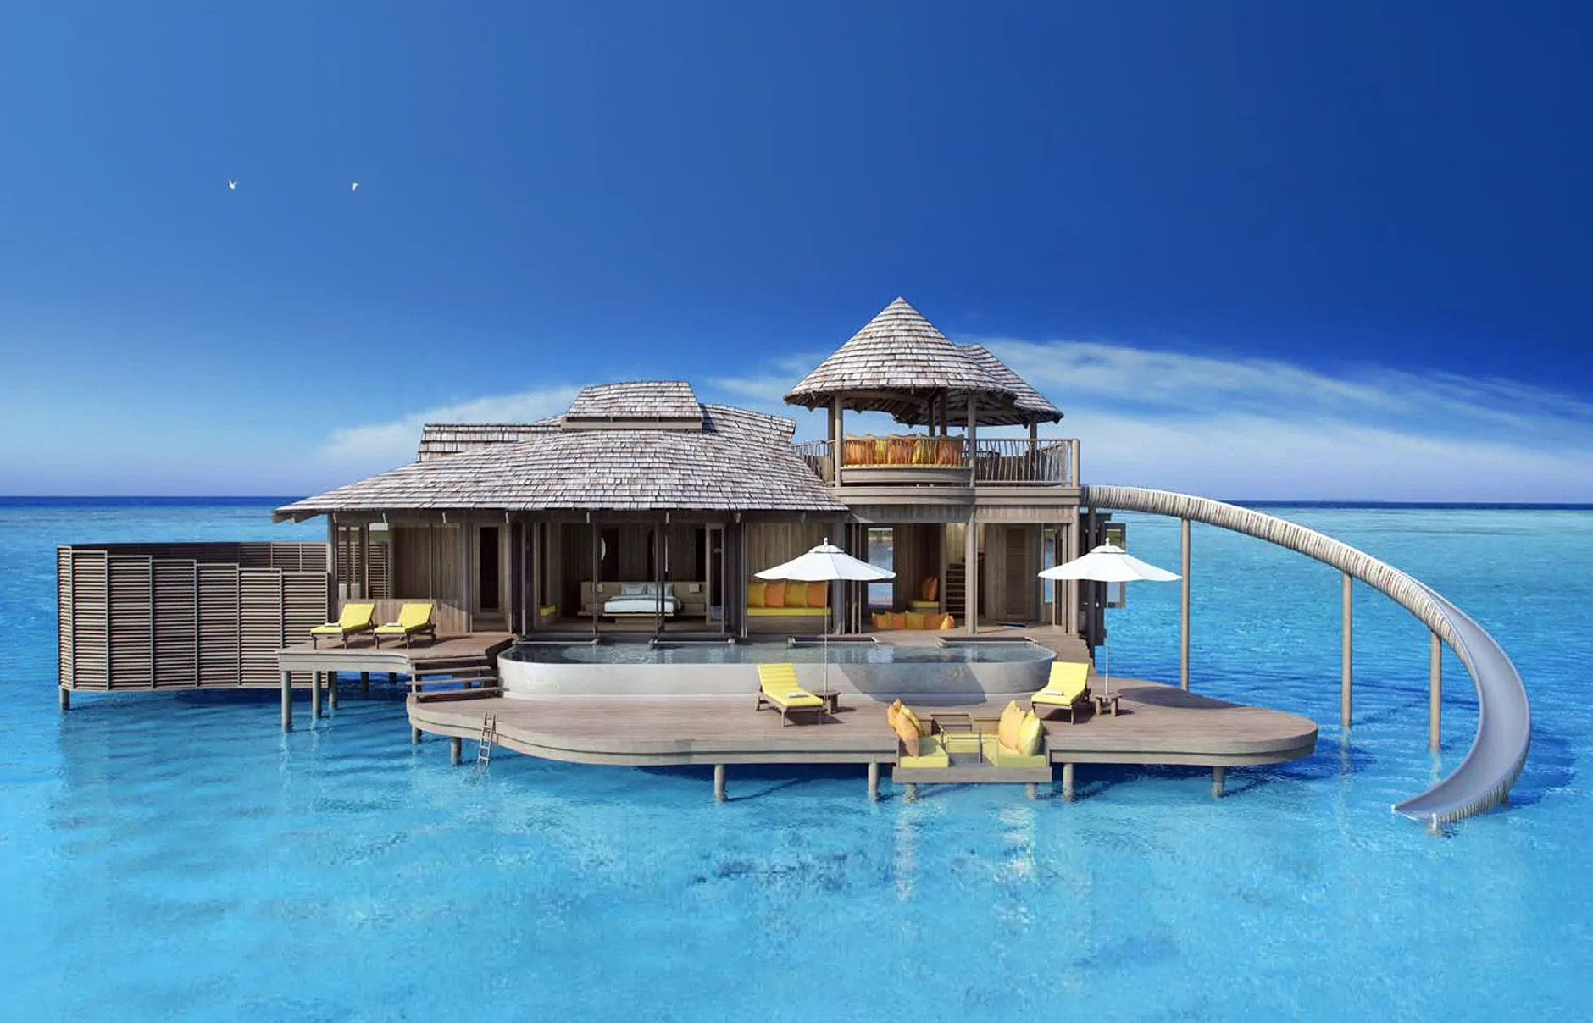
A Conceptual Integration of Customer Experience and Loyalty in Luxury Hotels: Lessons from Recent Literature
Mohd Rizwan Bin Abd Majid, Tressy Belly & Mohd Hafiz Bin Hanafiah
Universiti Malaysia Sabah & Universiti Teknologi MARA
Presented at JTHCA 2025 Conference

Slide 2

Abstract
This systematic literature review synthesized 20 studies (2019–2024) on customer experience, perceived value, price fairness, satisfaction, and loyalty in luxury hotels. Findings show that experience quality influences perceived value and satisfaction, which in turn enhance relationship quality and loyalty. Price fairness is underexplored but critical for loyalty formation, especially in Malaysia Luxury Hotel.

Slide 3

Research Objectives
1. Examine conceptualization and measurement of customer experience quality.
2. Synthesize evidence linking experience quality with perceived value, satisfaction, price fairness, and loyalty.
3. Evaluate theoretical frameworks applied.
4. Assess methodological strengths and weaknesses.
5. Identify research gaps and future directions for Malaysian luxury hotels.

Slide 4
Theoretical Background
Key frameworks include:
• Stimulus–Organism–Response (S–O–R) model
• Expectation–Confirmation Theory
• Value-based and Relationship Marketing perspectives
These explain how experiential stimuli trigger evaluations
(perceived value, satisfaction) leading to loyalty.

Slide 5
Methodology
Systematic Literature Review (SLR) using PRISMA guidelines.
Database: Scopus (2019–2024).
Inclusion: Empirical and conceptual studies on luxury hotel guests.
Final set: 20 articles.
Analysis: Thematic synthesis guided by Braun & Clarke (2006).

Slide 6
Key Findings
Customer experience quality strongly predicts perceived value and satisfaction.
Perceived value mediates between experience and loyalty.
Price fairness affects satisfaction and loyalty but remains under-studied.
Satisfaction and relationship quality bridge experience and loyalty outcomes.

Slide 7
Geographical and Methodological Trends
Studies span Asia, Europe, and the Middle East.
• Malaysia is underrepresented in luxury contexts.
• Majority employ cross-sectional surveys with limited causal inference.
• Need for qualitative, longitudinal, and mixed-method research.

Slide 8
Conceptual Integration
Proposed model:
Customer Experience Quality → Perceived Value → Satisfaction → Relationship Quality → Loyalty
↳ Moderated by Price Fairness and Emotional Perceived Value.

Slide 9
Discussion & Research Gaps
• Emotional perceived value treated as peripheral despite strong influence.
• Price fairness rarely integrated into conceptual models.
• Lack of Malaysia-centric luxury hotel research.
• Limited methodological diversity across studies.

Slide 10
Future Research Directions
• Employ longitudinal and mixed-method designs.
• Position emotional perceived value as a central construct.
• Develop robust fairness measurement scales.
• Focus on eco-luxury and experiential tourism in Malaysia.
• Strengthen theory–practice integration.

Slide 11
Practical Implications
Implement systematic guest experience monitoring.
Promote transparent and fair pricing strategies.
Design personalised experiences targeting emotional value.
Develop loyalty programs tailored for luxury clientele.

Slide 12
Conclusions
Luxury hospitality research has matured but lacks integration of fairness and emotional value.
Malaysia presents opportunities for destination-specific theory and practice.
Advancing this research supports Malaysia MADANI goals and SDGs for sustainable, high-value tourism.

Slide 13
Thanks!

