Slide 1


Leveraging Role of Government Support, External Pressure, and Sustainability in Event Technology Adoption within the Business Events Industry
Marry Tracy Pawan & Dr. Juliana Langgat
Faculty of Business, Economics and Accountancy
Universiti Malaysia Sabah

Slide 2

INTRODUCTION
A vital component of the global tourism and hospitality industry
Representing a diverse range of events including meetings, conferences, exhibition incentive travels, and trade shows
BE industry in Asia has experienced a massive development in the last decade where Asia is known as the central hub for business events
(Rashid et al, 2020; Chubchuwong, 2019).
However, due to the global COVID pandemic crisis, has enforce the event organizer to go beyond the status quo of their current practices and work toward fulfilling the SDGs for a positive impact and change through technology and innovation (Celuch, 2020).
With a total of 1691 events for the past seven years which delivered an estimated economic impact of RM8.66 billion, Malaysia is on track to drive positive momentum for be industry (MyCEB, 2000)

Slide 3
Research Problem
1. The BE industry did not leverage its capabilities until the COVID-19 pandemic began (UNWTO, 2020).
2. Many BE organizers were identified as never reaching their full potential and lagging behind other tourism sectors (Burton & Hubona, 2006; Kotze et al, 2016).
3. There are many factors that influence the adoption including difficulty to deliver on various aspects of the virtual experience (Disimulacion,2020), very challenging (Gale, 2020), budget constraints (Buhalis & Law, 2008), and a skills shortage (Event academy report, 2019).

Slide 4
Previous studies have explored the marketing strategies, event management process, factors in selecting BE destinations, and event design in Malaysia. However, scarce research exists, particularly in Malaysia, regarding event technology adoption by the MICE industry (Deve, 2018).
1
Many researchers have invested significant effort to build theories that predict user technology adoption (Agarwal & Prasad, 1999). However, there is no significant model that can explain the role of event technology adoption in the BE industry in Malaysia from the perspective of the event organizer.
RESEARCH GAP
2
Previous study using the theory of planned behavior, the Theory of acceptance model, and the theory of Reason action in exploring the behavioral intention in adopting event technology (Kim & Park, 2009; Kim et al, 2011; Sox et al, 2017)
Kusonwattana et all (2022) suggested that the model or theory can be extended and explored.
3

Slide 5
Research Objective
To examine the influence of government support (GS) on Event Technology Adoption (ETA) among business event in Malaysia.
To access the impact of External Pressure (EP) on Event Technology Adoption (ETA) among business event in Malaysia
To evaluate the role of Sustainability in driving Event Technology Adoption (ETA) among business event in Malaysia.

Slide 6
UNDERPINNING THEORIES
Technology Organizational Environmental (TOE) Framework
Technology
Organization
External task environment
(Tornatzky and Fleisher,1990)
works at the organizational level and it indicates whether a firm’s adoption decision is influenced by the technological, organizational, and environmental elements (Baker, 2012).

Slide 7

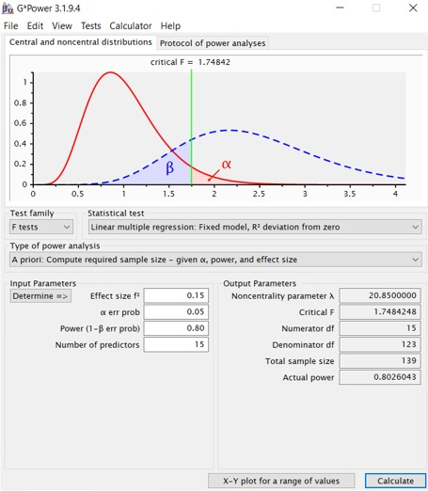


Research Methodology
Sample Size based on the G-Power analysis
Quantitative Study
Electronic Questionnaire
SPSS
Smart-PLS
103 respondents

Slide 8
Respondent Profile
Findings
No | Demographic Variables | Category | Frequency | Percentage %
1 | Gender | Male | 65 | 42.8
 |  | Female | 87 | 57.2
2 | Age | 21-30 years old | 32 | 21.1
 |  | 31-40 years old | 72 | 47.4
 |  | 41-50 years old | 25 | 16.4
 |  | 51-60 years old | 23 | 15.1
3 | Qualification | Diploma | 20 | 13.2
 |  | Bachelor’s degree | 70 | 46.1
 |  | Master’s degree | 50 | 32.9
 |  | Doctorate Degree | 12 | 7.9
4 | Categories of business event stakeholder | Event organizer | 113 | 74.3
 |  | Venue provider | 23 | 15.1
 |  | Professional Conference Organizer | 16 | 10.5
5 | Position | General Manager | 13 | 8.6
 |  | Director | 16 | 10.5
 |  | Assistant Director | 12 | 7.9
 |  | Manager | 52 | 34.2
 |  | Assistant Manager | 59 | 38.8
N = 152 respondents

Slide 9
Result Summary of Reflective Measurement Model
Findings
Constructs | Items | Loadings | Cronbach's alpha | CR | AVE
Government Support | GS33 | 0.884 | 0.904 | 0.927 | 0.720
 | GS34 | 0.878
 | GS35 | 0.610
 | GS36 | 0.921
 | GS37 | 0.909
External Pressure | EP42 | 0.571 | 0.855 | 0.902 | 0.657
 | EP43 | 0.624
 | EP45 | 0.904
 | EP46 | 0.938
 | EP47 | 0.934
Sustainability | S53 | 0.808 | 0.839 | 0.881 | 0.553
 | S54 | 0.649
 | S55 | 0.744
 | S56 | 0.760
 | S57 | 0.717
 | S58 | 0.775
Event Technology Adoption | ETA48 | 0.906 | 0.875 | 0.910 | 0.669
 | ETA49 | 0.753
 | ETA50 | 0.792
 | ETA51 | 0.825
 | ETA52 | 0.807
the values for Cronbach alpha in this study ranged from 0.839 to 0.904, which meets the threshold of 0.7 recommended by Hair et al (2010).
composite reliability results for all constructs have surpassed the minimum cut off value of 0.7 with the range from 0.881 to 0.927. These results indicated that the measurement model has adequate reliability.
all the outer loading indicator values have met the requirement suggested by Byrne (2016), ranging from 0.610 to 0.938.
the AVE values for all constructs are greater than 0.5, ranging from 0.553 to 0.720. Hence, the results conclude that the measurement model has acceptable convergent validity.

Slide 10
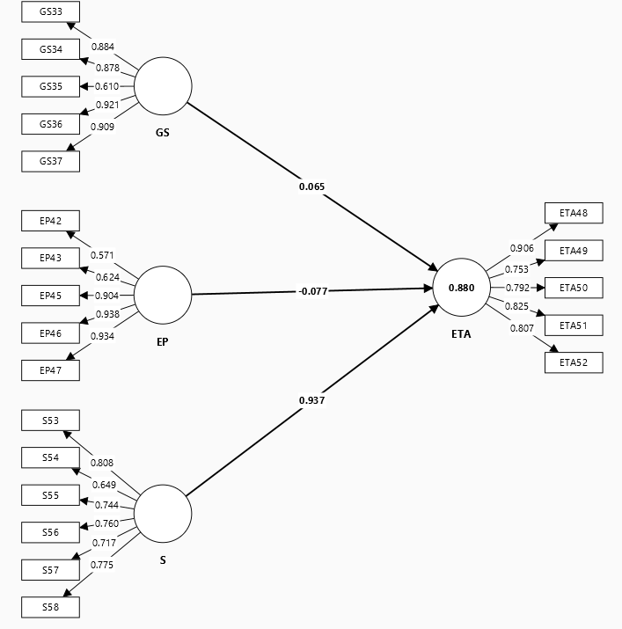
Heteorptriat Monotrait (HTMT) Criterion
Analysis and Findings
Structural Model
 | 1 | 2 | 3 | 4
External Pressure
Event Technology Adoption | 0.403
Government Support | 0.227 | 0.505
Sustainability | 0.511 | 0.269 | 0.469

Slide 11
Result of the Structural Model
(Hypothesis Testing)
Findings
Hypothesis | Relationship | Std. Beta | Std. Error | BCI LL | BCI UL | t-values | p-values | Results
H1 | GS->ETA | 0.065 | 0.032 | 0.019 | 0.122 | 2.058 | 0.020 | Supported
H2 | EP->ETA | -0.077 | 0.047 | -0.153 | 0.001 | 1.662 | 0.048 | Supported
H3 | S->ETA | 0.937 | 0.030 | 0.875 | 0979 | 30.909 | 0.000 | Supported
The results reveal that GS, EP, and Sustainability significantly influence event technology adoption.

Slide 12
Discussion
Government Support (GS)
The finding shows that GS positively influenced the event technology adoption in BE industry.
Government often provide support and grants to businesses adopting new technologies. For example, MyCEB is a government agency established to promote Malaysia as a destination for BE. Through its various financial support programs like “Meet in Malaysia” campaign, MyCEB encourages the use of advanced technologies such as virtual conferencing platforms.
Support for digital transformation – MDEC has been instrumental in promoting digitalization across various industries, including the event sector. For example, through Digital Economy Blueprint (MyDigital), encourage event organizer to embrace digital tools such as AI-driven event management software, event apps and big data analytics.
External Pressure (EP)
EP from industry associations and bodies setting new benchmarks for event management can drive technology adoption.
Increasing demand from client and stakeholder expectations has made the event organizer to adopt technologies that meet their expectations.
Technological advancements in other sectors – EP from these interconnected sectors pushed event organizers to integrate similar technologies.

Slide 13


Discussion
Sustainability
MyCEB has been promoting sustainability through its “Sustainable Event Guidelines”. In line with the guideline, many event organizer in Malaysia adopted event technology that reduces carbon footprint of their event (SDG 13). Use of mobile apps for event registration, digital ticketing, and paperless documentation is becoming more common in conferences and exhibitions.
Hybrid events for reduced travel emission (SDG 11) – to allow international participants to join virtually.

Slide 14

CONCLUSION
Event technology has become an unavoidable component of event management in the new economy.
To be able to use such technology, event organizers must understand that the shift from traditional to contemporary approaches is not solely based on technology as infrastructure but rather represents a shift in the organization’s policy to the business model and market in order to remain competitive.
Thus, this study will delve deeper into the adoption of event technology in the MICE industry in Malaysia.
By establishing a framework of event technology adoption in BE industry, this study will enable the event organizer particularly the convention centers to make informed decisions about the adoption of event technology,
Finally, the study’s findings will offer insights that can contribute to the overall development and sustainability of the BE industry in Malaysia.

