Slide 1



From Bedside to Classroom:
Shaping Nurse Educators through
Certificates in Training and Assessment
By;
MAZLINDA MUSA
MNSc (UM),BNSc (Hons)(UKM), RN
Faculty of Medicine and Health Sciences,
Universiti Malaysia Sabah

Slide 2

Content:
Bedside to Classroom
Global demand for competent nurse educators
Why It Matters
The Transition Gap
Common Challenges in Transition
The Certificate in Training and Assessment
How It Bridges the Gap
Take Home Message

Slide 3

Bedside to Classroom
The transition from expert clinical nurse to academic or nurse educator is a complex and often challenging career shift, necessitating structured support and formal preparation to ensure both faculty retention and quality nursing education (Haynes-Lewis & Pearson, 2020; Rahim & Prasla, 2012).
This career move requires nurses to exchange their clinical mastery for novice status in an unfamiliar academic environment, which demands a different set of competencies (Toll, 2020).

Slide 4
Global Demand for Competent Nurse Educators
The global demand for competent nurse educators is reaching a crisis point, driven by a projected worldwide deficit of nurses and midwives, which necessitates a rapid expansion of nursing education capacity (WHO, 2020; WHO, 2025).
This massive need for new graduates is directly threatened by a shrinking pool of qualified nurse educators.
The academic nursing workforce is aging, with many faculty members approaching retirement age, leading to an "exodus of skills and experience" (Shortage of Academic Nurses, 2024).

Slide 5
Global Demand for Competent Nurse Educators
For instance, in the United States, about one-third of nursing faculty is expected to retire by 2025 (Shortage of Academic Nurses, 2024).
This demographic trend compounds an already serious faculty shortage, severely limiting the capacity of nursing schools to enroll and educate enough new students (Shortage of Academic Nurses, 2024).

Slide 6
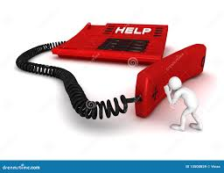
Global Demand for Competent Nurse Educators
Quality of Education as a Foundation for Safe Practice.
The quality of the future nursing workforce depends entirely on the quality of educational support and preparation provided, which requires a strong, robust, and highly skilled academic nursing workforce (Davidson, 2024; Haynes-Lewis & Pearson, 2020).
When institutions struggle to fill faculty positions, they often hire experienced clinical nurses who, despite their clinical expertise, may lack formal pedagogical training, leading to the "expert nurse, novice educator" dilemma (Jetha, Boschma, & Clauson, 2016).

Slide 7
Global and Regional Trends in Workforce Development
The development of the nurse educator workforce is challenged by global shortages and the aging faculty population, emphasizing the urgency of improved preparation strategies (Grassley, 2014).
Global Shortage: The shortage of nursing faculty is severe worldwide, contributing to the overall nursing shortage by limiting the number of qualified applicants schools can admit (Grassley, 2014).
  For example, a US-focused review protocol cited an 8.8% faculty vacancy rate in 2012, demonstrating the chronic nature of this issue (Grassley, 2014).

Slide 8
Global and Regional Trends in Workforce Development
Southeast Asia/Resource-Limited Settings: Studies in Indonesia and Ghana highlight a critical need for clear role definitions and specific competencies for nurse educators, particularly those working in hospitals or resource-limited academic settings (Laari et al., 2025; Wulandari et al., 2025).
In these regions, advanced training programs must be explicitly revised to include pedagogical content to combat the lack of teaching preparation among masters and PhD graduates (Wulandari et al., 2025).

Slide 9

Why It Matters
Nurses transitioning from bedside to education roles consistently encounter significant barriers related to identity, workload, and institutional acclimatization (Toll, 2020).

Slide 10
The Transition Gap
The transition of experienced nurses from clinical practice to academic or educator roles often reveals a significant gap between clinical competence and teaching competence, leading to the widely recognized "expert nurse, novice educator" dilemma.
This concept describes the complex challenges faced by clinicians who, despite possessing deep clinical mastery (expert status), lack the necessary pedagogical skills and professional identity for the education role (novice status) (Dintwe, Gause, & Sehularo, 2025; Toll, 2020).

Slide 11
The Transition Gap
The Expert Nurse, Novice Educator Dilemma Clinical Expertise vs. Pedagogical Expertise.
The assumption that clinical excellence automatically translates into teaching expertise is the root cause of this dilemma (Jetha, Boschma, & Clauson, 2016).
  Clinical nurses excel in providing direct care, managing complex patient situations, and demonstrating critical thinking in real-time.
  The academic role, however, demands proficiency in curriculum design, student assessment, educational theory application, and research/scholarship—competencies rarely developed during clinical practice (Wulandari et al., 2025).

Slide 12
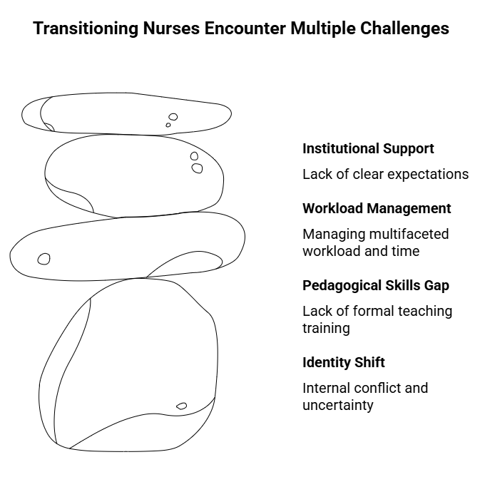
Common Challenges in Transition

Slide 13
Common Challenges in Transition
1) Identity Shift and Role Ambiguity:
The primary challenge is the internal conflict of moving from being an "expert" clinician to a "novice" educator (Dintwe, Gause, & Sehularo, 2025; Toll, 2020).
This leads to transition shock, role ambiguity, and feelings of uncertainty regarding academic expectations (Dintwe et al., 2025; The transition of clinical nurses to nurse educator roles – A scoping review, 2024).
Clinicians often experience tension when relinquishing their managerial or supervisory roles for the new academic duties (Dintwe et al., 2025).

Slide 14
Common Challenges in Transition
2) Gap in Pedagogical Skills:
While nurses possess deep clinical expertise, they often lack formal training in teaching methodologies, curriculum design, learning theories, and student evaluation strategies (Wulandari et al., 2025).
This gap highlights the problem of assuming that clinical knowledge translates automatically into teaching competence (Jetha, Boschma, & Clauson, 2016).
In some regions, even Master’s and PhD programs for nurses may not include comprehensive courses on educational pedagogy (Wulandari et al., 2025).

Slide 15
Common Challenges in Transition
3) Workload and Institutional Support:
Novice educators struggle with managing a multifaceted workload that includes lecturing, curriculum development, research, and student supervision, alongside managing time constraints (Toll, 2020).
A lack of clear expectations and institutional support, including defined policies and adequate managerial backing, exacerbates these struggles (Rahim & Prasla, 2012; Wulandari et al., 2025).

Slide 16
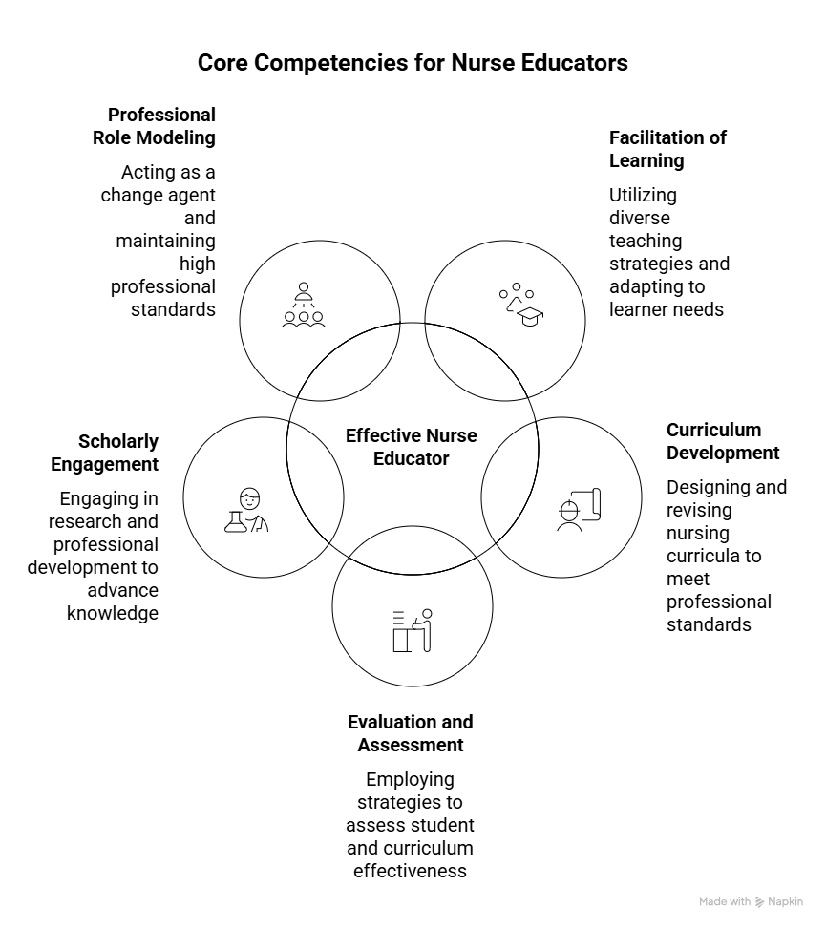
Key Competencies Required to Become an Effective Nurse Educator

Slide 17
Key Competencies Required to Become an Effective Nurse Educator
Competency Domain | Description
Facilitation of Learning | Utilizing diverse teaching strategies, applying learning theories, and adapting instructional methods to different learner needs and settings (e.g., in-person, online, clinical) (Haynes-Lewis & Pearson, 2020; Mani & Ahmed, 2025).
Curriculum and Program Development | Designing, developing, and revising nursing curricula based on standards (like Competency-Based Education or AACN The Essentials), ensuring outcomes align with required professional competencies (Mani & Ahmed, 2025).
Evaluation and Assessment | Employing appropriate strategies for student evaluation, assessing the effectiveness of the curriculum, and providing constructive feedback (Rahim & Prasla, 2012).
Scholarly/Research Engagement | Engaging in continuous quality improvement, professional development, and scholarly activities or research to contribute to the knowledge base of nursing and education (Haynes-Lewis & Pearson, 2020).
Professional Role Modeling | Acting as an agent for change, socializing students into the profession, and maintaining high standards of emotional intelligence and professional conduct (Haynes-Lewis & Pearson, 2020).

Slide 18
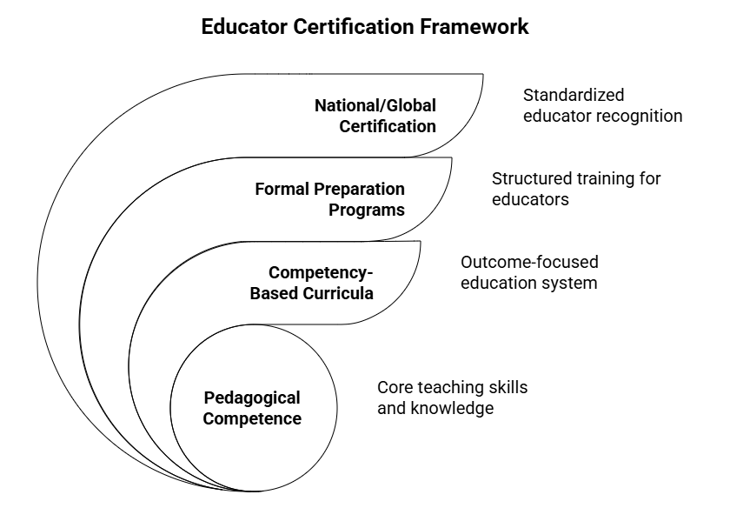
Frameworks and Structured Certification Programs

Slide 19
Frameworks and Structured Certification Programs
Formal programs are essential to systematically instill pedagogical competence and ease the transition shock (Haynes-Lewis & Pearson, 2020).
Competency-Based Curricula (CBE):
  Implementing a CBE framework requires educators to focus on outcomes and measurable student abilities.
  Adopting a CBE curriculum necessitates continuous faculty development to address implementation challenges and ensure educators are proficient in new teaching methods and assessment techniques (Mani & Ahmed, 2025).

Slide 20
Frameworks and Structured Certification Programs
Formal Preparation Programs:
  Structured programs, whether for academic nurse educators (ANEs) or clinical nurse instructors (CNIs), are vital.
  One mixed-methods study aimed to design and evaluate a comprehensive competency-based curriculum paired with structured mentoring to successfully prepare clinical expert nurses for instruction (Beiranvand, 2022).

Slide 21
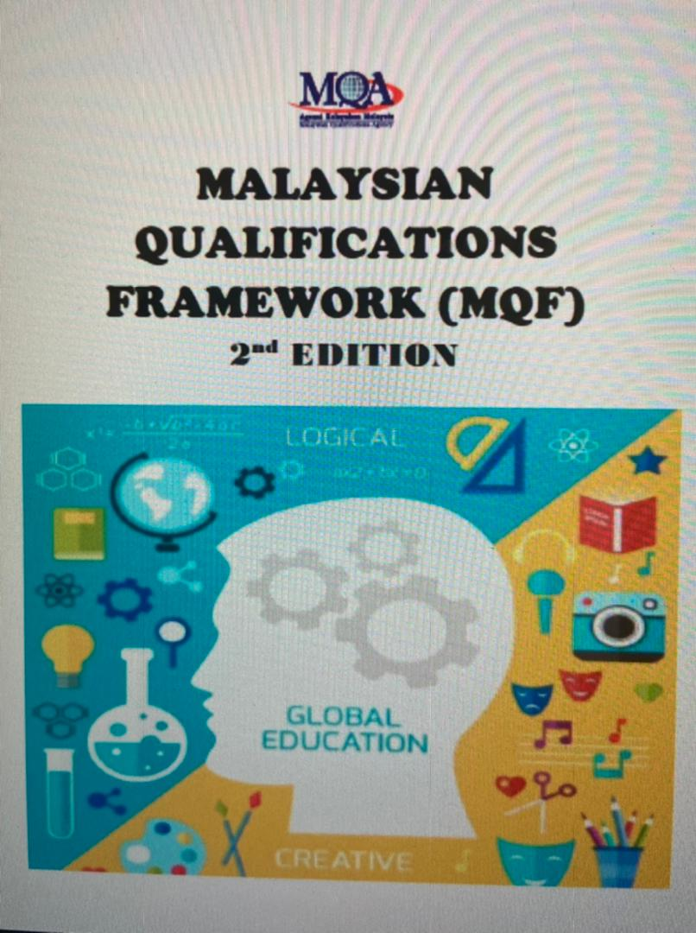
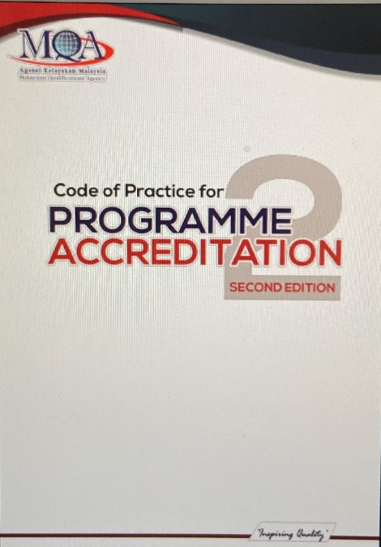

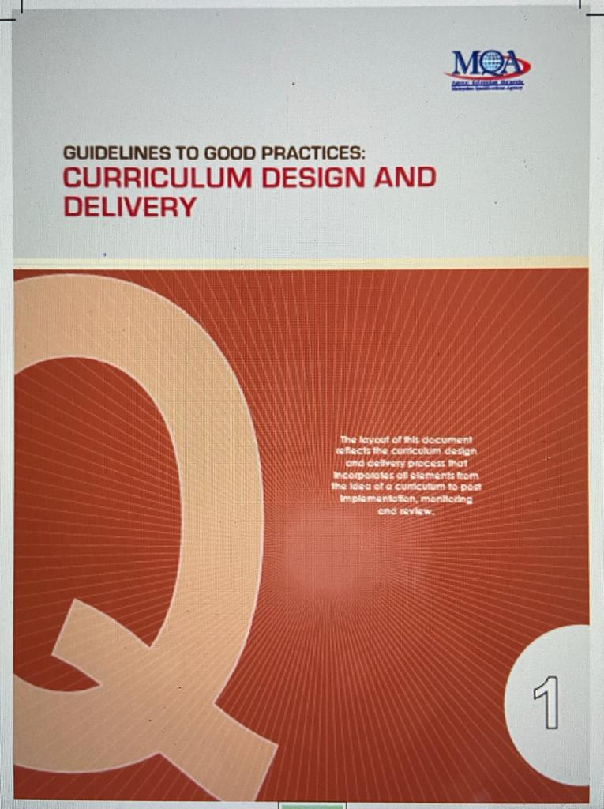
Frameworks and Structured Certification Programs
National/Global Certification:
  Although the request mentioned WHO Core Competencies, the literature frequently refers to the National League for Nursing (NLN) Certified Nurse Educator (CNE) certification, which provides a framework for curriculum development, role descriptions, and faculty evaluations (Haynes-Lewis & Pearson, 2020).

Slide 22

Strategies Institutions Use to Prepare and Mentor New Nurse Educators
Effective preparation programs must be comprehensive, formal, and sustained throughout the novice phase (Laari et al., 2025).
Robust Orientation: Institutions must provide an extensive, well-rounded introduction to the academic setting, covering institutional policies, academic culture, and specific pedagogical expectations.
  This prevents difficult transitions that might prompt new faculty to return to clinical practice (Haynes-Lewis & Pearson, 2020; Rahim & Prasla, 2012).

Slide 23
Strategies Institutions Use to Prepare and Mentor New Nurse Educators
Structured Mentorship: Mentorship is identified as a critical facilitator for successful transition, inspiring confidence and aiding the development of the new role identity (Rahim & Prasla, 2012; Toll, 2020).
Programs should mandate a formal, sustained relationship with an experienced faculty member to transfer knowledge and support the emotional challenges of the shift (Beiranvand, 2022; Haynes-Lewis & Pearson, 2020).

Slide 24
Strategies Institutions Use to Prepare and Mentor New Nurse Educators
Addressing Informal Coping: In settings like Ghana, novice educators often rely on self-inspired, informal coping strategies, such as seeking peer support (Laari et al., 2025).
Institutional support should shift these efforts from informal survival tactics to formal, evidence-based strategies, ensuring a smoother transition for all faculty (Laari et al., 2025).

Slide 25
Strategies Institutions Use to Prepare and Mentor New Nurse Educators
Retention Strategies: Beyond initial preparation, long-term retention depends on providing supportive leadership, transparent pathways for professional growth, and institutional commitment to work-life balance (Riaz, Soomro, Kali, Abid, Ramzan, & Ishaq, 2025).

Slide 26
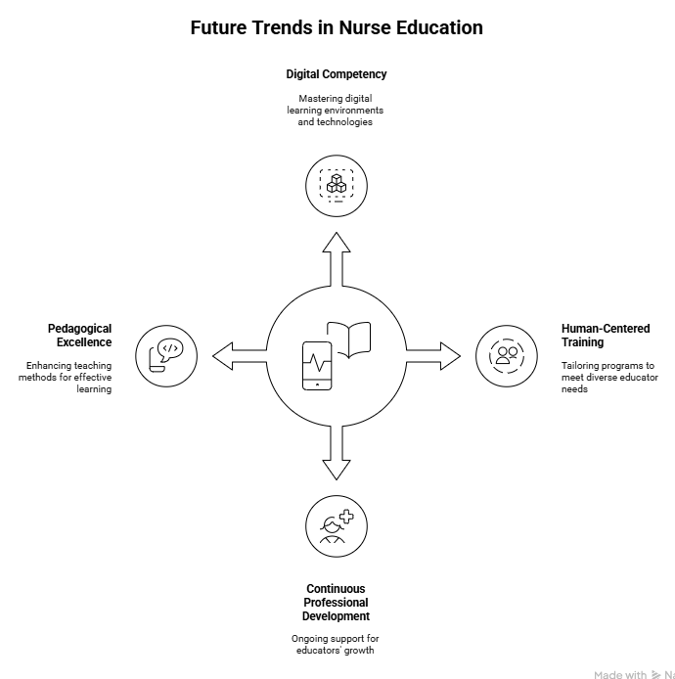
Future Development & Training of New Nurse Educators

Slide 27
Future Development & Training of New Nurse Educators
The future development and training of nurse educators are driven by:
  rapid digitalization,
  the need for enhanced pedagogical competencies, and
  demands for greater specialization and flexibility in roles, as highlighted by recent academic literature (2022–2025).

Slide 28
Future Development & Training of New Nurse Educators
The next generation of nurse educators must embody adaptability, critical reflection, and technological fluency to navigate the rapidly transforming healthcare landscape.
A dominant trend is the urgent shift towards digital competency and transformation, requiring educators to master digital learning environments, implement virtual clinical learning and simulation technologies (VR/AR), and integrate advanced tools like AI (e.g., ChatGPT) into instruction.

Slide 29
Future Development & Training of New Nurse Educators
Training programs must be human-centered and tailored, moving beyond generic skills to address the specific needs of different age groups and experiential levels of educators, fostering transformative learning through critical reflection in ODeL environments.
Furthermore, Continuous Professional Development (CPD) must be continuous and robust, supporting competencies across pedagogy, research, digital mastery, and adaptability to global health crises.

Slide 30
Future Development & Training of New Nurse Educators
Finally, there is a clear push for strengthening pedagogical excellence through techniques like Case-Based Learning (CBL) to effectively link theory and practice, ensuring students are equipped for complex, real-world clinical challenges.

Slide 31
Summary
The journey from bedside to classroom is more than a career shift — it’s a transformation of identity and purpose.
Clinical mastery gives us credibility, but teaching demands something different: the ability to make knowledge visible, transferable, and alive in others.
Through structured programs like the Certificate in Training and Assessment, nurses learn to translate experience into pedagogy — to design, facilitate, and evaluate learning in ways that are intentional, evidence-based, and centered on the learner.
These programs don’t replace clinical expertise; they refine it into educational excellence.

Slide 32
Summary
As nursing education faces growing global demand and a shrinking pool of qualified educators, the clinician–educator model has become essential.
Continuous professional development, innovation in digital and simulation-based teaching, and cross-border recognition of qualifications will define our future.
Ultimately, shaping nurse educators isn’t about leaving the bedside behind — it’s about extending its influence.
Every well-prepared educator ensures that what was once learned in care continues to echo through generations of new nurses.

Slide 33
Take home message
As we cultivate the next generation of nurse educators, let us extend the same compassion we expect in clinical care to those entering academia.
The transition from practitioner to educator is complex, often marked by uncertainty and self-doubt.
Many of us remember those early days — the steep learning curve, the invisible expectations, and the silence that sometimes met our struggles.

Slide 34
Take home message
If we truly aim to strengthen nursing education, we must not allow new educators to walk that same path alone.
Mentorship, empathy, and structured support are not acts of charity but professional responsibilities.
Guiding others with patience and respect ensures that the lessons of our own difficult beginnings become the foundation for a more supportive academic culture — one where teaching excellence grows through shared experience, not repeated hardship.

Slide 35
References
Beiranvand, S. (2022). From clinical expert nurse to part-time clinical nursing instructor: Design and evaluation of a competency-based curriculum with structured mentoring: A mixed methods study. BMC Nursing. [DOI not provided].
Dintwe, T., Gause, G., & Sehularo, L. A. (2025). Challenges experienced by newly employed nurse educators during transition from being expert clinicians to novice nurse educators. BMC Nursing, 24(911). https://doi.org/10.1186/s12912-025-03572-1
Grassley, J. (2014). The experiences of transition from clinical expert to novice academic nurse educator: A systematic review protocol of qualitative evidence. The JBI Database of Systematic Reviews and Implementation Reports, 12(7), 173–184. [URL available].
Mani, Z., & Ahmed, Z. (2025). Transitioning to competency-based education in nursing: A scoping review of curriculum review and revision strategies. BMC Nursing, 24(1111). https://doi.org/10.1186/s12912-025-03319-y
Nuryani, S. N. A., Arnyana, I. B. P., Parwati, N. N., Dantes, G. R., & Juanamasta, I. G. (2022). Benefits and challenges of clinical nurse educator roles: A qualitative exploratory study. Open Access Macedonian Journal of Medical Sciences, 10(G), 38–44. https://doi.org/10.3889/oamjms.2022.7706

Slide 36
References (cont…)
Riaz, K., Soomro, I. A., Kali, K., Abid, I., Ramzan, K., & Ishaq, K. (2025). Exploring the perceptions of private sector nursing educators on long-term retention in a single institution: A qualitative phenomenological inquiry. Zenodo. [URL available].
The transition of clinical nurses to nurse educator roles – A scoping review. (2024). Nurse Education Today. [Source details not fully extracted].
Wanchai, A., Nakamadee, B., & Prompuk, B. (2023). Perspectives of Thai nurses about nurse educators’ competencies for teaching graduate education: A qualitative descriptive study. Pacific Rim International Journal of Nursing Research, 27(4), 585–597. https://doi.org/10.60099/prijnr.2023.260333
Wongpimoln, B., Pholputta, L., Ngernthaisong, C., & Sarnkhaowkhom, C. (2021). Transitional experiences from clinical nurse experts to novice nurse lecturers in the university for local development in Thailand: A phenomenological study. Nurse Media Journal of Nursing, 11(2), 197–209. https://doi.org/10.14710/nmjn.v11i2.37366
Wulandari, C. I., Handiyani, H., Novieastari, E., Soemantri, D., & Rizany, I. (2025). Experience of nurses with educator role in selected hospitals of Indonesia: Phenomenological study. Advances in Medical Education and Practice, 16, 237–246. [DOI not provided in abstract].

Slide 37
References (cont…)
Advancing Healthcare Education: A Comprehensive Review of Case-Based Learning. (2024). Indian Journal of Continuing Nursing Education. https://journals.lww.com/ijcn/fulltext/2024/01000/advancing_healthcare_education__a_comprehensive.8.aspx
Digital health education and training for undergraduate and graduate nursing students: Scoping review. (2024). JMIR Nursing, 7(1), e58170. https://doi.org/10.2196/58170
El Arab, R. A., Al Moosa, O. A., Abuadas, F. H., & Somerville, J. (2025). The role of AI in nursing education and practice: Umbrella review. JMIR, 27(1). https://www.jmir.org/2025/1/e69881
Jobst, S., Lindwedel, U., Marx, H., Pazouki, R., Ziegler, S., König, P., Kugler, C., & Feuchtinger, J. (2022). Competencies and needs of nurse educators and clinical mentors for teaching in the digital age—a multi-institutional, cross-sectional study. BMC Nursing. https://bmcnurs.biomedcentral.com/articles/10.1186/s12912-022-01018-6
Kuljua, E., Jarvaa, E., Oikarinen, A., Hammarén, M., Kanste, O., & Mikkonen, K. (2024). Educational interventions and their effects on healthcare professionals’ digital competence development: A systematic review. International Journal of Medical Informatics, 185, 105396. https://doi.org/10.1016/j.ijmedinf.2024.105396
Sustainable integration of digitalisation in nursing education—an international scoping review. (2024). BMC Nursing. https://pmc.ncbi.nlm.nih.gov/articles/PMC11043537/
The role of AI in nursing education and practice: Umbrella review. (2025). JMIR. https://www.jmir.org/2025/1/e69881
Transformative learning in open distance and e-learning: The critical role of nurse educators. (2025). Discover Education, 4, 308. https://link.springer.com/article/10.1007/s44217-025-00772-4

Slide 38



Thank you

